Slide 1
GenIDLEST Co-Design
Keyur Joshi, Long He
& Danesh Tafti
Collaborators
Xuewen Cui, Hao Wang, Wu-chun Feng &
Eric de Sturler
Virginia Tech
AFOSR-BRI Workshop
July 20-21, 2014

Slide 2
Recap
Development of Structure module
  Unstructured grid
  Finite element
  Capable of geometric nonlinearity
Interface with GenIDLEST
  Structured finite volume fluid grid
  Immersed Boundary Method
Validation
  Turek Hron FSI benchmark

Slide 3
Goals
Improvement of Structure module performance
  OpenACC directive based acceleration
    Identify major subroutines to target for conversion
    Port the subroutine codes to OpenACC and optimize
    Explore potentially better sparse matrix storage format
  Linear solvers
    Improvement in Preconditioner
    Improvement in Solver Algorithms
  Parallelization of FSI

Slide 4
FSI framework
Immersed Boundary Method
Finite Element Solver
Fluid structure Interaction coupling

Slide 5
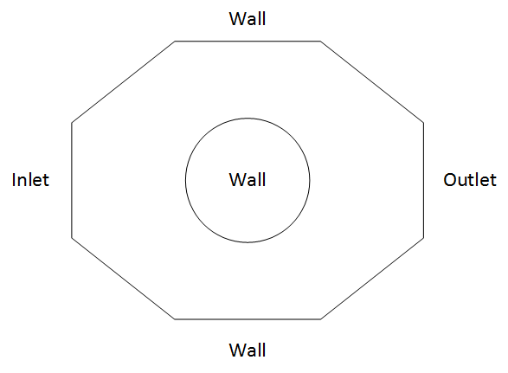
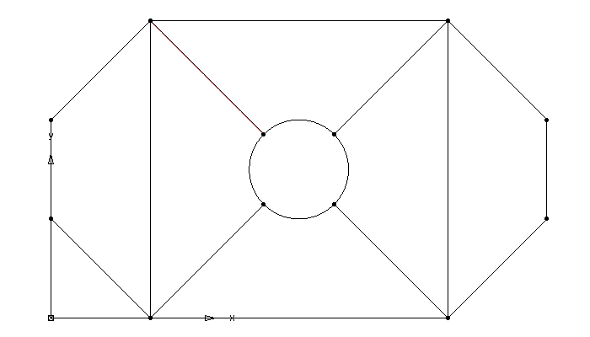
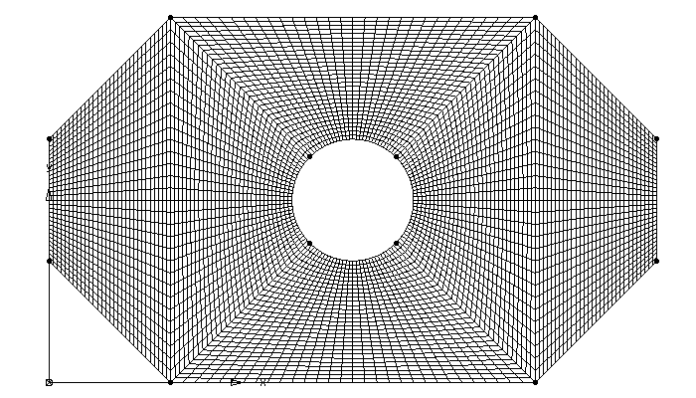
Immersed Boundary Method
Body conforming grid
Immersed boundary grid
Notes:
If we want to simulate the geometry on the left, for BCG : at least divide it into 6 blocks.
IBM: bgmesh and surface mesh.

Slide 6
Immersed Boundary Method
Curvilinear body-fitting grid around a circular surface
Body non-conforming cartesian grid and an immersed boundary
Notes:
Have a close look at the circle

Slide 7
Immersed Boundary Method
Types of nodes and domains
  Fluid
  Solid
  Fluid IB
Nodetype: solid is 0, fluid is 1, fluid ibnode is 2

Slide 8
Immersed Boundary Method
Based on the immersed boundary provided by the surface grid, all the nodes in the background are assigned as one of the following nodetypes: fluid node, solid node, fluid IB node, solid IB node.
The governing equations are solved for all the fluid nodes in the domain.
Modifications are made on the IB node values in order for the fluid and solid nodes to see the presence of the immersed boundary.
Nodetype: solid is 0, fluid is 1, fluid ibnode is 2
Notes:
If one close fluid node has a velocity 1, the next ib node maybe have a interpolation velocity value of 0.5. and in the next time step, this 0.5 will act as a velocity boundary condition

Slide 9

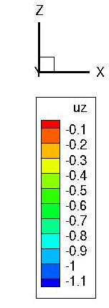

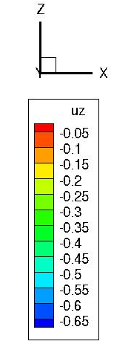


Nonlinear Structural FE Code
Capable of Large deformation, large strain, large rotation
Geometric Nonlinearity
Total Lagrangian as well as Updated Lagrangian formulation
3D as well as 2D elements
Linear model
Nonlinear model
Extensible to material nonlinearity,( hyperelasticity, plasticity)
Extensible to active materials such as piezo-ceramics

Slide 10
Nonlinear Structural FE Code
Special sparse matrix storage stores only nonzero elements
Preconditioned Conjugate Gradient method
Nonlinear iterations through Newton-Raphson (NR) iterations, also modified NR and initial stress updates are supported
Newmark method for time integration gives unconditional stability and introduces no numerical damping
Parallelized through OpenMP and extensible to MPI
Exploring METIS for mesh partition and mesh adaptation

Slide 11
Fluid structure Interaction coupling
MPI
OpenMP/OpenACC
Notes:
Read the bgmesh and the ib surface first, and then put them into IBM, IBM define the nodetype on the background mesh. And then fluid solver will solve the governing equations for the fluid domain. After this, IBM will calculate the forces act on the IB surface. Then structure solver will solve the structure equations under these forces. After this, for strong coupling, we will check the convergence: the displacement change between each inner iteration; for loose coupling, we will match to the next time step. Then the coordinates and velocity and accelerations on the immersed surface will be updated base on the deformation calculated by the structure solver.

Slide 12
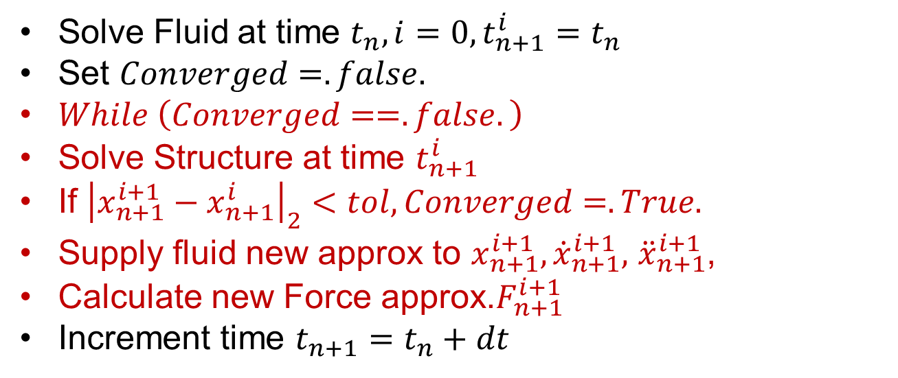
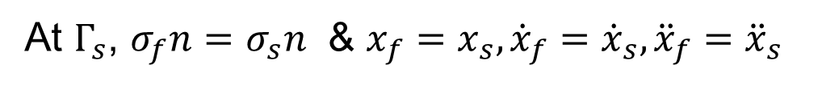


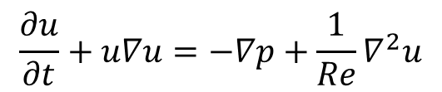
Turek-Hron FSI Benchmark
Fluid
$$\frac{∂u}{∂t}+u∇u=−∇p+\frac{1}{Re}∇^{2}u$$
$$Γ_{s}$$
wall
inlet
outlet
Structure
$$M\ddot{x}+C\left(\dot{x}\right)\dot{x}+K\left(x\right)x=F$$
Interface
At $Γ_{s}$, $σ_{f}n=σ_{s}n$ & $x_{f}=x_{s}, {\dot{x}}_{f}={\dot{x}}_{s},{\ddot{x}}_{f}={\ddot{x}}_{s}$
Solve Fluid at time $t_{n}, i=0,t_{n+1}^{i}=t_{n}$
Set $Converged=.false.$
$While \left(Converged==.false.\right)$
Solve Structure at time $t_{n+1}^{i}$
If ${\left|x_{n+1}^{i+1}−x_{n+1}^{i}\right|}_{2}<tol,Converged=.True.$
Supply fluid new approx to $x_{n+1}^{i+1},{\dot{x}}_{n+1}^{i+1},$ ${\ddot{x}}_{n+1}^{i+1}$,
Calculate new Force approx.$F_{n+1}^{i+1}$
Increment time $t_{n+1}=t_{n}+dt$
Notes:
$σ_{f}n=σ_{s}n$ 1. forces on the fluid is the same with the force on the structure
2. displacement, velocity, acceleration on the interface are the same for fluid and structure

Slide 13
FSI Validation: Turek Hron Benchmark FSI2
Notes:
Read the bgmesh and the ib surface first, and then put them into IBM, IBM define the nodetype on the background mesh. And then fluid solver will solve the governing equations for the fluid domain. After this, IBM will calculate the forces act on the IB surface. Then structure solver will solve the structure equations under these forces. After this, for strong coupling, we will check the convergence: the displacement change between each inner iteration; for loose coupling, we will match to the next time step. Then the coordinates and velocity and accelerations on the immersed surface will be updated base on the deformation calculated by the structure solver.

Slide 14
Parallelization of FSI
Level 1 – Allow Fluid domain to be solved in parallel on several nodes while structure is restricted to one compute node
Allow to leverage already MPI parallel Fluid solver to be solved on several nodes

Slide 15
Parallelization of FSI
Level 2 – Make structure object that can be solved on different compute nodes in addition to Level1 parallelism.
Since structure objects are independent, they can be solved separately provided they don’t directly interact (contact). Each object can use OpenMP/OpenACC parallelism
Allow to leverage already MPI parallel Fluid solver to be solved on several nodes

Slide 16
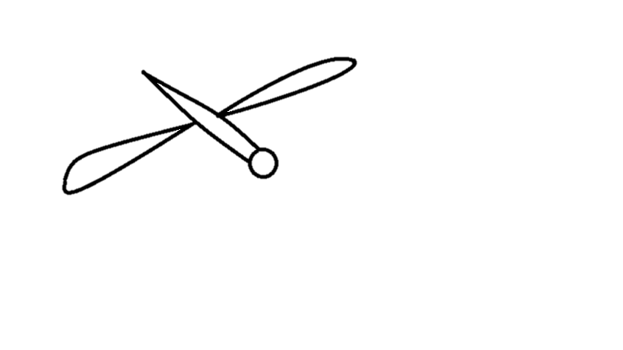
Parallelization of FSI
Level 3 – Structural computation themselves need to be split into subdomains. Different parts of structure offer different complexity.
Notes:
Enhanced capability such as contact detection, collision simulation are very demanding computationally.
Due to several demands on multifunctional, lightweight materials, materials used in MAV constructions are increasingly complex to model (orthotropic properties, layered materials, carbon nanotubes, piezomotors)
Also, properties of these materials may be dependent on load, temperature and other environmental factors. Some parts may go through plastic deformation too. Such simulations pose computational challenge in structural solution.

Slide 17
Parallelization of FSI
Level 4 – Structure keeps moving across fluid domain
Size and Association of Structural domain with background fluid block keeps changing. Demands very clever design to minimize scatter/gather operations.
Design shall be governed by communication cost and algorithms for distributed solver.
Notes:
Enhanced capability such as contact detection, collision simulation are very demanding computationally.
Due to several demands on multifunctional, lightweight materials, materials used in MAV constructions are increasingly complex to model (orthotropic properties, layered materials, carbon nanotubes, piezomotors)
Also, properties of these materials may be dependent on load, temperature and other environmental factors. Some parts may go through plastic deformation too. Such simulations pose computational challenge in structural solution.

Slide 18
Level2-Multiple flags in fluid flow
Created Solid object
  Each object is completely independent and as long as they don’t interact and don’t share any fluid block they can be worked on by different compute nodes

Slide 19

Multiple Flags in 2D Channel flow

Slide 20
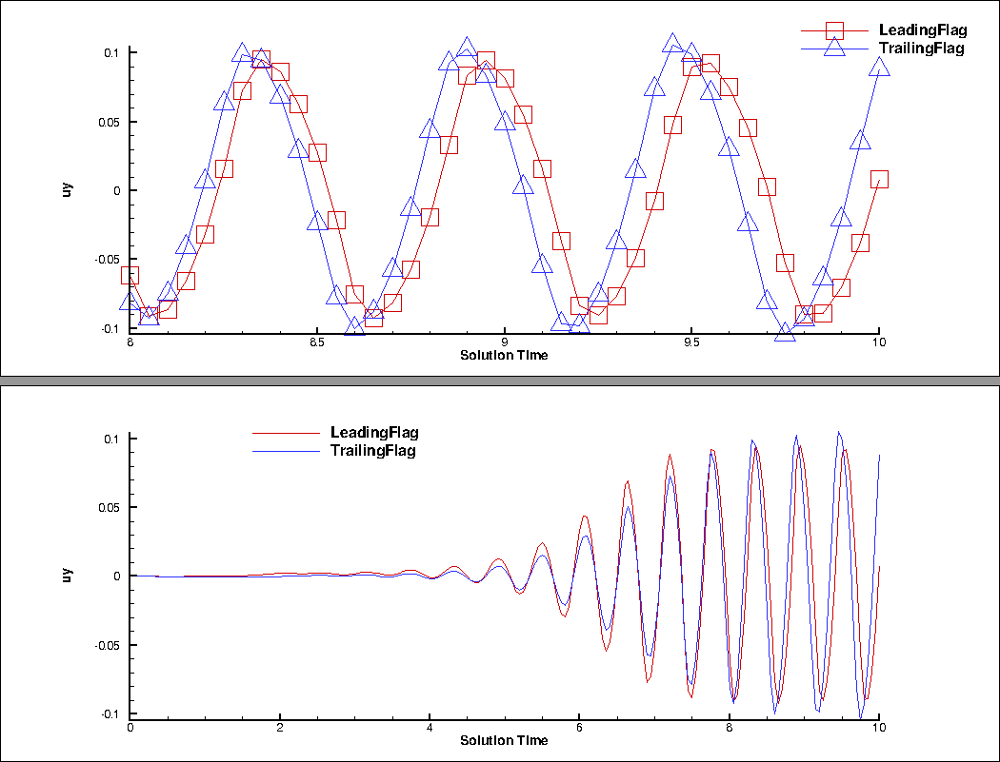
Influence of interaction on flagtip displacements

Slide 21
OpenACC directive based Acceleration
With Xuewen Cui, Hao Wang, Wu-chun Feng, Eric de Sturler

Slide 22
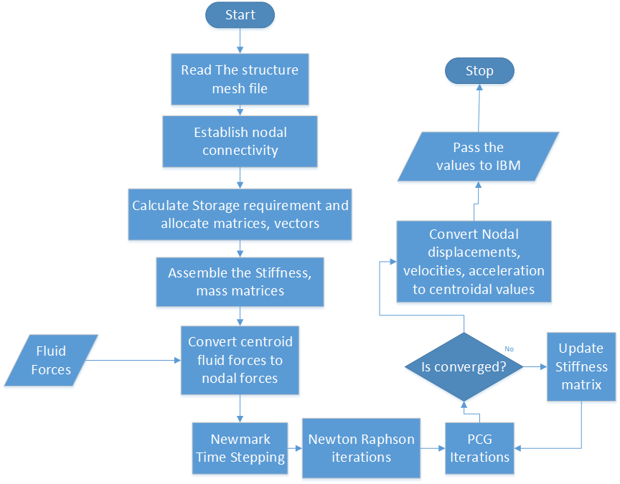
Identifying parallelization opportunity
List Scan
Highly parallel
Histogram
Histogram
Highly parallel
Histogram
Histogram
Highly parallel

Slide 23
Identification based on profiling
static solution
 | Time (s) | % time spent | No of calls | ~ iterations/PCGSolver
Total | 174.64 | 100.00
PCGSolver | 125.57 | 71.90 | 7 | 2150
idboundary | 22.06 | 12.63 | 1
assembly | 15.87 | 9.09 | 15
preconditioner | 6.18 | 3.54 | 15128
PCGSolver, preconditioner and assembly routines comprise of ~90% total run time
In transient solution, PCGSolver needs fewer iteration to converge (Assembly time dominates)
Matvec Operation is ~80 cost in PCGSolver
transient solution 100 steps
 | Time (s) | % time spent | No of calls | ~ iterations/PCGSolver
Total | 1289.60 | 100.00
assembly | 582.82 | 45.19 | 501 | 250
PCGSolver | 539.23 | 41.81 | 251
preconditioner | 26.52 | 2.06 | 61176
idboundary | 22.28 | 1.73 | 1
newmarksolver | 16.60 | 1.29 | 1

Slide 24
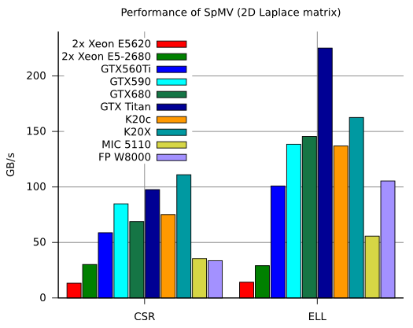
Matvec Performance on GPU
Ref: Benchmark by Paralution Parallel computation library
Memory Bandwidth for
GTX Titan=288 GB/s

Slide 25
Choice of Sparse Matrix Storage Format
Compressed Sparse Row (CSR) Storage Format
  Store Diagonal elements Ki separately in a vector
  Off-diagonal elements are stored in CSR format
1.2 | 2.4 | 5.2
2.4 | 3.5 |  | 4.5
5.2 |  | 4.9
 | 4.5 |  | 6.7 | 7.8
 |  |  | 7.8 | 2.4
Ki(diag elems)
1.2 | 3.5 | 4.9 | 6.7 | 2.4
K
Row pointers
1 | 3 | 5 | 6 | 8 | 9
Column index
2 | 3 | 1 | 4 | 1 | 2 | 5 | 4
Kj (Off-diag elems)
2.4 | 5.2 | 2.4 | 4.5 | 5.2 | 4.5 | 7.8 | 7.8

Slide 26
Choice of Sparse Matrix Storage Format
ELL or ELLPACK

Slide 27
Matvec strategies performance
Just matvec operation 10000 times
 | Time (s)
CSR | 68.95
ELL (Rowwise memory access) | 8.77
ELL (Column wise memory access) | 26.52
Prefetching RHS vector to improve memory access | 84.64

Slide 28
Performance on Lab GPU machine
OpenACC
  DOF = 103323, 1 step(8 PCGSolver calls)
 | Host(s) – OpenMP (PGI/Intel) |  | Device(s) – OpenACC (PGI)
 | OMP_THREADS=1 | OMP_THREADS=16 | CSR Vector(32) | CSRELL(1024)
Overall | 246.67/ | 1120.44/ | 180.01 | 149.17
PCGSolver | 118.95/ | 51.32/ | 57.10 | 20.84
Matvec |  |  | 44.8 | 10.41

Slide 29
Performance expectation
Diagonal Element (i) = 103323
Off-diagonal elements (j)= 4221366
Useful Flops/matvec = i+2*j=8546055
ELL total flops/matvec = i+2*i*maxrownz = 9195747 (~107.6%)
CSR best matvec flops/sec = 2.88 Gflops/s
ELL best useful matvec flops/sec = 12.41 Gflops/s
ELL best total matvec flops/sec = 13.36 Gflops/s
  Memory Bandwidth 144 GB/s. Considering 8x2 bytes per 2 flops for off-diagonal elements, it give 18 GFlops/sec.
We should expect the upper bound to be ~18Gflops/sec

Slide 30
Achieved Solver Speed up
 | Steady State |  | Transient (100 steps, dt=1e-3s)
 | CPU-single core | OpenACC on GPU (speedup) | CPU-single core | OpenACC on GPU (speedup)
Total time(s) | 247.09 | 149.17 (~1.7X) | 4455.86 | 3862.03(~1.15x)
PCGSolver | 119.17 | 20.84 (~6x) | 742.80 | 186.01(~4x)

Slide 31
Future Development
Parallelization of assembly subroutine
Porting entire structure on GPU
Efficient Solvers and preconditioning
MPI parallelization for truly scalability

