Slide 1


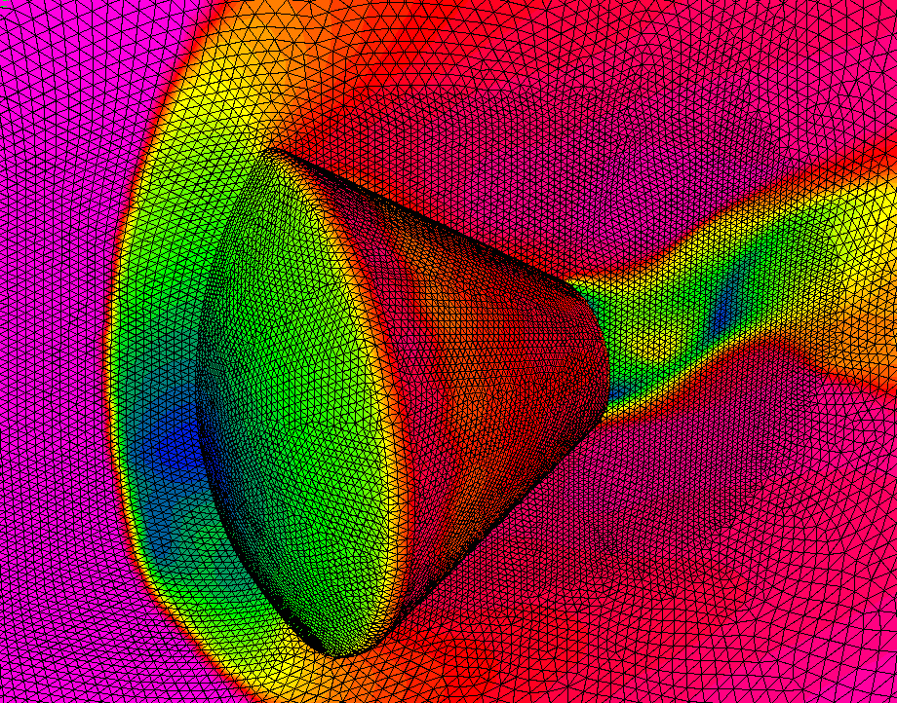
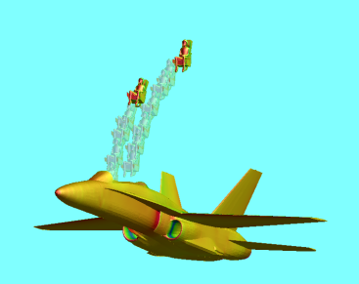
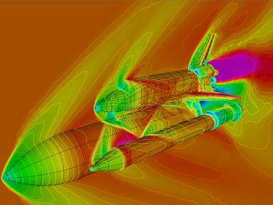
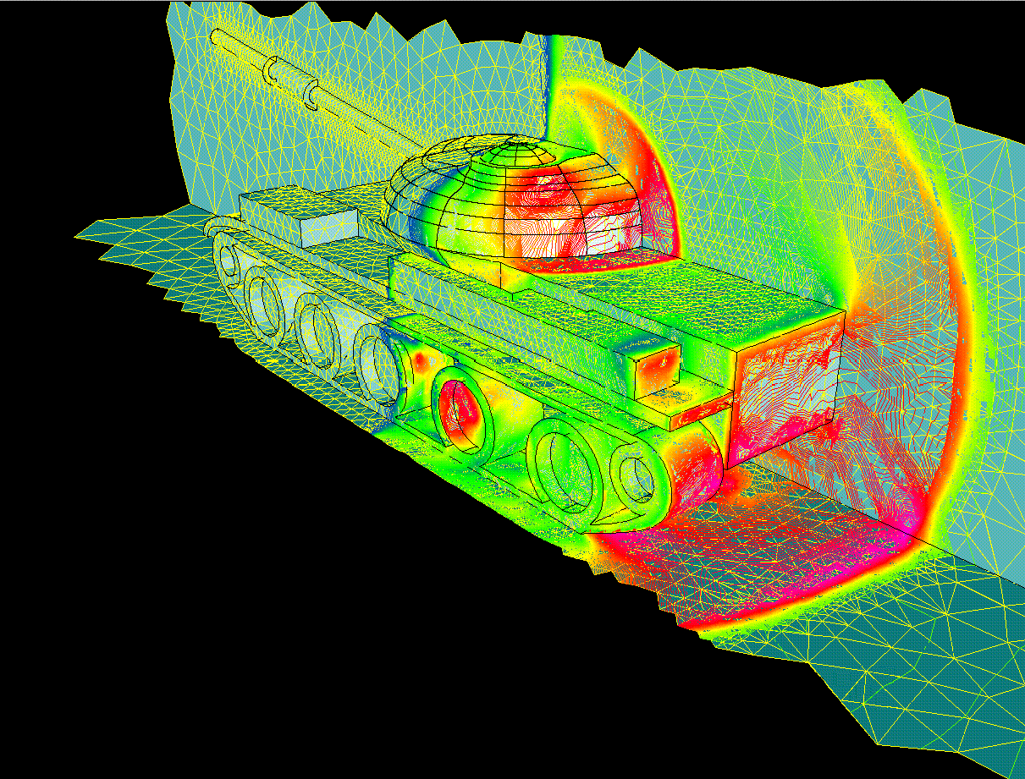
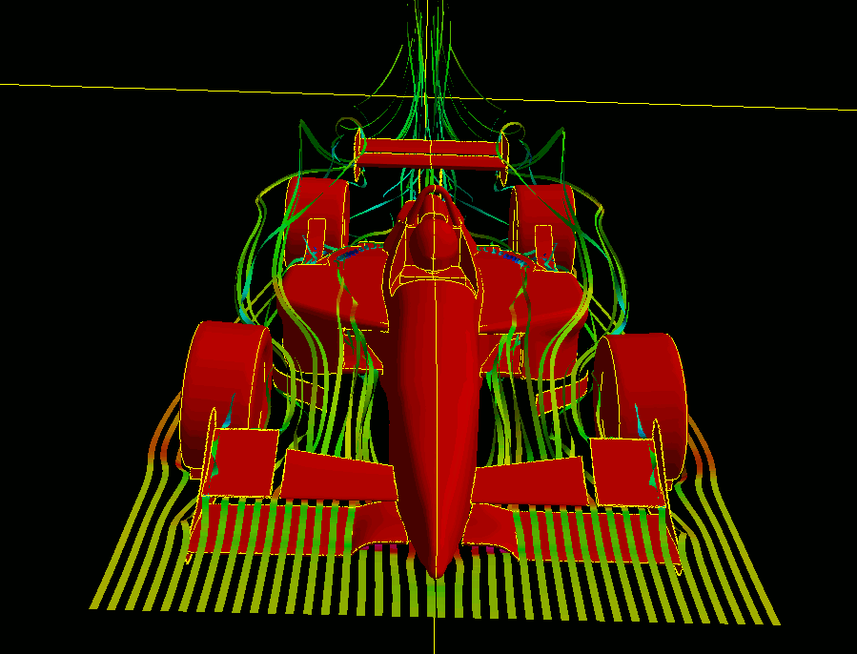
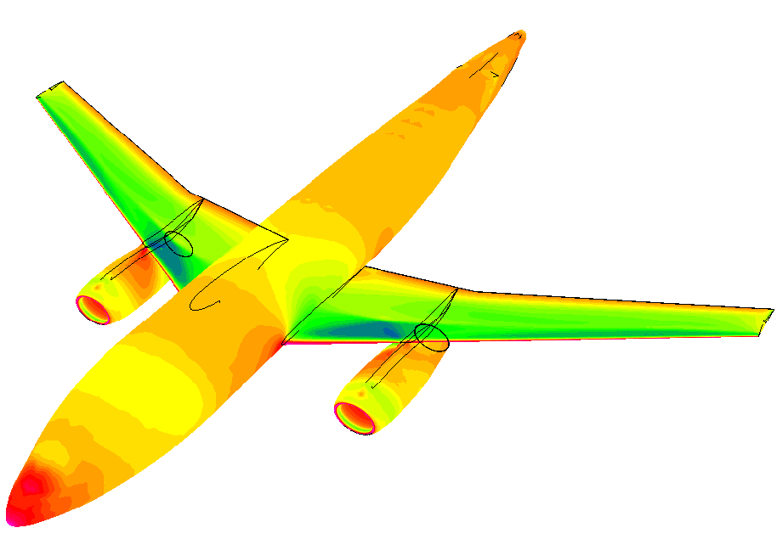
Development of a Portable, GPU-Accelerated Discontinuous Galerkin CFD Code for Compressible Flows on Unstructured Hybrid Grids
AFOSR BRI
Co-Design of Hardware/Software for Predicting UAV Aerodynamics
Jialin Lou, Xiaodong Liu, Lixiang Luo, Hong Luo, and Jack Edwards
Department of Mechanical and Aerospace Engineering
North Carolina State University
and
Frank Mueller, and Saransh Gupta
Department of Computer Science
North Carolina State University
Presented by Xiaodong Liu, Ph.D. Student ,
July 20-21, 2015

Slide 2
Outline
AFOSR BRI – Co-Design of Hardware/Software for Predicting UAV Aerodynamics
A brief overview
Motivation and objective
Governing equations of fluid dynamics
Discontinuous Galerkin formulation
Development of RDGFLO solver
Application
Concluding remarks
Future work

Slide 3
GPU Computing in CFD – Overview
AFOSR BRI – Co-Design of Hardware/Software for Predicting UAV Aerodynamics
GPGPU
General-purpose computing on graphics processing units The utilization of GPU, which typically handles computation only for computer graphics, to perform computation in applications traditionally handled by CPU.
Why?
The great potential and scalability of GPGPU for CFD applications!
How?
Offload the computing-intensive portion from the host CPUs to the GPU devices.
Programming models
OpenCL: the currently dominant open GPGPU programming language NVIDIA’s CUDA: the dominant proprietary framework OpenACC: a collection of directives designed to simplify parallel programming
Notes:
Not new concept. It’s roughly clear to everyone in scientific computing why you want to it and how you can do it. But maybe a lot of people do not know much what specific method to try.

Slide 4
GPU Computing in CFD – Overview
AFOSR BRI – Co-Design of Hardware/Software for Predicting UAV Aerodynamics
A variety of applications (selected)
For the finite difference method (FDM) E. Elsen, P. LeGresley, and E. Darve. Large Calculation of the Flow over a Hypersonic Vehicle Using a GPU. J. Comput. Phys., 227(24):10148–10161, 2008. For the finite volume method (FVM) A. Corrigan, F. Camelli, R. Löhner, and J. Wallin. Running Unstructured Grid-based CFD Solvers on Modern Graphics Hardware. Int. J. Numer. Methods Fluids, 66(2):221–229, 2011. For the spectral difference method (SDM) B. Zimmerman, Z. Wang, and M. Visbal. High-Order Spectral Difference: Verification and Acceleration Using GPU Computing. AIAA Paper, 2013-2491, 2013. For the discontinuous Galerkin method (DGM) A. Klöckner, T. Warburton, J. Bridge, and J. S. Hesthaven Nodal Discontinuous Galerkin Methods on Graphics Processors. J. Comput. Phys., 228(21):7863–7882, 2009.
Observation: most GPU-related CFD solvers are based on CUDA

Slide 5
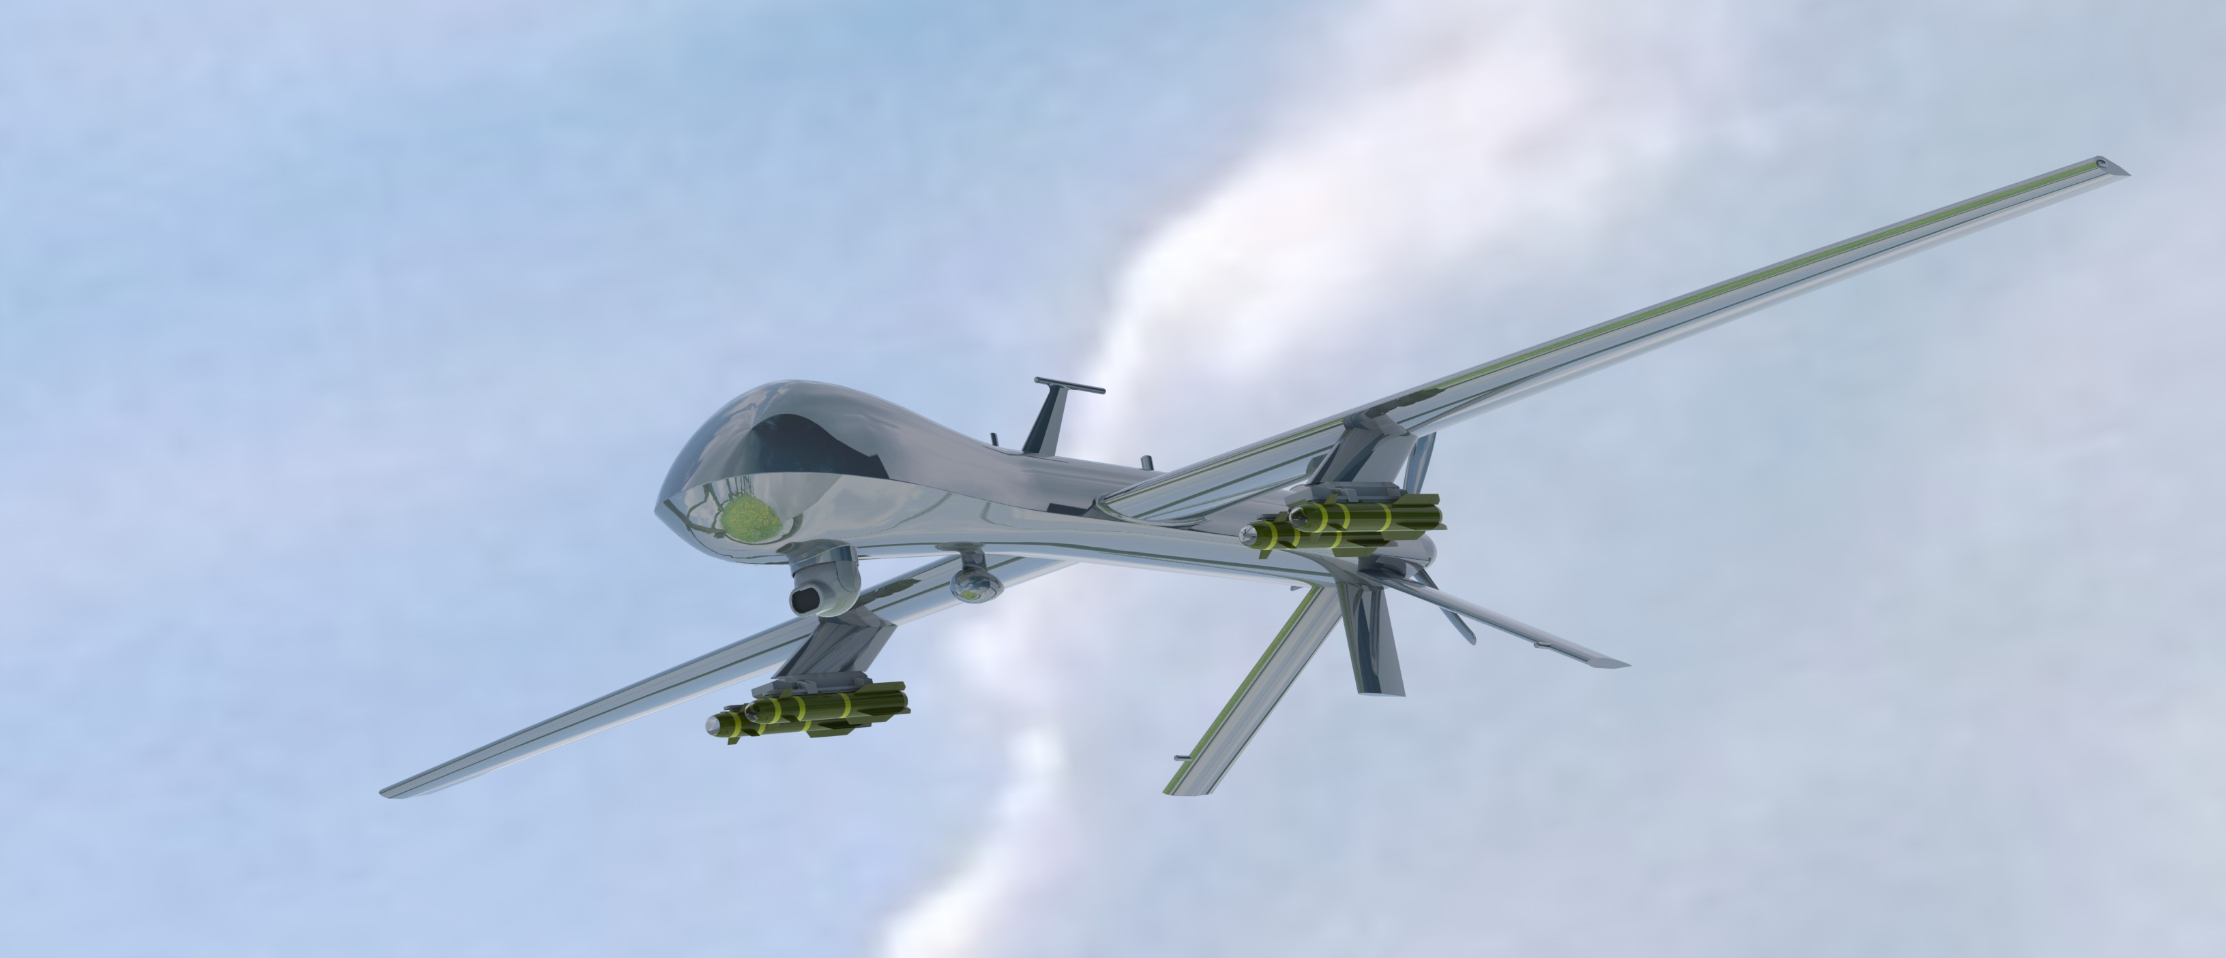
Motivation & Objectives
AFOSR BRI – Co-Design of Hardware/Software for Predicting UAV Aerodynamics
Motivation
Tap the power of GPU parallel computing for the aerodynamic design of Unmanned Aerial Vehicle (UAV) with CFD toolkits
MQ-1 Predator UAV (Source: grabcad.com CAD by Chao Wey)

Slide 6


Motivation & Objectives
AFOSR BRI – Co-Design of Hardware/Software for Predicting UAV Aerodynamics
Objectives
A portable, efficient and ultimately competitive GPU parallelization strategy for extensible and sustainable high-fidelity CFD code development
An unavoidable debate – CUDA, OpenCL or OpenACC?
It really depends on your needs, e.g., for us, cross-platform portability Support from a wide range of compiler and accelerator vendors C/C++ and Fortran Best performance Less fine-tuning effort, especially for a legacy code package Available computing resource

Slide 7







GPU-Computing Framework
AFOSR BRI – Co-Design of Hardware/Software for Predicting UAV Aerodynamics
Desirable features of the resulting CFD code
Multi-compiler compatibility GNU Fortran compiler Intel Fortran compiler PGI Accelerator Fortran compiler (with OpenACC support) CAPS Fortran compiler (with OpenACC support) Cross-platform portability Intel CPUs AMD CPUs / APUs (with potential OpenACC support in 2014) NVIDIA CUDA-enabled GPUs (with OpenACC support) Extensible and sustainable programming schemes Competitive performance
Notes:
In a practical sense, the current OpenACC-based code does not enjoy a wide range of portability.

Slide 8
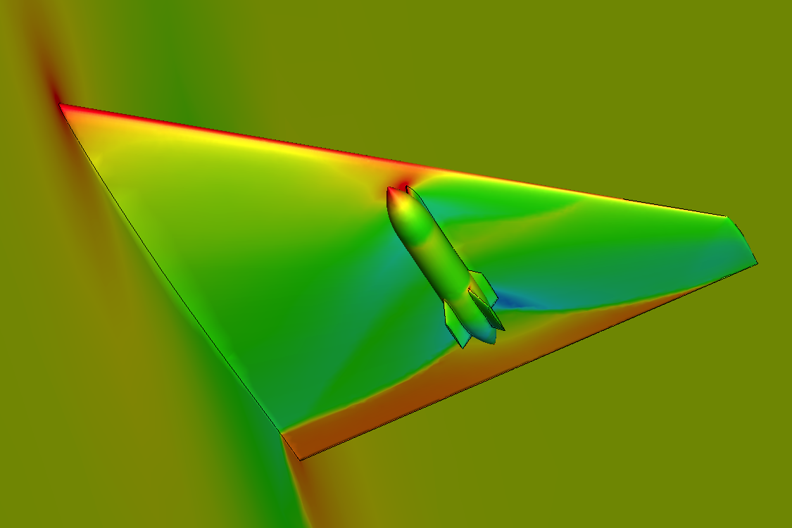
Legacy CFD Package
AFOSR BRI – Co-Design of Hardware/Software for Predicting UAV Aerodynamics
RDGFLO – a baseline code for OpenACC-based GPU parallelization
A Reconstructed Discontinuous Galerkin finite element FLOw solver High-order solution of compressible flows on 3-D hybrid grids Explicit / implicit solution schemes Domain-partition based MPI parallel computing
Gallery
ONERA M6 wing
wing/pylon/finned-store configuration
Boeing 747 aircraft

Slide 9
Governing Equations of Fluid Dynamics
AFOSR BRI – Co-Design of Hardware/Software for Predicting UAV Aerodynamics
The Navier-Stokes equations for unsteady compressible flows
where the summation convention is used. The conservative variable vector U, advective flux vector F, and viscous flux G are defined by

Slide 10
Governing Equations of Fluid Dynamics
AFOSR BRI – Co-Design of Hardware/Software for Predicting UAV Aerodynamics
The Navier-Stokes equations for unsteady compressible flows (cont.)
The pressure p can be computed from the equation of state (EOS) which is valid for perfect gas. The ratio of specific heats γ is assumed to be constant and equal to 1.4. The viscous stress tensor τ_{ij} and heat flux vector q_{j} are given by where T is the temperature of the fluid, Pr the laminar Prandtl number, which is 0.7 for air. μ represents the molecular viscosity, which can be determined through the Sutherlands law where μ₀ is the viscosity at the reference temperature T₀ and S = 110K.

Slide 11
Discontinuous Galerkin Method
AFOSR BRI – Co-Design of Hardware/Software for Predicting UAV Aerodynamics
Weak formulation of the governing equations
where B_{i}(x) is the basis function of polynomials of degree p, and N is the dimension of the polynomial space p. The Taylor-basis discontinuous Galerkin (DG(p)) solution in each element For example, the underlying piecewise linear polynomial DG(P1) solution where (x_{c}, y_{c}, z_{c}) is the coordinate of the element center.

Slide 12
Discontinuous Galerkin Method
AFOSR BRI – Co-Design of Hardware/Software for Predicting UAV Aerodynamics
Hierarchical WENO reconstruction
A quadratic polynomial DG(P2) solution is obtained via a hierarchical WENO reconstruction approach in each element Least-squares reconstruction to obtain an initial quadratic solution WENO reconstruction for the second derivatives to maintain linear stability WENO reconstruction for the first derivatives to maintain nonlinear stability Reference articles H. Luo, Y. Xia, S. Li, and R. Nourgaliev. A Hermite WENO Reconstruction-Based Discontinuous Galerkin Method for the Euler Equations on Tetrahedral grids. J. Comput. Phys. 231(16):5489–5503, 2012. H. Luo, Y. Xia, S. Spiegel, R. Nourgaliev, and Z. Jiang. A Reconstructed Discontinuous Galerkin Method Based on a Hierarchical WENO Reconstruction for Compressible Flows on Tetrahedral Grids. J. Comput. Phys. 236:477–492, 2013.

Slide 13
Discontinuous Galerkin Method
AFOSR BRI – Co-Design of Hardware/Software for Predicting UAV Aerodynamics
Semi-discrete form
A system of ordinary differential equations (ODEs) in time where M is the mass matrix and R is the residual vector. Three-stage TVD Runge-Kutta (TVDRK3) time stepping

Slide 14
Design of OpenACC Parallel Regions
AFOSR BRI – Co-Design of Hardware/Software for Predicting UAV Aerodynamics
Example: a readily vectorizable region
Domain integral: loop over mesh elements Ω_{e}
OpenMP version !$omp parallel !$omp do do ie = 1, Nelem do ig = 1, Ngp !... contribution to this element rhsel(:, :, ie) = rhsel(:, :, ie) + flux enddo enddo !$omp end parallel | OpenACC version !$acc parallel !$acc loop do ie = 1, Nelem do ig = 1, Ngp !... contribution to this element rhsel(:, :, ie) = rhsel(:, :, ie) + flux enddo enddo !$acc end parallel

Slide 15
Design of OpenACC Parallel Regions
AFOSR BRI – Co-Design of Hardware/Software for Predicting UAV Aerodynamics
Example: a region that is not readily vectorizable
Face integral: loop over mesh faces Τ_{e}
OpenMP version !$omp parallel !$omp do do ifa = Njfac+1, Nafac do ig = 1, Ngp !... contribution to the face-left element rhsel(:, :, iel) = rhsel(:, :, iel) - flux !... contribution to the face-right element rhsel(:, :, ier) = rhsel(:, :, ier) + flux enddo enddo !$omp end parallel | OpenACC version !$acc parallel !$acc do do ifa = Njfac+1, Nafac do ig = 1, Ngp !... contribution to the face-left element rhsel(:, :, iel) = rhsel(:, :, iel) - flux !... contribution to the face-right element rhsel(:, :, ier) = rhsel(:, :, ier) + flux enddo enddo !$acc end parallel
“race condition” – multiple writes to the same elemental residual vector!

Slide 16
Design of OpenACC Parallel Regions
AFOSR BRI – Co-Design of Hardware/Software for Predicting UAV Aerodynamics
A common method for avoiding “race condition” in face integral
Perform face integral at the element level All the computing is implemented as loops over mesh elements Overheads Lead to redundant computation of face integrals (doubled!) Require an additional element-face connectivity array Reference articles on unstructured DG/FV methods (with CUDA) A. Corrigan et al. Running Unstructured Grid-based CFD Solvers on Modern Graphics Hardware. Int. J. Numer. Methods Fluids, 66(2):221–229, 2011. Tristan Cabel and Stephane Lanteri. Discontinuous Galerkin Time-Domain Solver on GPU Based Systems. Plafrim meeting, May 31, 2011
This design approach requires a major rebuild in code structures!
Notes:
This “element based” loop strategy is still a very fast method on GPU devices, if you read the referred papers

Slide 17
Design of OpenACC Parallel Regions
AFOSR BRI – Co-Design of Hardware/Software for Predicting UAV Aerodynamics
An alternative approach to avoiding “race condition” in face integral
Face renumbering (coloring method) renumber the faces and split them into several groups. Any two faces that share a common cell do not reside in the same group. The original face loops are nested in a sequential loop over groups.
An example of “face renumbering & grouping”
Before
Physical boundary faces |  |  |  | Partition boundary faces |  |  | Internal faces
After
4 groups |  |  |  | 3 groups |  |  | 6 groups

Slide 18
Design of OpenACC Parallel Regions
AFOSR BRI – Co-Design of Hardware/Software for Predicting UAV Aerodynamics
Example: face loops after “face renumbering & grouping”
The original face loops are nested in a sequential loop over groups.
OpenMP version Nfac1 = Njfac do ipass = 1, Npass_ift Nfac0 = Nfac1 + 1 Nfac1 = fpass_ift(ipass) !$omp parallel !$omp do do ifa = Nfac0, Nfac1 do ig = 1, Ngp !... contribution to the face-left element rhsel(:, :, iel) = rhsel(:, :, iel) - flux !... contribution to the face-right element rhsel(:, :, ier) = rhsel(:, :, ier) + flux enddo enddo !$omp end parallel enddo | OpenACC version Nfac1 = Njfac do ipass = 1, Npass_ift Nfac0 = Nfac1 + 1 Nfac1 = fpass_ift(ipass) !$acc parallel !$acc do do ifa = Nfac0, Nfac1 do ig = 1, Ngp !... contribution to the face-left element rhsel(:, :, iel) = rhsel(:, :, iel) - flux !... contribution to the face-right element rhsel(:, :, ier) = rhsel(:, :, ier) + flux enddo enddo !$acc end parallel enddo

Slide 19
Design of OpenACC Parallel Regions
AFOSR BRI – Co-Design of Hardware/Software for Predicting UAV Aerodynamics
“Face renumbering & grouping” vs. “element loops”
Advantages No redundant computation. Least intrusion to the original code structures. Recoverable to CPU parallel computing. Disadvantages Sequential groups lead to overheads in initializing more parallel kernels. Remarks No direct comparison of these two strategies is yet conducted for our solver. It is unknown which will render better performance on GPU. 2. Since portability is our design priority, the current approach is a preferred, although optimal performance might be compromised.

Slide 20


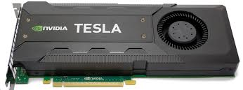




Hardware/Software Resource
AFOSR BRI – Co-Design of Hardware/Software for Predicting UAV Aerodynamics
CPU
2-way SMPs with AMD Opteron 6128 (Many Core) with 8 cores per socket (16 cores per node) 32 GB DRAM 2.0 GHz core-speed for 6128 Opteron (single core)
GPU
NVIDIA Tesla K20c Memory amount: 5.0 GB Stream processors: 2496
Software (64 bit)
Operating system CentOS 5.7 Linux x86 64 Compilation & runtime suite PGI Accelerator Fortran Compiler (ver. 13.4) OpenMPI (ver. 1.5.5)

Slide 21
Development of RDGFLO
Workflow for p-multigird Discontinuous Galerkin method
!! Loop over time steps | !! P-multgrid
DO itime = 1, ntime | <ACC> Transfer P1->P0
<ACC> Predict time-step size on higher level | <ACC> Predict time-step size on lower level
!! Loop over TVDRK stages for rDG(P1P2) | <ACC> Compute R.H.S vector R
Do istage = 1, nstage | <ACC> Compute L.H.S matrix A = M/dt – dR/dU
 | <ACC> Solve the linear system Au=R
<ACC> P1P2 lest-squares reconstruction | !! Linear solver + Preconditioner
<ACC> R.H.S. residual from diffusion | ! Preconditioning: P⁻¹Au=P⁻¹R
<ACC> WENO reconstruction | ! Option 1. GMRES + LU-SGS
<ACC> residual from convection | ! Option 2. LU-SGS + Jacobi
<ACC> update solution vector | ! Option 3. Jacobi
 | ! Option 4. …
ENDDO | ENDDO

Slide 22
Development of OpenACC Parallel Regions
Workflow for implicit rDG method
DO itime = 1, ntime
→ Predict time-step size
→ Compute R.H.S vector R | !successfully ported on GPU.
→ Compute L.H.S matrix A = M/dt – dR/dU | !successfully ported on GPU.
→ Solve the linear system Au=R
Jacobi/ LU-SGS/ GMRES algorithm | !Jacobi successfully ported on GPU.
→ …
→ Preconditioning: P⁻¹Au=P⁻¹R
Option 0. no preconditioning ✗
Option 1. Jacobi
Option 2. LU-SGS
ENDDO

Slide 23
Performance Assessment
AFOSR BRI – Co-Design of Hardware/Software for Predicting UAV Aerodynamics
Timing measurements
Unit running time T_{unit} where the running time T_{run} refers to the time recorded for completing the time marching loop with a given iteration number Ntime.
Control sets (simulations in double-precision arithmetic)
GPU | Parallel computing with 1 GPU device
CPU | Serial computing with 1 CPU core

Slide 24
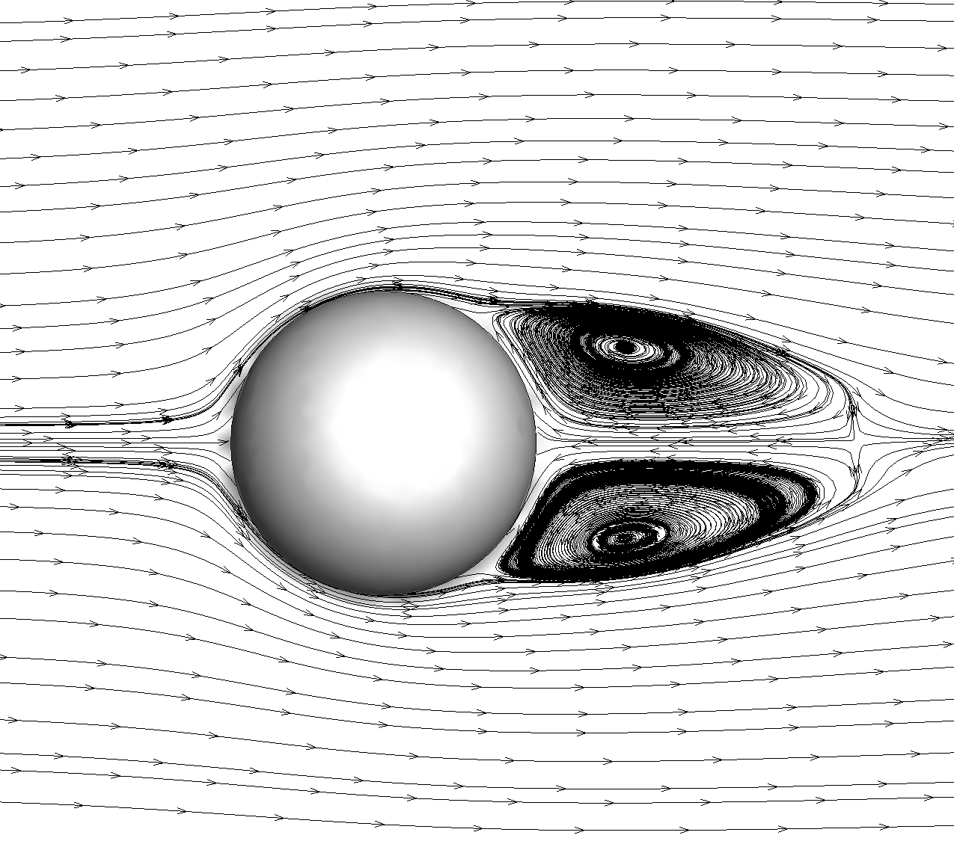
Timing test
Viscous flow over a 3D sphere. M∞ = 0.5, α = 0° and Re=118.
On a set of two tetrahedral grids. (nelem = 62,477 and 200,416) Streamlines plotted on the the computation domain

Slide 25
Timing test
Timing measurements of using p-multigrid DG methods
 | T_{unit} by pMG DG(P1) |  |  | T_{unit} by pMG rDG(P1P2)
Nelem | GPU | CPU | Speedup | GPU | CPU | Speedup
62,477 | 17.67 | 54.42 | 3.08 | 32.07 | 156.00 | 4.86
200,416 | 16.41 | 54.59 | 3.33 | 30.45 | 162.46 | 5.34

Slide 26
Timing test
Subsonic flow past a sphere at M∞ = 0.50 and α = 0°.
On a sequence of four successively refined tetrahedral grids. Pressure contours plotted on the surface triangular meshes

Slide 27
Timing test
Test results on L.H.S.
Timing on L.H.S.
nelem | 1gpu | 1cpu | speed_up-1 | 16cpu | speed_up-16
535 | 3.00E-03 | 1.20E-02 | 4.00 | 1.23E-04 | 0.04
2426 | 5.45E-02 | 4.27E-01 | 1.16 | 5.36E-03 | 0.10
16467 | 1.35E-01 | 4.27E-01 | 3.16 | 3.78E-02 | 0.28
1247061 | 8.00E-01 | 3.45E+00 | 4.31 | 2.84E-01 | 0.36
Test results on wall-time
Timing on wall-time
nelem | 1gpu | 1cpu | speed_up-1 | 16cpu | speed_up-16
535 | 9.70E-03 | 3.71E-02 | 3.82 | 3.75E-03 | 0.39
2426 | 6.56E-02 | 1.70E-01 | 2.59 | 1.55E-02 | 0.24
16467 | 1.82E-01 | 1.27E+00 | 6.95 | 1.20E-01 | 0.66
1247061 | 1.15E+00 | 1.14E+01 | 9.93 | 8.10E-01 | 0.71

Slide 28
Application of RDGFLO
Timing test for Tayler-Green vortex (DNS) on hexahedral and tetrahedral grids ;
Taylor-Green vortex (DNS) with Rosenbrock-Wanner method ;
Implementation of one equation turbulence model in rDG
code.

Slide 29
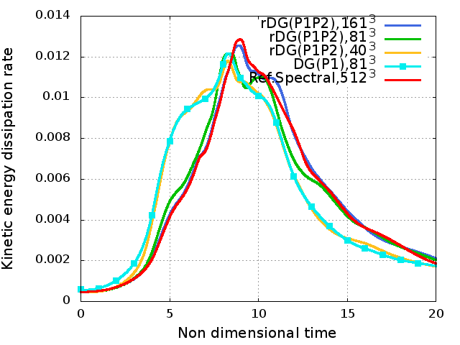
Application of RDGFLO – DNS
Explicit rDG periodic boundary condition
Add an array ‘bperi(2,nbfac)’ to store the periodic B.C. information
DNS problem: 3D Taylor-Green vortex problem on hexahedral grid

Slide 30
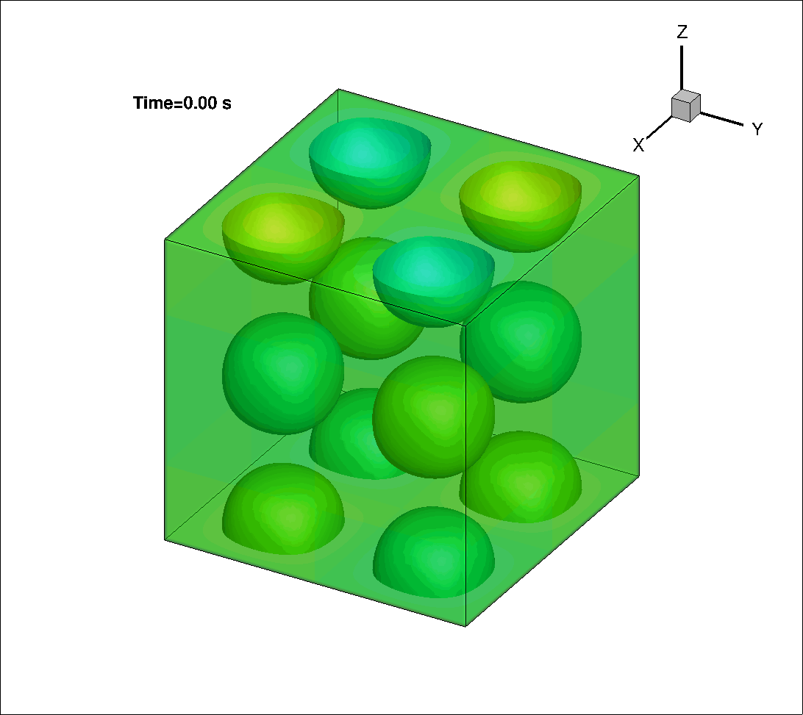
Application of RDGFLO – DNS
DNS problem: 3D Taylor-Green vortex problem on hexahedral grid
GPU/CPU computing history of the iso-surface of the z-component of the dimensionless vorticity (nelem =81³, 0<t<20s)

Slide 31
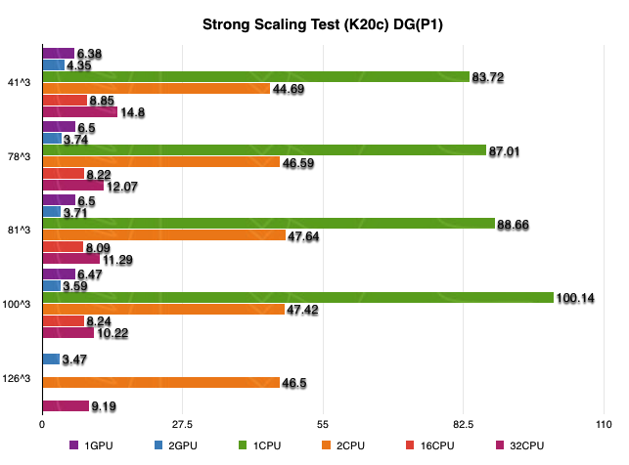
Timing test
Numerical test: Taylor vortex problem on hexahedral grid (DG(P1))
Notes:
DGP1 UP TO 15.48(1 v.s.1), 8.85(1 v.s. 16) 3.40 (2 v.s. 32);

Slide 32
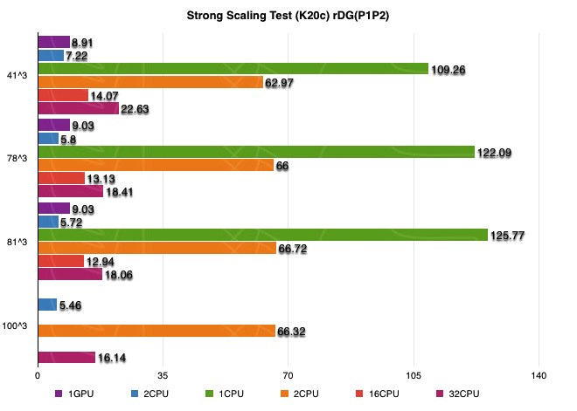
Timing test
Numerical test: Taylor vortex problem on hexahedral grid (rDG(P1P2))
Notes:
rDGP1P2 UP TO 13.93 (1 v.s. 1), 1.58 (1 v.s. 16) 3.13 (2 v.s. 32)

Slide 33
Timing test
Numerical test: Taylor vortex problem on hexahedral grid
Weak Scaling (NVIDIA C2070)
 |  | Unit Time |  | Parallel Efficiency
nelem | nGPU | DGP1 | rDGP1P2 | DGP1 | rDGP1P2
78³ (0.5M) | 1 | 15.17 | 21.92 | - | -
100³ (1.0M) | 2 | 15.87 | 23.82 | 95.59% | 92.02%
126³ (2.0M) | 4 | 17.04 | 25.86 | 89.03% | 84.76%
158³ (4.0M) | 8 | 17.13 | - | 88.56% | -

Slide 34
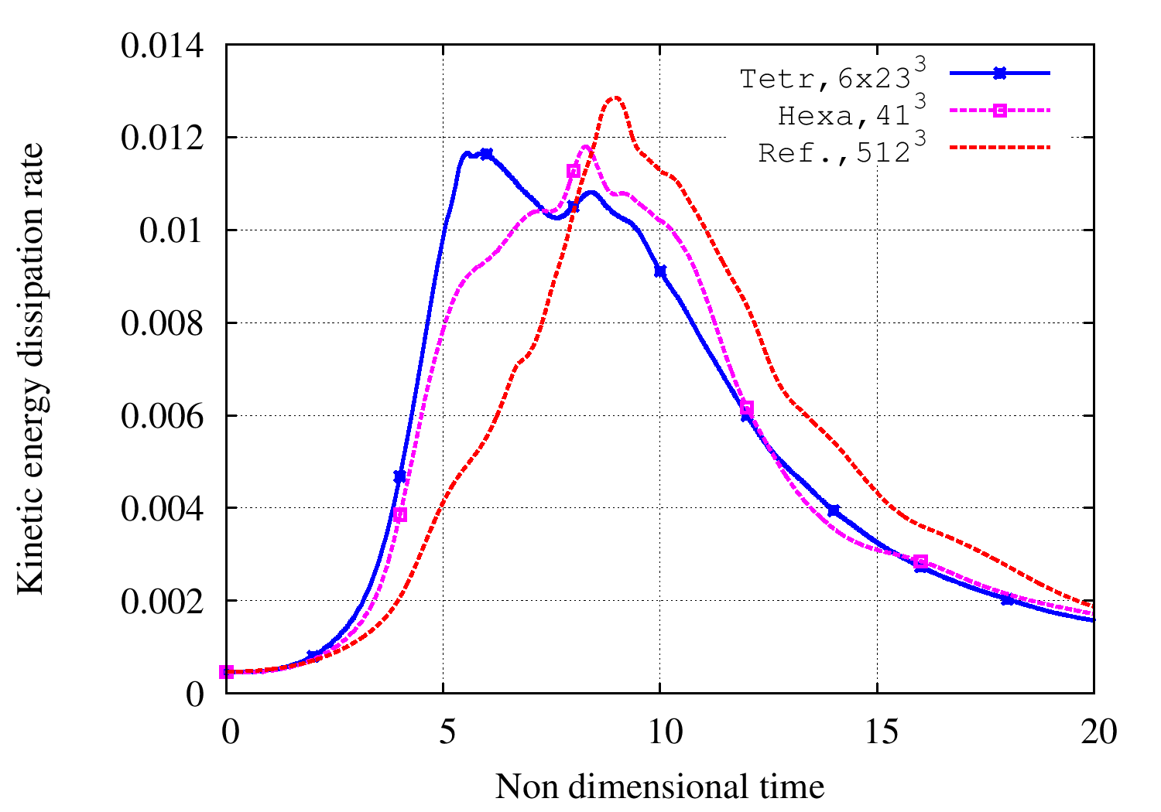
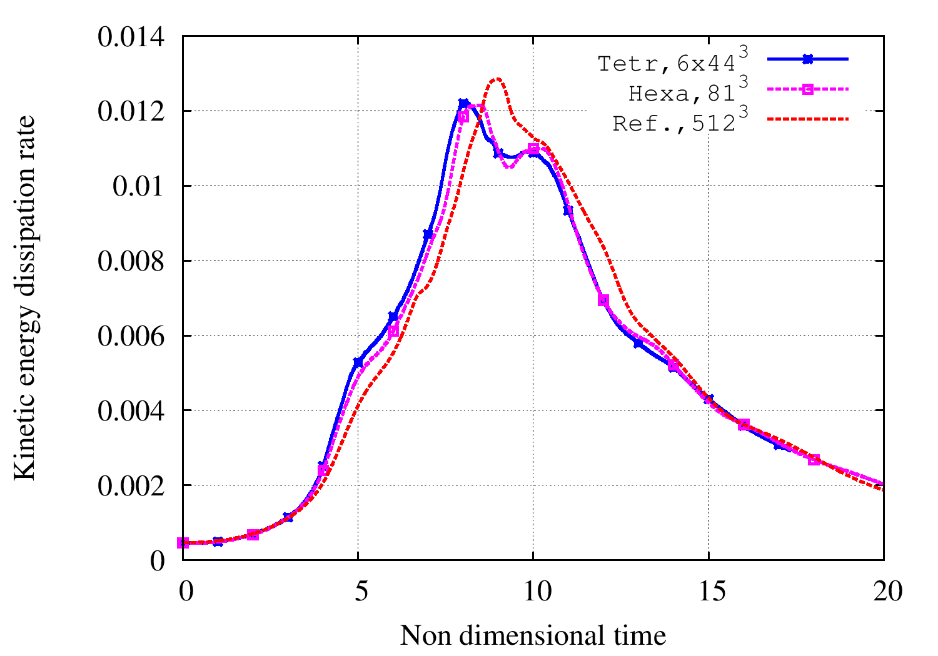
Application of RDGFLO – DNS
Numerical test: Taylor vortex problem on hexahedral/tetrahedral grid

Slide 35
Strong Scaling Test (K20c) On Tetrahedral Grids
Test results with DG(P1)
nelem | 1gpu | 1cpu | speed_up-1 | 16cpu | speed_up-16
41,154 | 4.03 | 47.85 | 11.87 | 6.07 | 1.51
511,104 | 3.17 | 47.36 | 14.94 | 4.13 | 1.30
Test results with rDG(P1P2)
nelem | 1gpu | 1cpu | speed_up-1 | 16cpu | speed_up-16
41,154 | 19.68 | 86.13 | 4.38 | 15.92 | 0.97
511,104 | 16.08 | 85.52 | 5.32 | 9.49 | 0.59

Slide 36
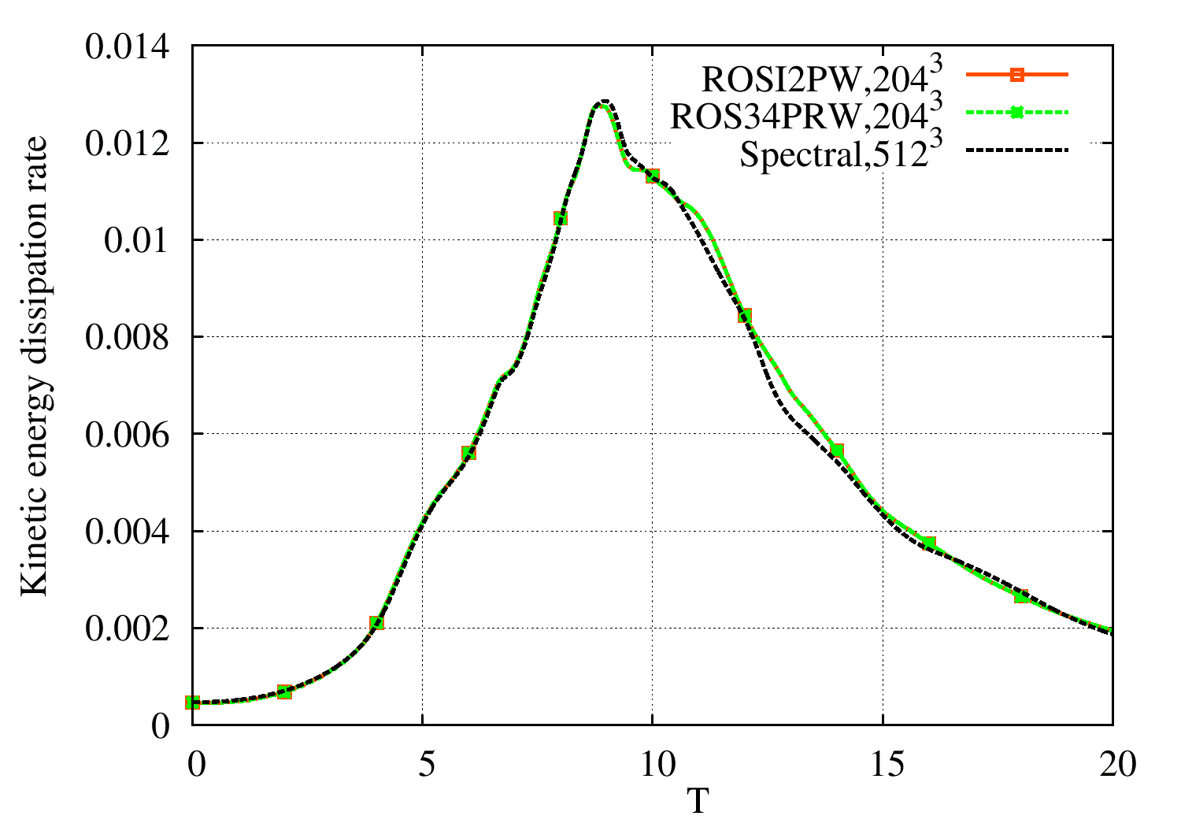
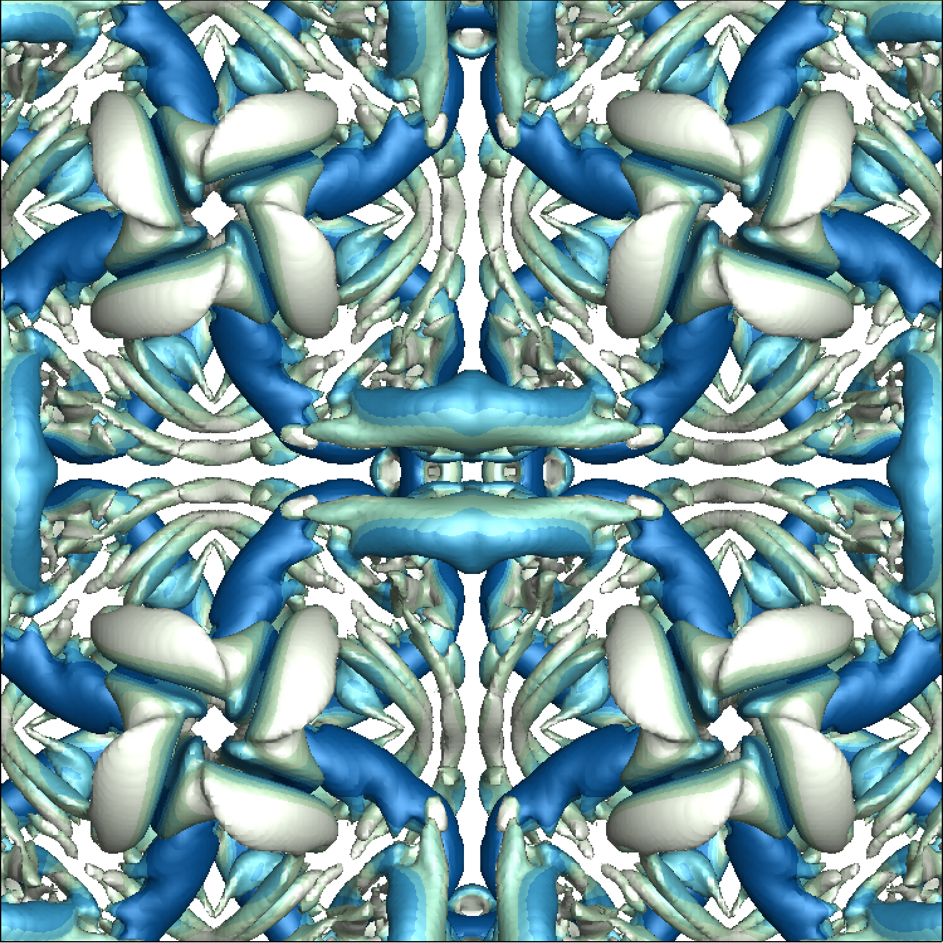

Application of RDGFLO – Rosenbrock-Wanner
Taylor-Green vortex with Rosenbrock-Wanner method
ROW methods require
27% CPU time less that ESDIRK3.
Schemes | dt | Time steps | CPU time
ESDIRK3 | 0.08 | 2500 | 369256.0
ROSI2PW | 0.04 | 5000 | 269021.2
ROS34PRW | 0.04 | 5000 | 255536.2

Slide 37
Application of RDGFLO – Turbulence model
Sparlart –Allmaras turbulence model for DG (Burgess and Mavriplis)
The variable is designed to remain positive regardless of the value of and is given by
The effect of the modification is to deactivate the production, destruction and diffusion terms of the turbulence model equation when becomes negative.

Slide 38
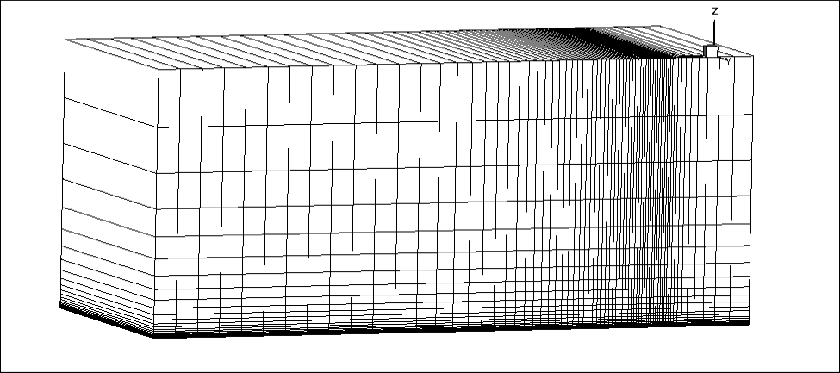
Application of RDGFLO – Turbulence model
Test case I.Flat plate with Ma=0.2, Re=500,000, T=300K
The wall-normal spacing: 1.0X10⁻⁶
Hexamesh:nelem=13,056 ,npoin=26,578 .
The dimensionless velocity profile
in the boundary layer

Slide 39
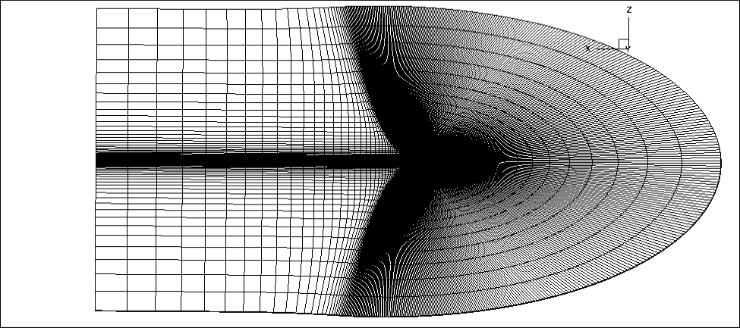
Application of RDGFLO – Turbulence model
Test case II.NACA0012 with Ma=0.15, Re=600,000, T=300K,AoA=10°
DG (P1)
 | C_{l} | C_{d}
Medium | 1.0742676 | 0.01417780
Fine | 1.0848066 | 0.01270036
rDG (P1P2)
 | C_{l} | C_{d}
Medium | 1.0901676 | 0.01222621
Fine | 1.0884246 | 0.01236461
The wall-normal spacing : 1.0X10⁻⁶
Mesh: Hexahedral
Medium mesh: nelem=14,366 npoin=29,152
Fine mesh : nelem=57,344 npoin=115,648
Ref. solution: C_{l} = 1.0891-1.10,
C_{d} = 0.01225-0.01245 .

Slide 40
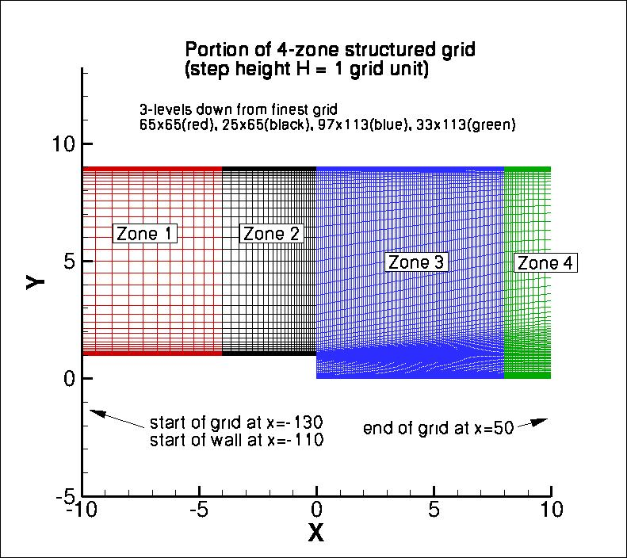
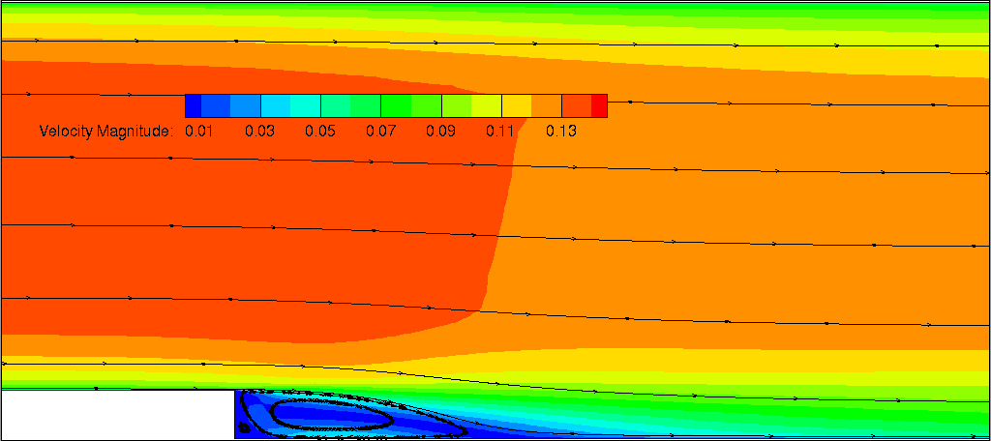
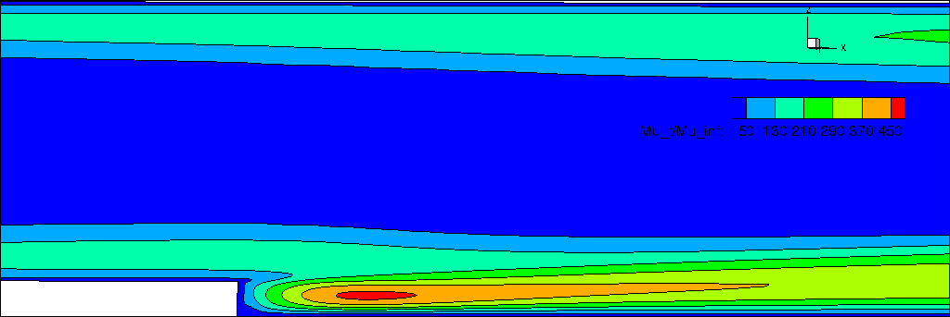
Application of RDGFLO – Turbulence model
Test case III.Backward Facing Step with Ma=0.128, Re=36,000,T=300K.
Reattachment location
 | DG(P1) | rDG(P1P2)
Xr | 6.05 | 6.08
The wall-normal spacing : 5.95 X 10⁻⁴ ,
Mesh: Hexahedral

Slide 41
Concluding Remarks
AFOSR BRI – Co-Design of Hardware/Software for Predicting UAV Aerodynamics
Development of RDGFLO
p-Multigrid reconstructed DG method on GPU platform (For viscous ) An average speed-up factor up to 3.3x can be achieved using pMG-DG(P1) An average speed-up factor up to 5.3x can be achieved using pMG-rDG(P1P2) An implicit reconstructed discontinuous Galerkin method on GPU cluster Port R.H.S on GPU platform Port L.H.S on GPU platform Port Jacobi on GPU platform Explicit Periodic Boundary Condition on GPU platform An average speed-up factor up to 13.93x can be achieved using rDG(P1P2) Multiple-GPU computing carries out high parallel efficiency accurate solver for unsteady flow problems
Application of RDGFLO
Taylor-Green vortex (DNS) with Rosenbrock-Wanner method Validating the accuracy and efficiency of Rosenbrock-Wanner method Implementation of one equation turbulence model in rDG code

Slide 42
Future Work
AFOSR BRI – Co-Design of Hardware/Software for Predicting UAV Aerodynamics
Development of RDGFLO
p-Multigrid reconstructed discontinuous Galerkin method on GPU platform Renumbering algorithm to avoid memory contention issue for LU-SGS Implicit Rosenbrock method on GPU platform Porting to GPU platform using OpenACC derivatives Fully implicit reconstructed discontinuous Galerkin method on GPU platform Extend the implicit solver onto higher order method to make the fully implicit rDG solver working on GPU platform Attempt to avoid local array issue for GMRES solver
Application of RDGFLO
Direct Numerical Simulation for Taylor-Green Vortex problem Extend the current work onto Multi-GPU platform via MPI data transfer to handle finer mesh or problem of larger scale. Turbulent model Port the current explicit turbulent model to GPU platform

