Slide 1
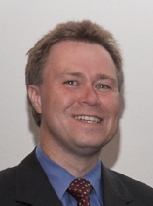
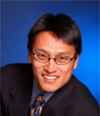
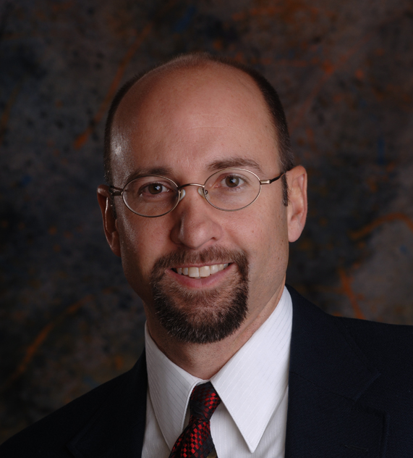
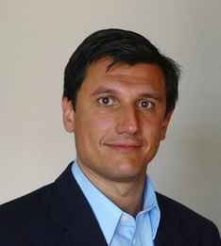
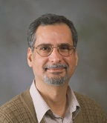

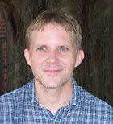
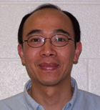
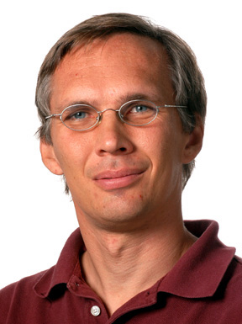

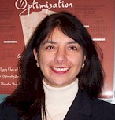

Synergistic Co-Design of Hardware and Software for Structured and Unstructured Grid Computations
E. de Sturler, W. Feng (PI), C. Roy, A. Sandu, D. Tafti
J. Edwards, H. Luo, F. Mueller
Air Force Office of Scientific Research (AFOSR) Basic Research Initiative
Transformational Computing via Co-Design of High-Performance Algorithms & HW Computational Mathematics Program via Grant No. FA9550-12-1-0442 Program Manager: Fariba Fahroo
Notes:
Thank you for the opportunity to present our AFOSR BRI. Thank you to Fariba Fahroo for funding this AFOSR Basic Research Initiative.
Second-year project … about 20 months in …

Slide 2
Vision
N-body
Algorithms
Software
216x
4x
Synergistic co-design process for the
structured/unstructured grid motifs (or dwarfs)
in computational fluid dynamics (CFD)
to support aerodynamic predictions for
micro-air vehicles (MAVs).
  Malleable and maintainable algorithms
  … that can be mapped and optimized in software
  … onto the right type of processing core in hardware
  … at the right time
  … to deliver multiplicative speed-up that would not have possible by Moore’s Law alone (e.g., 88x → 371x, as noted above)
  Co-design feedback to vendors to guide future hardware design
  Enabling of domain scientists and engineers to focus on their science and engineering rather than the computer science and engineering
371x
88x
Hardware
Theoretical 1600x
Notes:
Synergistic co-design process for the n-body computational motif and adapt and apply it to the structured/unstructured grid motifs found in computational fluid dynamics (CFD) in support of aerodynamic predictions for micro air vehicles (MAVs).
Synergistic co-design process for the structured/unstructured grid motifs found in computational fluid dynamics (CFD) to support aerodynamic predictions for micro-air vehicles (MAVs).
Creation of malleable algorithms that can be mapped and optimized onto the right type of processing core at the right time,
Delivery of an order of magnitude better performance than would have otherwise been possible by Moore’s Law alone.
engaged hardware vendors, notably AMD and Supermicro, to support our effort.
Assists in guiding their future hardware design
While Moore’s Law theoretically doubles processor performance every 24 months, much of the realizable performance remains untapped because the burden falls to the (less informed) domain scientist or engineer to exploit parallel hardware for performance gains. Even when such untapped hardware potential is fully realized, it is often not coupled with advances in algorithmic innovation, which can deliver further (multiplicative) speed-up beyond Moore’s Law, as noted in the AFOSR BAA. For example, in a heterogeneous system containing a CPU and GPU, a straightforward 1600-core GPU parallelization of a CPU-based n-body code for molecular modeling resulted in only an 88.4-fold speed-up over a serial, but SSE-vectorized, CPU code. An additional 4.2-fold was extracted when applying architecture-aware GPU optimizations, resulting in a 371-fold speed-up [35]. By also leveraging algorithmic innovation via a hierarchical charge partitioning algorithm [5], we delivered an additional 216-fold speed-up, resulting in a multiplicative speed-up of 80,000-fold [45].

Slide 3
Why Synergistic Co-Design?
Exascale is coming … why worry?
System Attributes | 2010 | “2015” |  | “2020”
System peak | 2 Petaflops | 200-300 Petaflops |  | 1 Exaflop = 1000 Petaflops
Power | 6 MW | 15 MW |  | 20-30 MW
System memory | 0.3 PB | 5 PB |  | 32-64 PB
Node performance | 125 GF | 0.5 TF | 7 TF | 1 TF | 10 TF
Node memory BW | 25 GB/s | 0.1 TB/sec | 1 TB/sec | 0.4 TB/sec | 4 TB/sec
Node concurrency | 12 | O(100) | O(1,000) | O(1,000) | O(10,000)
System size (nodes) | 18,700 | 50,000 | 5,000 | 1,000,000 | 100,000
Total Node Interconnect BW | 1.5 GB/s | 20 GB/sec |  | 200 GB/sec
MTTI | days | O(1day) |  | O(1 day)
Source: Kathy Yelick (Lawrence Berkeley National Laboratory)
Notes:
Tianhe-2: ~35 petaflops sustained. ~55 petaflops peak.
Moore’s Law will get us to exascale performance?!

Slide 4
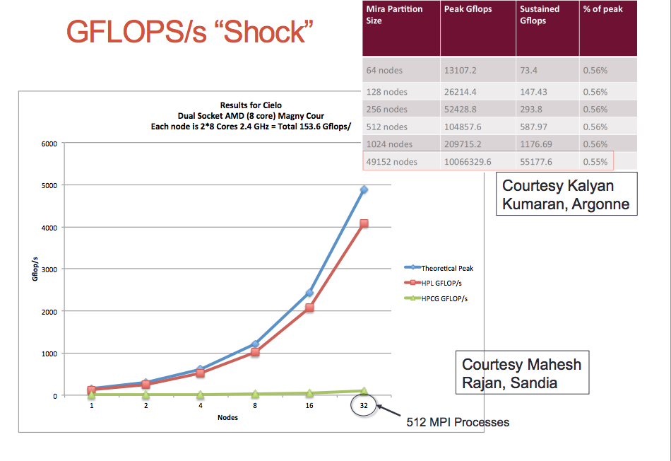
GFLOPS “Shock”
Notes:
The table on the previous slide charts progress with respect to the BLUE line.
(Hardware advances to exascale track with the blue line.)
HPL (High-Performance LINPACK) performs O(n3) floating-point operations and moves O(n2) data.
When HPL gained prominence as a performance metric in the early 1990s there was a strong correlation between its predictions of system rankings and the ranking that full-scale applications would realize. NOT TRUE ANYMORE.
HPCG: SpMV; Sparse Triange; Dot products; Gauss-seidel smoother, multigrid preconditioners
Cielo @ LANL: 1-PF supercomputer consisting of 142,272 CPU cores
Mira BlueGene/Q @ ANL: 10-PF supercomputer consisting of 786,432 CPU cores

Slide 5
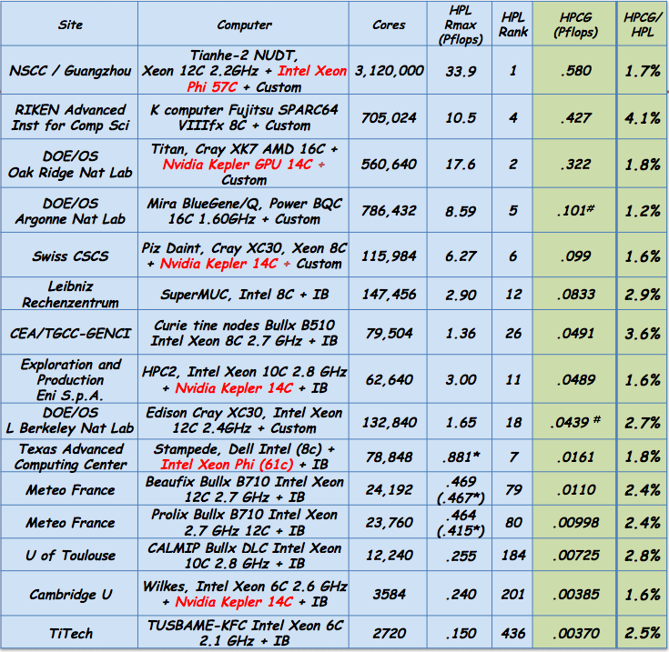
HPCG / HPL for TOP500 Supercomputers
Source: Jack Dongarra, Oak Ridge and http://tiny.cc/hpcg
Notes:
HPL
HPCG
Currently building petaflop systems for teraflop performance

Slide 6
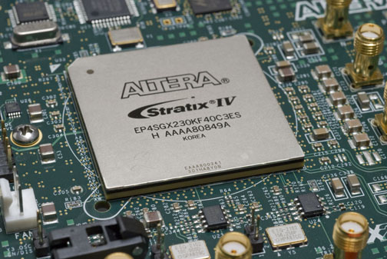
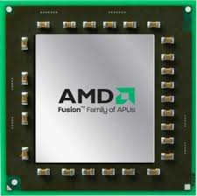
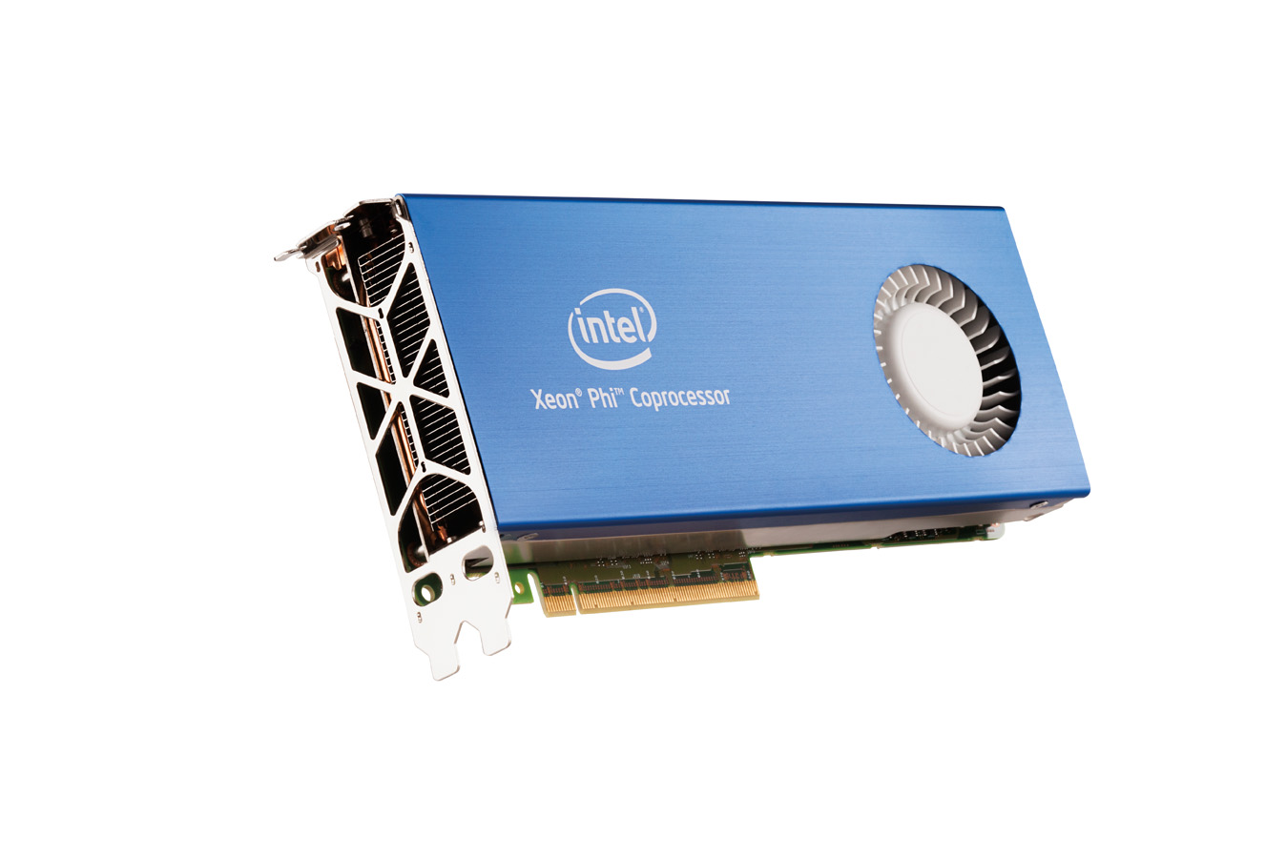
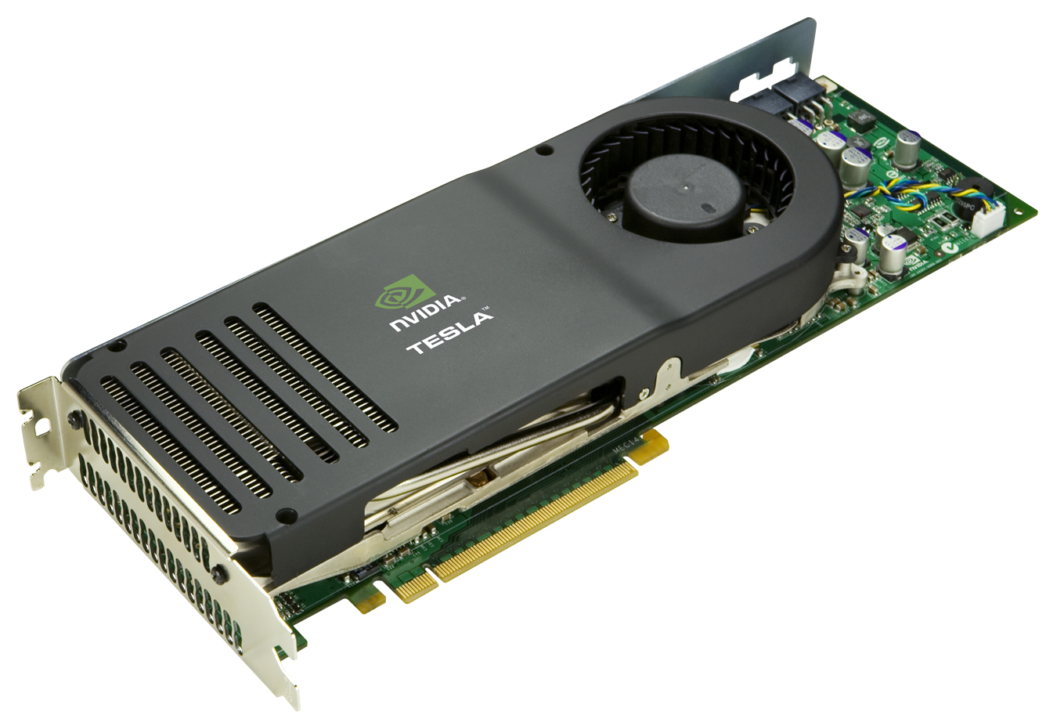
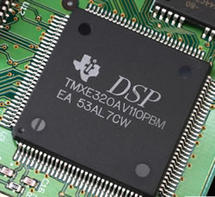


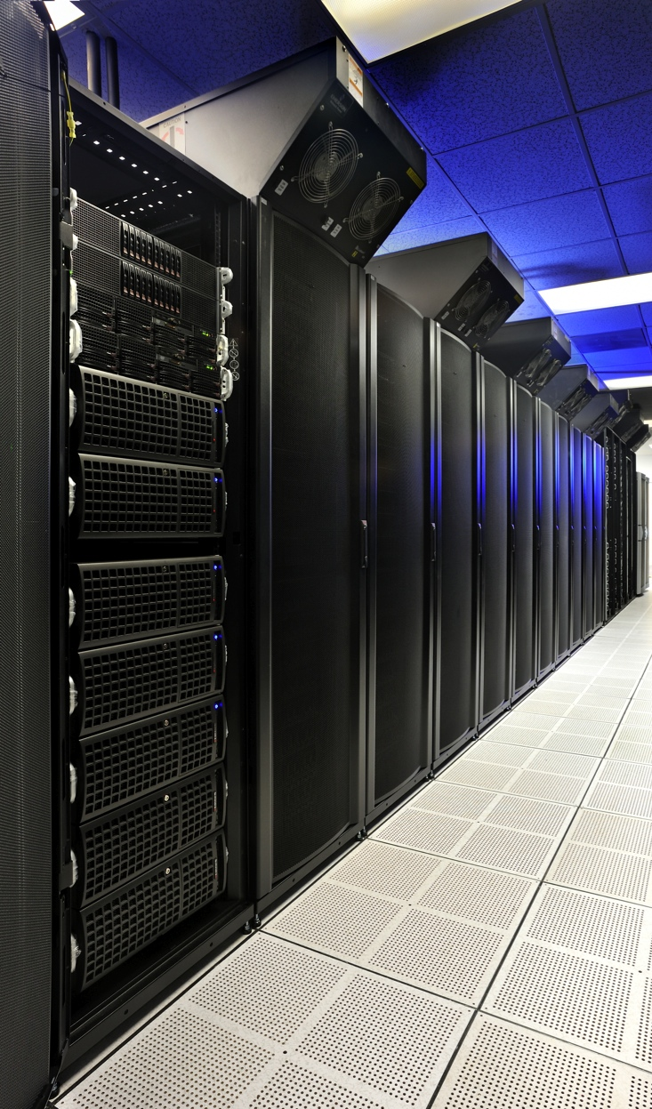
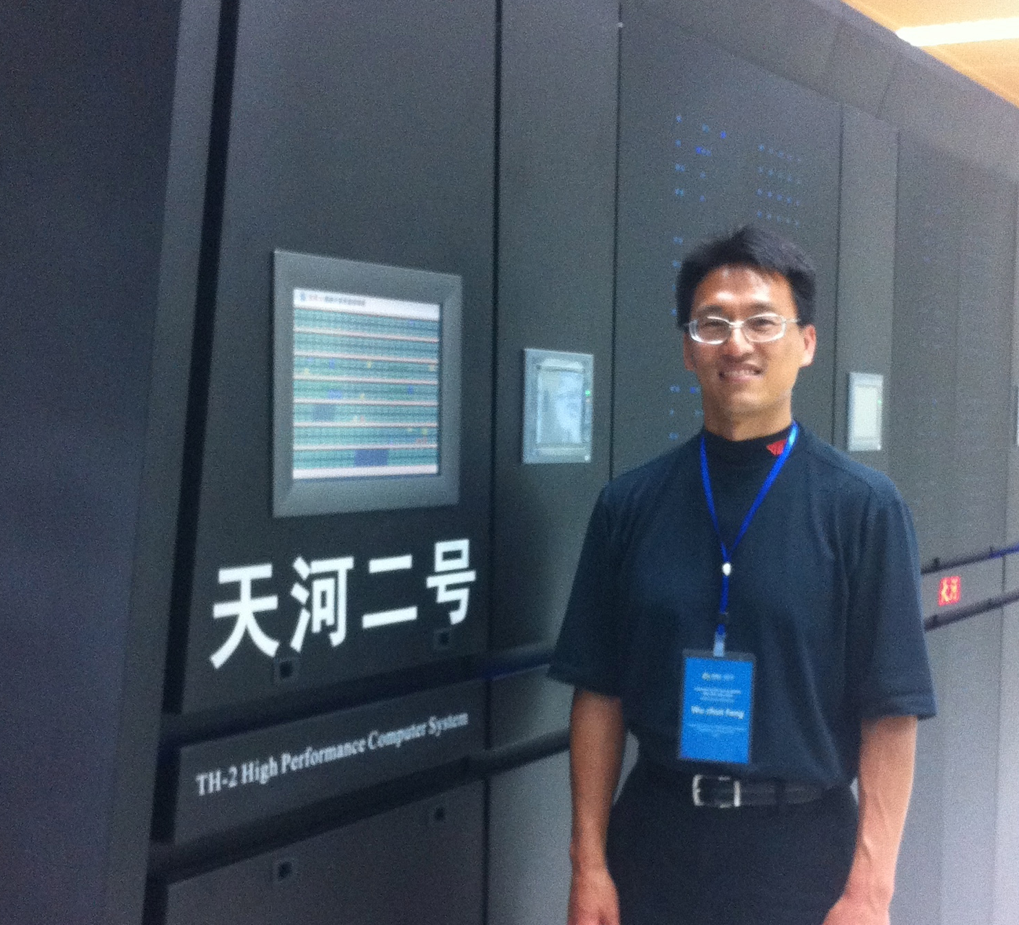
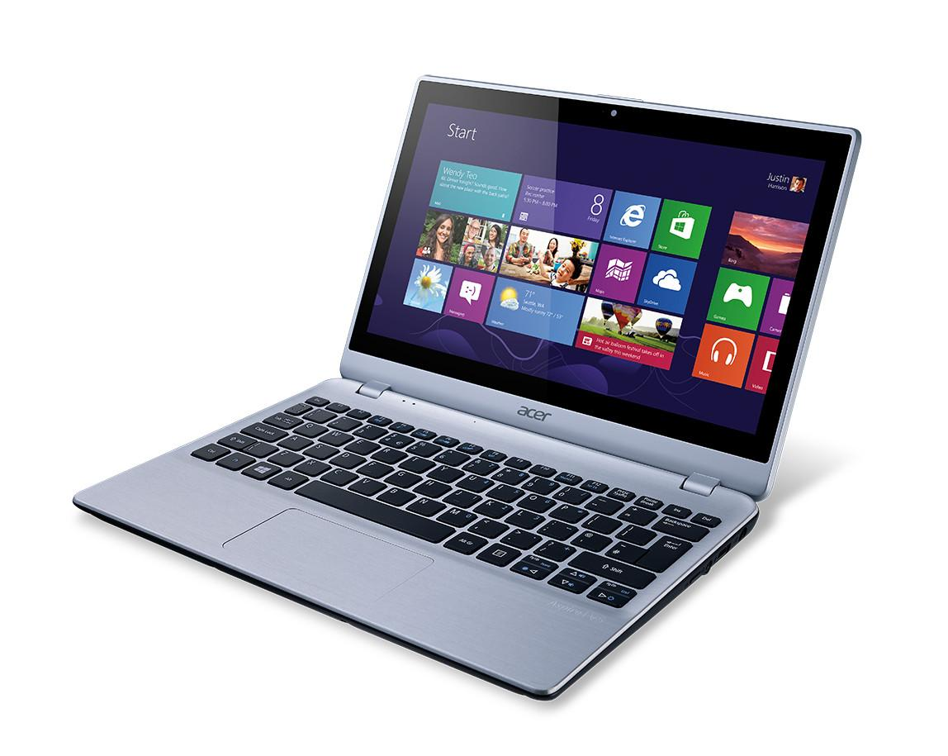
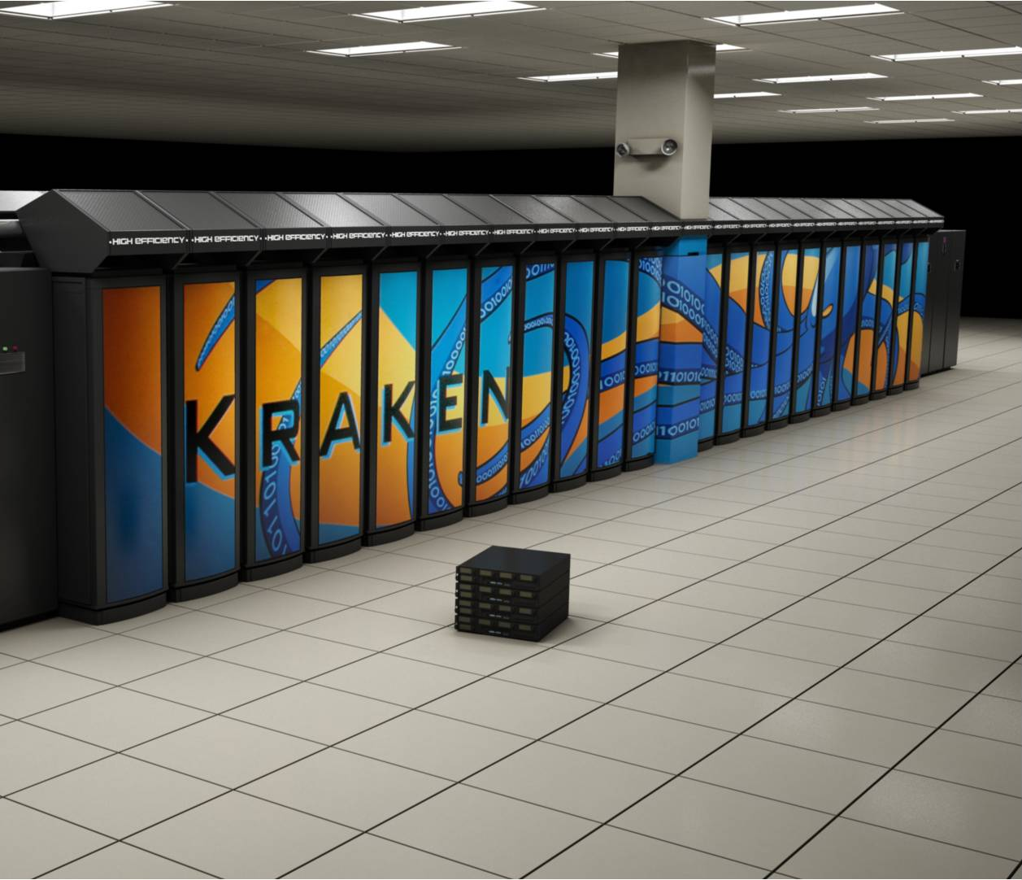

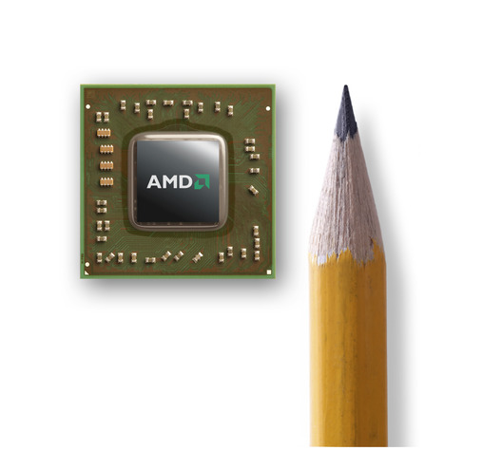
The Context for Synergistic Co-Design
Massive parallelism w/ increasing heterogeneity in computing resources
… across a wide variety of environments
Altera FPGA
AMD APU
Intel Xeon Phi (MIC)
NVIDIA GPU
TI DSP
  Performance via Parallelism
  2,508 CPU cores
  187,264 GPU cores
  ~ 6,000,000 threads
Tianhe-2
  Debuted on
  as GREENEST commodity supercomputer in U.S. (11/11)
Notes:
HokieSpeed: CPU+GPU heterogeneous supercomputer with large-scale visualization wall
HokieSpeed Viz Wall (Eight 46” 3D HDTVs)
2,508 CPU cores → 5,016 CPU threads
187,264 GPU cores → 5,992,448 GPU threads
Total: Nearly 6,000,000 threads
Green500: Consumer Reports ranking of the most energy-efficient supercomputers in the world, where
POWER is a first-order design constraint on par with PERFORMANCE
All 10 of the top 10 employ NVIDIA k20 series GPUs. Number 11? AMD FirePro GPUs.

Slide 7
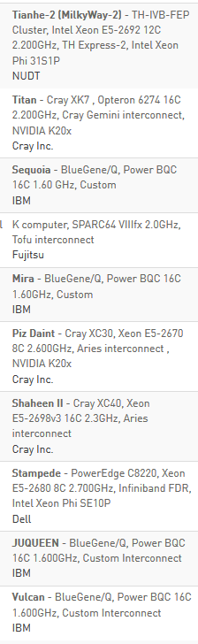
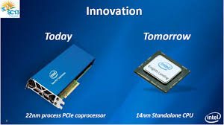
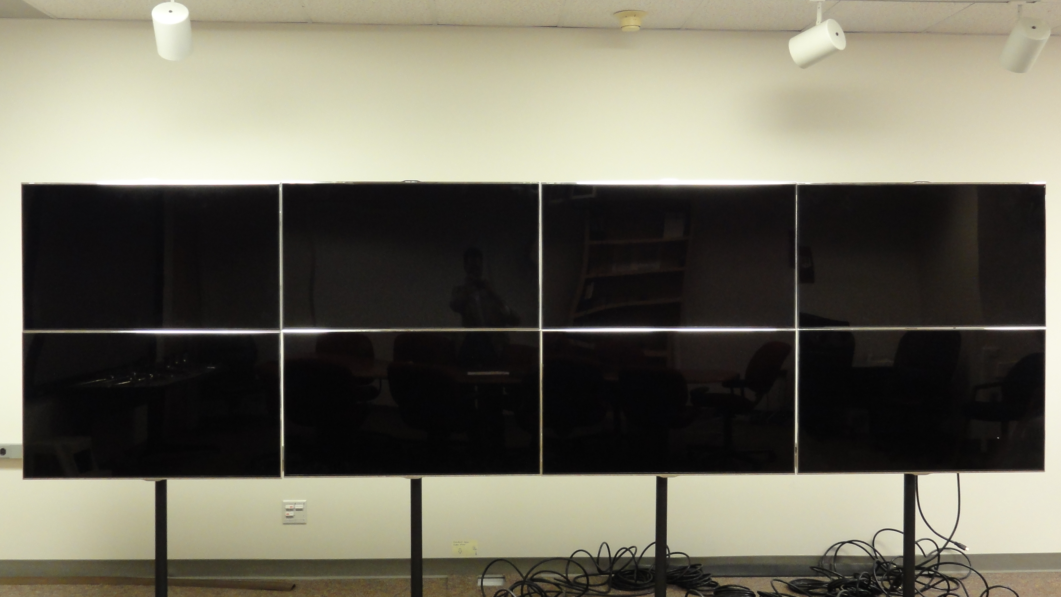
Heterogeneous Systems in HPC
Source:
top500.org
Top 10
Statistics
  Four of the top 10 systems
  Performance share in Top500 systems
  5% (2009) → 35% (2014)
HokieSpeed
  CPU+GPU heterogeneous supercomputer
  with large-scale visualization wall
  Debuted as the GREENEST
  commodity supercomputer
  in the U.S. in Nov. 2011
Tianhe-2
HokieSpeed Viz Wall
(Eight 46” 3D HDTVs)

Slide 8
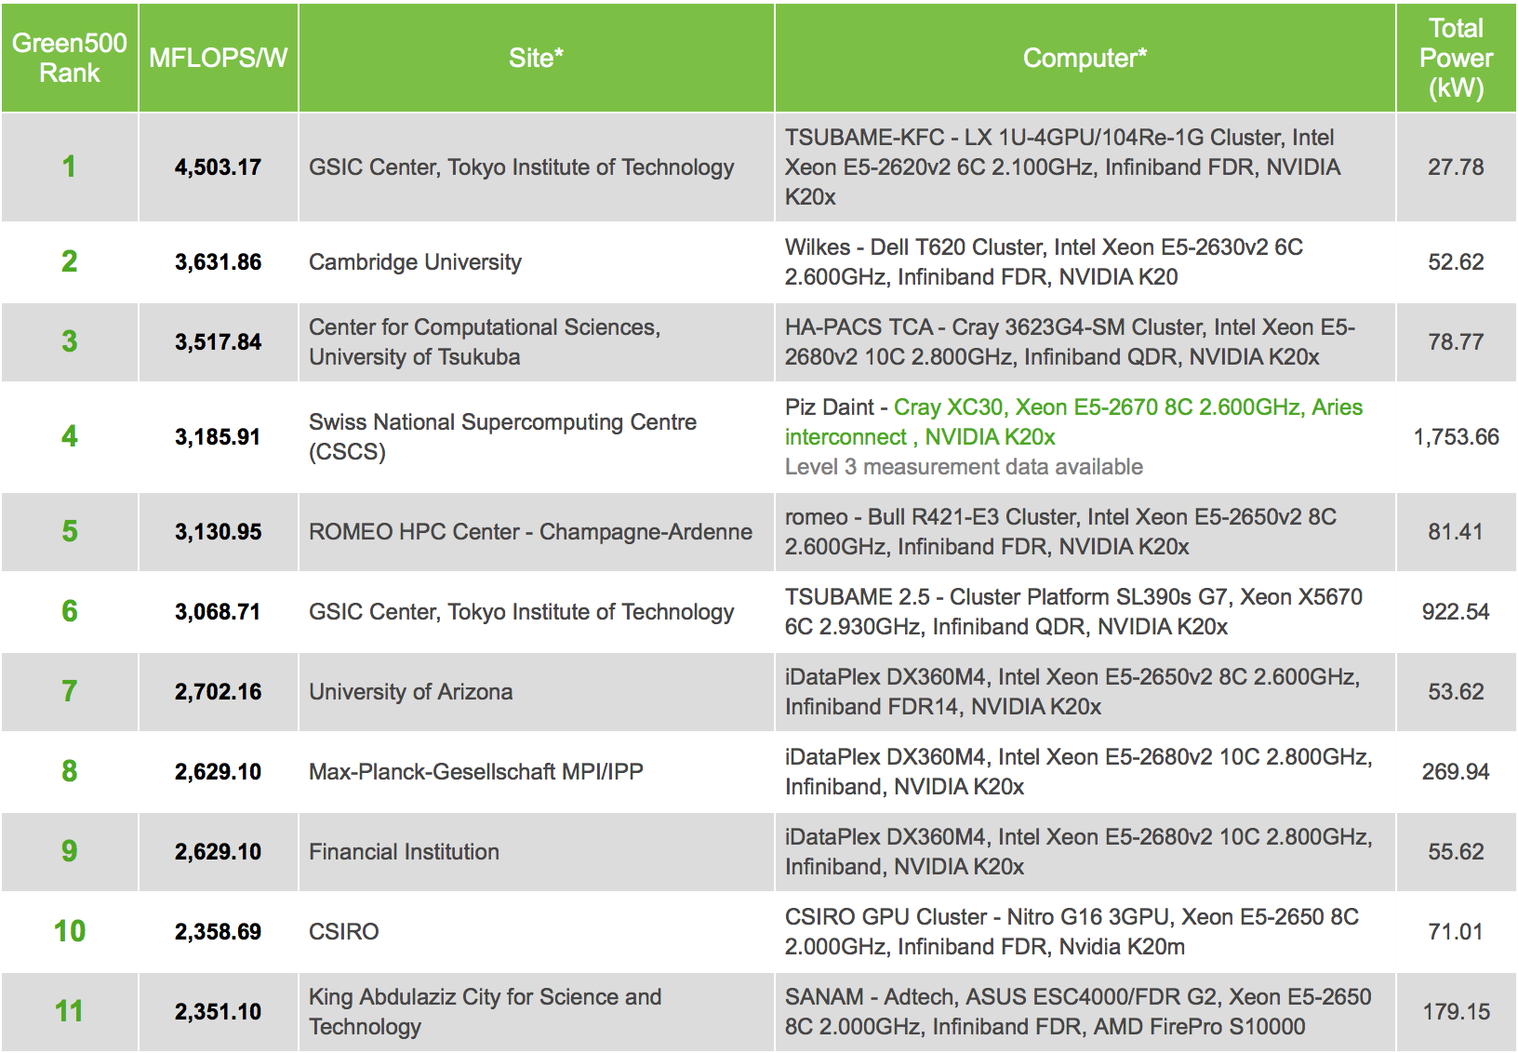
Heterogeneous Systems in HPC
Top 15 systems on are all GPU-accelerated.
Notes:
All 10 of the top 10 employ NVIDIA k20 series GPUs. Number 11? AMD FirePro GPUs.

Slide 9
Roadmap
N-body
Algorithms
Software
216x
4x
Vision
Motivation
Approach: Synergistic Co-Design
Artifacts
  Optimized CFD Codes
  CoreTSAR / AffinityTSAR
  MetaMorph
  MPI-ACC
  VOCL: Virtual OpenCL
Achievements & Publications
Next Steps
88x
Hardware
Formalize for CFD
(structured & unstructured grid)
Algorithms
Software
Generalize, as presented at a
White House BIGDATA Event
in May 2013
Hardware
Notes:
Generalize for other computational and communication patterns, e.g., dynamic programming, graph traversal, sparse linear algebra.

Slide 10
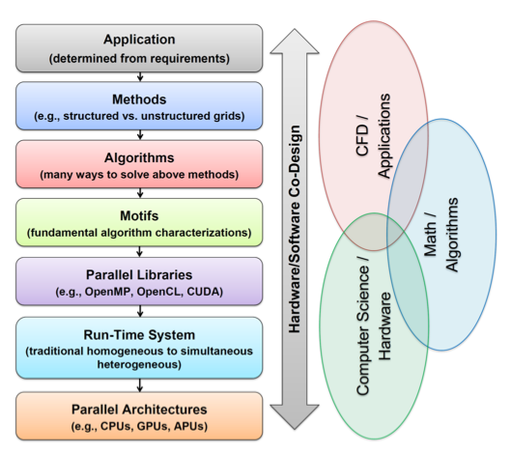
Co-Design & Associated Research Areas
N-body
Algorithms
Software
216x
4x
88x
Hardware
Performance
Performance
Programmability
Portability
Hardware always evolving.
Application software should NOT have to change.
Co-designed hardware/software ecosystem should automatically adapt to new hardware
Notes:
Via an ad-hoc co-design process, we achieved an 80,000-fold multiplicative speed-up on a n-body molecular modeling code [45], of which 216-fold resulted from algorithmic innovation [5], more than four-fold from targeted hardware/software co-design [35], and 88-fold from basic parallelism, as related to Moore’s Law.
Adapt and apply it to the structured/unstructured grid computational motifs found in computational fluid dynamics (CFD) in support of aerodynamic predictions for micro air vehicles (MAVs). Together, the result will be a synergistic hardware/software co-design approach that creates malleable algorithms that can be mapped and optimized onto the right type of processing core at the right time, and in turn, deliver an order of magnitude (or more) better performance than would have otherwise been possible by Moore’s Law alone.
1. Develop CFD algorithms and supporting hardware for micro air vehicle (MAV) simulation that achieve substantial speed-up over current simulations and provides significantly better hardware utilization. …
… allowing large eddy simulation (LES) calculations on 100-million element meshes to become routine.
… but challenges in mapping such codes to heterogeneous environments (CPU, GPU, APU, MIC).
2. Choose (wrt performance) between methods and algorithms that are co-designed with underlying systems software (e.g., parallel libraries like Trilinos) and hardware (e.g., GPU, APU)
… in turn, mapping onto hardware should optimally support algorithmic requirements of MAV simulation.
… example: simulation that requires the solution of the unsteady Reynolds-Averaged Navier Stokes equations (RANS) using the pressure-projection approach, where there is the choice between structure and structured finite-element meshes and explicit or implicit time steps, which is shown on the next slide.

Slide 11
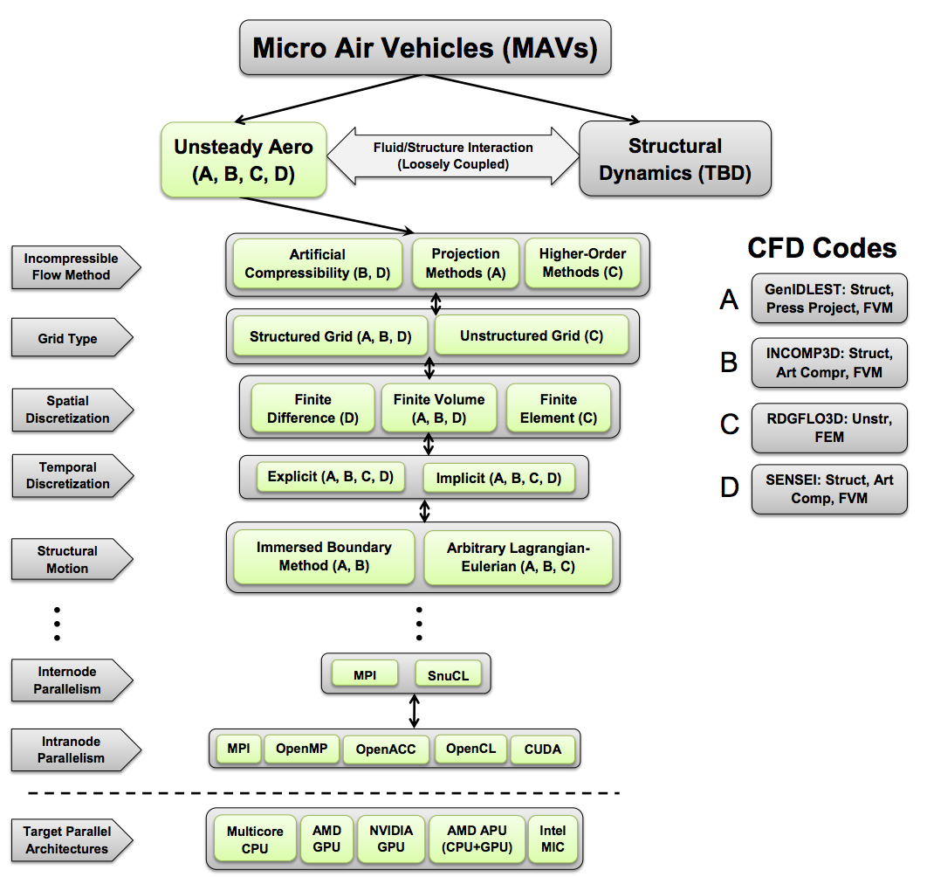
Synergistic Co-Design from 10,000 Feet:
Performance Perspective

Slide 12

It’s More than Co-Design for Performance …
“Productivity = Performance + Programmability + Portability”
Programmability and Portability? Who Cares?
  Five years from now, you will NOT know what hardware will look like.
    Re-write software if code is not portable.
  Case Study: Quantum Chemistry @ Stanford (~1,000,000 CUDA SLOC)*
    What has Stanford been doing to get their code to run on other platforms?
Performance in the Context of Programmability and Portability
  Hardware/Software Co-Design (No Change in Algorithm)
    Automated optimization (-O3) → advanced manual optimization → advanced automated optimization
  Integrated Hardware/Software/Algorithm Co-Design
    Manual co-design → automated co-design
* CU2CL: Automated CUDA-to-OpenCL Source-to-Source Translator could auto-translate the ~ 1,000,000 CUDA source lines of code (SLOC), which is part of our synergistic co-design ecosystem, but it only addresses functional portability for now.
Notes:
Hardware: Unified and cache-coherent memory for CPUs and GPUs

Slide 13
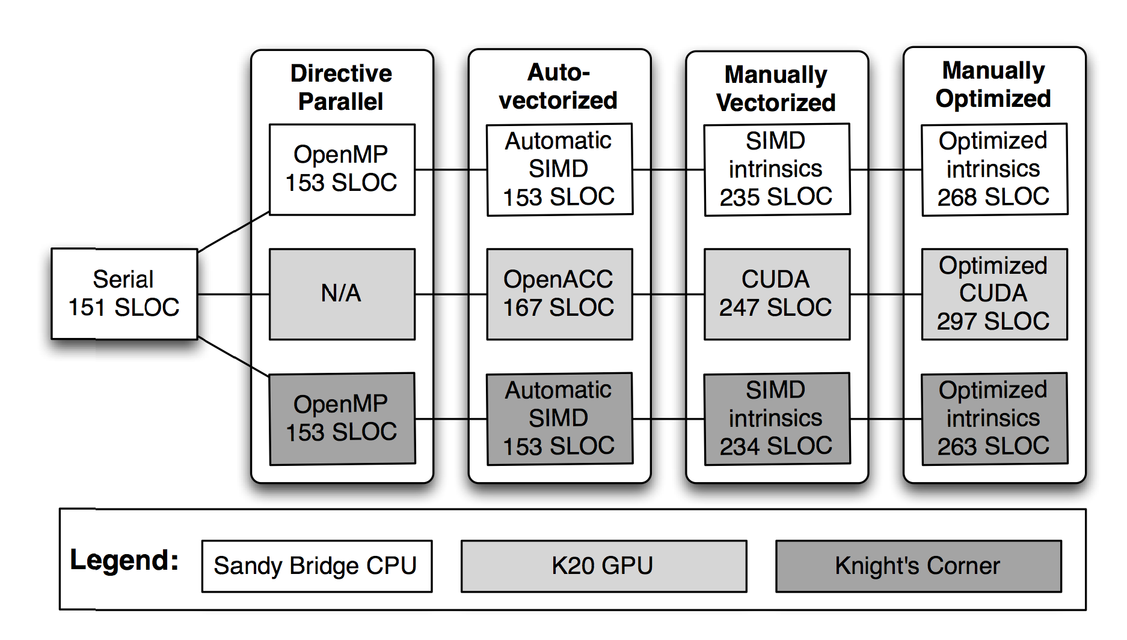
“Productivity = Performance + Programmability + Portability”
Least performance
Most performance
Most programmable
Most portable
Least programmable
Least portable
20x
175x
183x
N-body
problem
1x
160x
1,021x
12x
252x
885x
Applying a similar approach to “Lid-Driven Cavity” and “MetaMorph”
Notes:
DEFINE THE FIGURE!
Sandy Bridge CPU: Dual oct-core with multithreading (32). K20 GPU: XXXXX. KNC: 61 cores XXXX.
Legend: The different platforms, including NVIDIA Kepler K20 GPU and Intel MIC Knight’s Corner
Automatic software optimization → manual software optimization → (later) advanced automatic optimization.

Slide 14

“Productivity = Performance + Programmability + Portability”
Least performance
Most performance
Most programmable
Most portable
Least programmable
Least portable
20x
175x
183x
N-body
problem
1x
160x
automate
1,021x
12x
252x
885x
Recall: Stanford has ~ 1,000,000 CUDA SLOC that they need to translate to OpenACC/OpenMP or OpenCL
Notes:
DEFINE THE FIGURE!
Sandy Bridge CPU: Dual oct-core with multithreading (32). K20 GPU: XXXXX. KNC: 61 cores XXXX.
Legend: The different platforms, including NVIDIA Kepler K20 GPU and Intel MIC Knight’s Corner
Automatic software optimization → manual software optimization → (later) advanced automatic optimization.

Slide 15
Roadmap
Algorithms
Software
Vision
Motivation
Approach:
Synergistic Co-Design
Artifacts
  Optimized CFD Codes
  CoreTSAR / AffinityTSAR
  MetaMorph
  MPI-ACC
  VOCL: Virtual OpenCL
Achievements & Publications
Next Steps
Hardware
HokieSpeed Viz Wall
(Eight 46” 3D HDTVs)

Slide 16
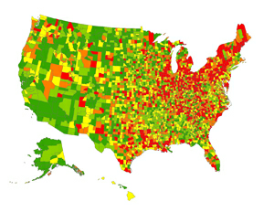

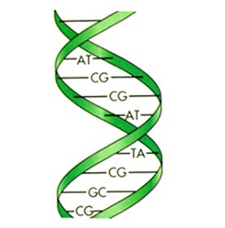
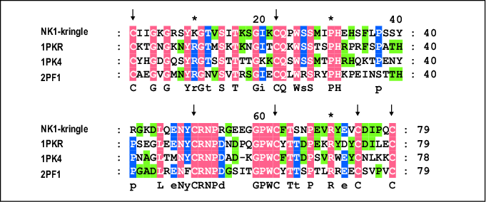
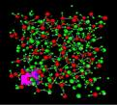
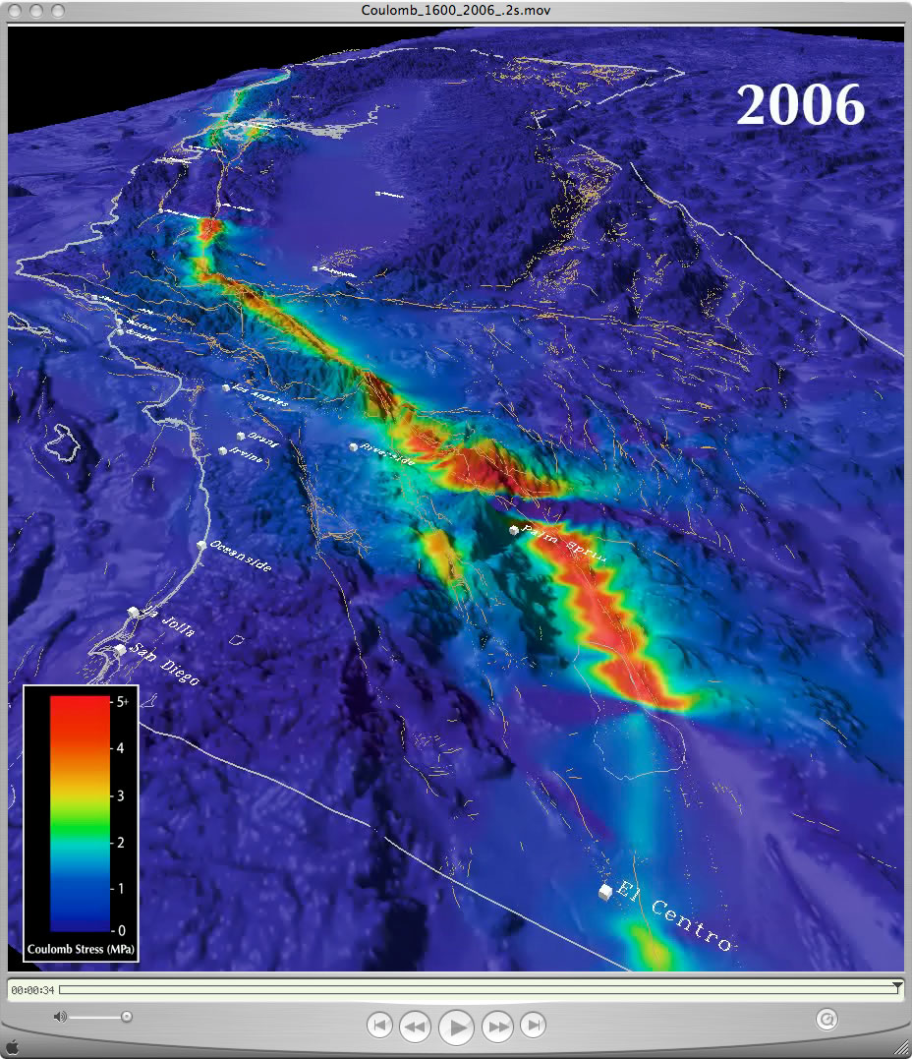
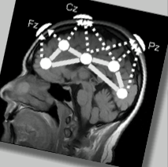

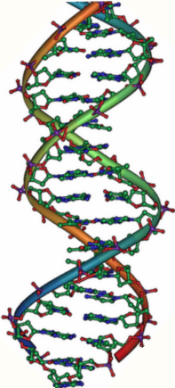
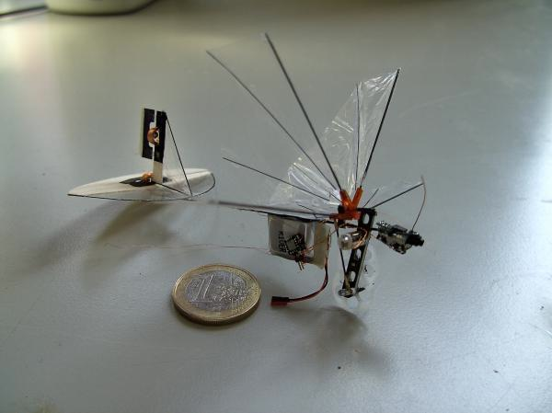

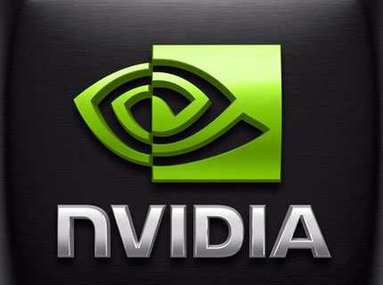


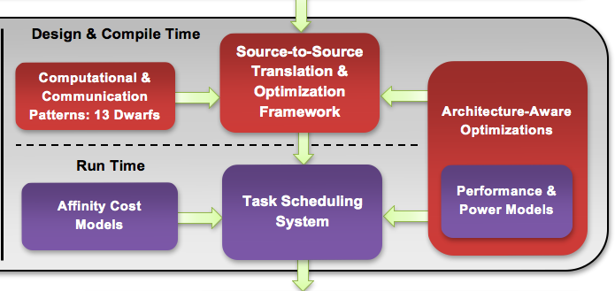
Ecosystem for Heterogeneous Parallel Computing
Intra-Node
MANUAL CO-DESIGN
Epidemiology
Sequence
Alignment
Molecular
Dynamics
Earthquake
Modeling
Neuro-
informatics
Cybersecurity
MAVs
Manual
Co-Design
→
Automated
Co-Design
Heterogeneous Parallel Computing Platform
Notes:
PROPOSED Software Ecosystem (originally OpenCL-oriented → OpenMP-oriented for ease of transition of CFD codes to heterogeneous environments):
A software ecosystem that we are planning to build for our material scientists, physicists, chemists, geologists, and in-situ visualization scientists at Virginia Tech, many with heavy investment in CUDA code that they want to be able to run on a potpourri of heterogeneous parallel computing (HPC) platforms, e.g.,
Integrated CPU+GPU systems, e.g., AMD Fusion and NVIDIA ION/ION2 chipsets
Desktop CPU+discrete GPU system, e.g., AMD/Intel x86 CPU + consumer AMD/NVIDIA GPU (Radeon HD 5870 or GTX 480/580)
Server/Cluster CPU+discrete GPU system, e.g., HokieSpeed, which is currently being installed at VT

Slide 17
Targeted CFD Codes
SENSEI (C. Roy, Virginia Tech)
  Structured, multiblock, 2nd order, finite-volume code
  Artificial compressibility method
  2nd-order spatial accuracy
  Artificial compressibility (AC)
GenIDLEST (D. Tafti, Virginia Tech)
  Structured, multiblock, 2nd order, finite-volume code
  Pressure projection method
  Arbitrary Lagrangian/Eulerian (ALE) and immersed boundary methods (IBM)
RDGFLO (H. Luo, NCSU)
  Unstructured, discontinuous Galerkin (DG) method
  High-order solution of compressible flows
  ALE
INCOMP3D (J. Edwards, NCSU)
  Structured, multiblock finite-volume code
  Second or higher order spatial accuracy
  ALE and IBM
Testbed Codes
Lid-Driven Cavity
SENSEI Lite
Notes:
Though I am merely a CS, I did stay at a Holiday Inn, and therefore must be an CFD expert.
When questioned on whether or not I am a CFD expert, my reply is "No, but I did stay at a Holiday Inn Express," attributing my expertise to my stay there.

Slide 18
Incompressible Navier-Stokes (INS) Finite-Difference Code
Performance: Hardware/Software Co-Design
Recap
  2D Cartesian grid FDM
  Solves INS using artificial compressibility (lid-driven cavity benchmark case)
  Ported from existing Fortran code to run on GPUs using OpenACC + PGI compiler
Recent work focused on performance optimization of OpenACC code and running on multiple GPUs.
Newer versions of PGI compiler (14.x) support more accelerator platforms, including AMD GPUs.
Speedup of INS code on several GPU platforms relative to a single CPU thread (SSE vectorized) running on a Xeon X5560.

Slide 19
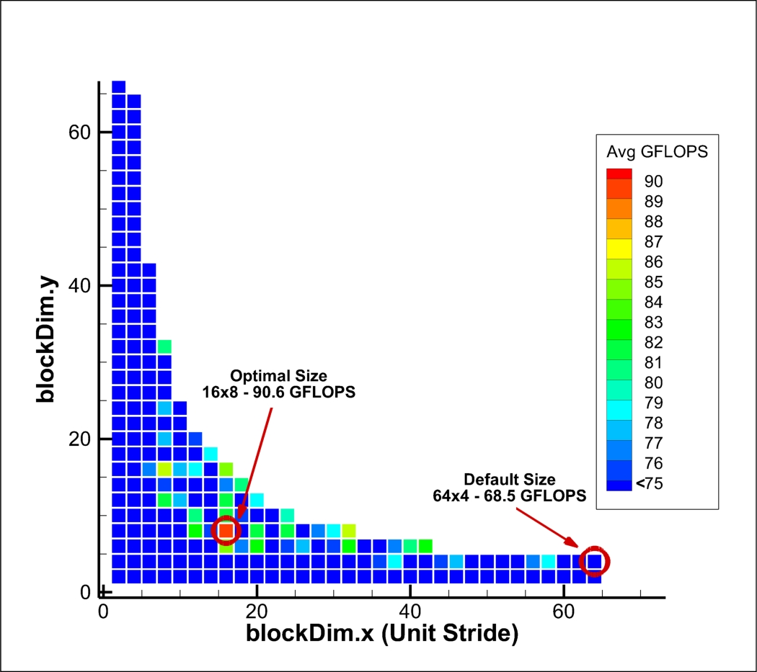
Optimization of OpenACC using Gang/Worker/Vector Clauses
Performance: Hardware/Software Co-Design
Can use OpenACC clauses to control the kernel launch configuration on NVIDIA devices.
Explored entire parameter space of possible 2D thread-block dimensions.
  Tested both Fermi (C2075) and Kepler (K20) GPUs, using double- and single-precision arithmetic.
  On all platforms, the default block size (when no vector clause was used) was observed to be 64x4.
  Manual tuning showed performance increases ranging from 6-33% on the different GPUs. The compiler default was never found to be optimal.
Applying approaches to eliminate “brute force” search → Starchart / Stargazer
Courtesy: Brent Pickering & Chris Roy
Optimization results for K20c GPU using double precision.
Default: 64x4 threads/block → 68.5 GFLOPS
Optimal: 16x8 threads/block → 90.6 GFLOPS
Notes:
Can use OpenACC clauses to control the kernel launch configuration on NVIDIA devices.
For CUDA accelerators, OpenACC vector parameter corresponds to the number of CUDA threads in a block.
Enables application-specific tuning.

Slide 20
Multi-GPU Scaling
Performance: Hardware/Software Co-Design
Near-linear performance scaling using multiple GPUs.
  Domain decomposition, with each domain partition residing on one GPU for duration of simulation (only ghost cells had to be exchanged on each iteration).
  One control CPU thread per GPU.
  PGI 14.1 compiler can generate code for AMD GPUs in addition to NVIDIA.
Two AMD GPUs from AMD Radeon 7990
vs. four NVIDIA C2070 GPUs

Slide 21
LDC: Hand-optimization for AMD/MIC/NVIDIA
Transliteration from F90 to C
  explicit solver ported to CUDA, OpenACC, and OpenCL
CUDA Dynamic Parallelism / Register Optimization
  “relocatable device code” required by DP uses excess registers
  Kernel fission and explicit max register count improve perf. significantly
    excess registers spill to slower local memory / limit active blocks per SM
  Dynamic parallelism potentially useful for in-GPU convergence testing
AMD kernel fission
  Small perf. loss vs. single kernel
StarChart OpenACC Optimization
  A tree-based method for efficiently searching a multi-parameter optimization space – ideal for high-level perf. tuning
  CUDA perf. ~2x better vs. default OpenACC w/ optimal parameter settings
    8x16 threadblock, 3.5 compute capability, CUDA 5.5 runtime, 72 registers

Slide 22
LDC: CUDA C Manual optimization
Runtime tracks with register pressure
Why? – spilling and SM occupancy…
Execution
Time (sec)
Register
Count

Slide 23
LDC: CUDA C Manual optimization
Fixed-size* register file per SM shared between all active threadblocks – overuse limits parallelism!
SM
Occupancy (%)
Register
Count
*32KB/SM on Fermi, 64KB/SM on Kepler

Slide 24
LDC: Work in Progress
ICPADS submission on CUDA Dynamic Parallelism w/ LDC
  alternatively PPoPP or IPDPS
CUDA Memory access optimization
  “restrict” + “const” – no pointer aliasing and some read-only access – preliminary results show ~1.3x speedup over current best

Slide 25
LDC: Future Work
Further improve occupancy? (only 60% currently)
Use dynamic parallelism to move convergence test / iteration loop into GPU?
Explore hand-optimization for AMD GPU and Intel MIC

Slide 26
Targeted CFD Codes
SENSEI (C. Roy, Virginia Tech)
  Structured, multiblock, 2nd order, finite-volume code
  Artificial compressibility method
  2nd-order spatial accuracy
  Artificial compressibility (AC)
GenIDLEST (D. Tafti, Virginia Tech)
  Structured, multiblock, 2nd order, finite-volume code
  Pressure projection method
  Arbitrary Lagrangian/Eulerian (ALE) and immersed boundary methods (IBM)
RDGFLO (H. Luo, NCSU)
  Unstructured, discontinuous Galerkin (DG) method
  High-order solution of compressible flows
  ALE
INCOMP3D (J. Edwards, NCSU)
  Structured, multiblock finite-volume code
  Second or higher order spatial accuracy
  ALE and IBM
Testbed Codes
Lid-Driven Cavity
SENSEI Lite
Status of these codes relative to co-design?
Notes:
Though I am merely a CS, I did stay at a Holiday Inn, and therefore must be an CFD expert.
When questioned on whether or not I am a CFD expert, my reply is "No, but I did stay at a Holiday Inn Express," attributing my expertise to my stay there.

Slide 27
GenIDLEST: Manual CUDA Fortran Optimization (2014)
Performance: Hardware/Software Co-Design
1 GPU: Reynolds 180, 64x64x64 grid, 90 iterations
4 GPU: Reynolds 395, 256x64x126 grid, 5 iterations
← Domain Manual →
Scientists Co-Design
Lower is Better!
← Older Newer →
Not all approaches will work well: kernels need enough work to amortize launch(es)
17.98x
5.75x
1.29x
1.32x
Example:
GPU-amenable
memory layout
Example: tree-based in-GPU reduction; more memory changes; sync relaxation
Notes:
Mention “On-Device marshalling” uses 20+ micro kernels for packing and unpacking specific elements of a face of the 3D space, library instead uses a single monolithic kernel to take any sub-slice in parallel

Slide 28
GenIDLEST: OpenACC optimization
Manual optimization
  Merge sum_domain_acc.f and dot_prod_acc.f to single OpenACC region – improves perf 4.5x-12.9x (large/small case, respectively)
  Porting additional kernels from (x/y/z)mom.f and dif_coeff.f
  Exploration of the async() clause to overlap compute/communicate
OpenMP vs. CUDA vs. OpenACC performance comparison
  Small case: 13.3s (CPU 1 proc + 4 OpenMP threads) vs. 5s/2.7x (1 proc + CUDA) vs. 7.5s/1.8x (1 proc + OpenACC)
  Large case: 83.2s (CPU 2 procs + 4 OpenMP threads each) vs. 23s/3.6x (2 procs + CUDA) vs. 49s/1.7x (2 procs + OpenACC)
StarChart - pc_jac_blk_acc.f tuning
  Params: register max, CUDA Runtime, compute capability, L1/s_mem swap
    72 register max, CUDA 5.5, cc35, and 48k L1/ 16k smem
    1.52x/1.58x speedup vs. default in small/large case, respectively

Slide 29
GenIDLEST: StarChart Performance Evaluation
-StarChart helps find
local/global minima
-Register usage is key
perf. determinant

Slide 30
GenIDLEST WIP

Slide 31
GenIDLEST Future Work
Apply OpenACC/StarChart to remaining kernels
  Isolate additional parameters
    Differentiate grid/block per kernel
  Non-orthogonal kernels

Slide 32
GenIDLEST: GPU Dot-Product Modifications
Performance: Hardware/Software Co-Design
← Domain Manual →
Scientists Co-Design
Lower is Better!
← Older Newer →
Notes:
Mention “On-Device marshalling” uses 20+ micro kernels for packing and unpacking specific elements of a face of the 3D space, library instead uses a single monolithic kernel to take any sub-slice in parallel

Slide 33
Dot Product: Serial on CPU
Programmability and Portability
HOST
DEVICE
Serial C
void dotProd(double *a,
double *b,
double *ret,
int n_elem)
{
int i;
*ret = 0.0;
for (i = 0; i < n_elem; i++)
ret += a[i] * b[i];
}
10

Slide 34
Dot Product: Parallel on GPU Device using CUDA
Programmability and Portability
HOST
DEVICE (GPU)
int main(int argc, char ** argv)
{
int n_elem;
double *a, *b, *ret, sum = 0.0;
//allocate and initialize a, b, and ret
...
double *dev_a, *dev_b, *dev_r;
size_t size = n_elem * sizeof(double);
//allocate device buffers
cudaMalloc((void**)&dev_a, size);
cudaMalloc((void**)&dev_b, size);
cudaMalloc((void**)&dev_r, size);
//initialize device buffers
cudaMemcpy(dev_a, a, size, cudaMemcpyHostToDevice);
cudaMemcpy(dev_b, b, size, cudaMemcpyHostToDevice);
//set grid/block size
...
//multiply elements
dotProd-vmul<<<grid, block>>>(dev_a, dev_b, dev_r,
n_elem);
//partial result
cudaMemcpy(ret, dev_r, size, cudaMemcpyDeviceToHost);
//CPU sum
int i;
for (i = 0; i < n_elem; i++)
sum += ret[i];
}
__global void dotProd-vmul(
double *a, double *b,
double *ret, int n_elem)
{
int i;
int tid = blockIdx.x *
blockDim.x + threadIdx.x;
int n_threads = blockDim.x *
gridDim.x;
for (i=tid; i<n_elem; i+=n_threads)
ret[tid] = a[tid] * b[tid];
}
27
12

Slide 35
Dot Product: Optimized Parallel on GPU Device
Programmability and Portability
int main(int argc, char **argv)
{
//global and block sizes
int ni, nj, nk, tx, ty, tz;
//pick a mode and zeroth device
cudaSetDevice(0)
//declare host memory
double *a, *b, *ret, zero = 0.0;
//allocate and initialize it
…
//Allocate device buffers
size_t size = sizeof(double)*ni*nj*nk;
double *dev_a, *dev_b, *dev_r;
cudaMalloc(&dev_a, size);
cudaMalloc(&dev_b, size);
cudaMalloc(&dev_r, sizeof(double));
//initialize them
cudaMemcpy(dev_a, a, size,
cudaMemcpyHostToDevice);
cudaMemcpy(dev_b, a, size,
cudaMemcpyHostToDevice);
cudaMemcpy(dev_r, &zero, sizeof(double),
cudaMemcpyHostToDevice);
//set computation shape
dim3 grid, block, shape, start, end;
block = dim3(tx, ty, tz);
grid = dim3((ni+tx-1)/ni, (nj+ty-1)/ty, 1);
shape = dim3(ni, nj, nk);
start = dim3(0, 0, 0);
end = dim3(ni-1, nj-1, nk-1);
//run the kernel
dotProd<<<grid, block, tx*ty*tz*sizeof(double)>>>
(dev_a, dev_b, shape.x, shape.y, shape.z,
start.x, start.y, start.z, end.x, end.y, end.z,
(nk+tz-1)/tz, dev_r, tx*ty*tz);
//bring the dot product back
cudaMemcpy (ret, dev_r, sizeof(double),
cudaMemcpyDeviceToHost);
}
__device__ void block_reduction(double *psum,
int tid, int len_)
{
int stride = len_ >> 1;
while (stride > 0) {
if (tid < stride)
psum[tid] += psum[tid+stride];
__syncthreads();
stride >>= 1;
}
}
//Implementation of double atomicAdd
...
__global__ void kernel_dotProd(double *phi1, double *phi2, int i, int j, int k, int sx,
int sy, int sz, int ex, int ey, int ez,
int gz, T * reduction, int len_)
{
extern shared psum[];
int tid, x, y, z, itr;
bool boundx, boundy, boundz;
tid = threadIdx.x + (threadIdx.y) * blockDim.x
+ (threadIdx.z) * (blockDim.x * blockDim.y);
x = (blockIdx.x)*blockDim.x+threadIdx.x+sx;
y = (blockIdx.y)*blockDim.y+threadIdx.y+sy;
psum[tid] = 0;
boundy = ((y >= sy) && (y <= ey));
boundx = ((x >= sx) && (x <= ex));
for (itr = 0; itr < gz; itr++) {
z = itr*blockDim.z+threadIdx.z +sz;
boundz = ((z >= sz) && (z <= ez));
if (boundx && boundy && boundz)
psum[tid] += phi1[x+y*i+z*i*j] *
phi2[x+y*i+z*i*j];
}
__syncthreads();
block_reduction(psum,tid,len_);
__syncthreads();
if(tid == 0)
atomicAdd(reduction,psum[0]);
}
HOST
DEVICE (GPU)
39
40

Slide 36
Dot Product via our MetaMoph Library
Programmability and Portability
int main(int argc, char **argv)
{
//global and block sizes
int ni, nj, nk, tx, ty, tz;
//pick a mode and zeroth device
choose_accel(0, accelModePreferCUDA);
//declare host memory
double *a, *b, *ret, zero = 0.0;
//allocate and initialize it
...
//Allocate device buffers
size_t size = sizeof(double)*ni*nj*nk;
double *dev_a, *dev_b, *dev_r;
accel_alloc(&dev_a, size);
accel_alloc(&dev_b, size);
accel_alloc(&dev_r, sizeof(double));
//initialize them
accel_copy_h2d(dev_a, a, size, true);
accel_copy_h2d(dev_b, a, size, true);
accel_copy_h2d(dev_r, &zero, sizeof(double),
true);
//set computation shape
a_dim3 grid, block, shape, start, end;
block[0] = tx, block[1] = ty, block[2] = tz;
grid[0] = (ni+tx-1)/ni, grid[1] = (nj+ty-1)/ty,
grid[2] = (nk+tz-1)/tz;
shape[0] = ni, shape[1] = nj, shape[2] = nk;
start[0] = 0, start[1] = 0, start[2] = 0;
end[0] = ni-1, end[1] = nj-1, end[2] = nk-1;
//run the kernel
accel_dotProd(&grid, &block, dev_a, dev_b,
&shape, &start, &end, dev_r, a_db, true);
//bring the dot product back
accel_copy_d2h(ret, dev_r, sizeof(double),
false);
}
36
also support: accelModePreferOpenCL
for AMD/MIC/CPU
all kernels/copies can be asynchronous with
flag = true, else blocking
grid & block specify thread organization a la CUDA/OpenCL
shape, start, and end allow dot product on arbitrary subregions of 3D space
Targeting one device at a time at present.
Notes:
Transparent execution on any CUDA/OpenCL compatible device without recompiling library or user application
Selected mode and device can be set per-run via environment variables
Optional automatic timing plugin for every kernel and host/device data transfer, with variable verbosity
Extensible to other domains and accelerator models
(just add new domain kernels, framework remains essentially the same)
Can be extended to include runtime scheduler behind the scenes
i.e. “accelModePreferAffinityTSAR”
New backends relatively easy to add to extensible switch, struct, and enum constructs at top-level

Slide 37
Automated Task Scheduling (with CoreTSAR)
Performance: Hardware/Software Co-Design
Automatically dividing parallel tasks across arbitrary heterogeneous compute resources simultaneously for functional portability
  CPUs, GPUs, APUs, Co-processors, FPGAs, …
Intelligent runtime task scheduling for performance portability
  Accelerators add physical heterogeneity and distributed memory
    GPUs, FPGAs, Co-processors (Intel MIC, Tilera Tile64, etc.)
  System topology adds heterogeneity through locality imbalance
    Hierarchical partially-shared caches
    Non-uniform memory access (NUMA) memory systems
    Operating system imbalance, work unevenly distributed to cores
    Non-uniform latency to peripheral devices

Slide 38
OpenMP Accelerator Behavior
Programmability and Portability
#pragma omp acc_region …
#pragma omp parallel …
Kernels
Original/Master thread
Worker threads
Parallel region
Accelerated region
Notes:
Now, what happens when we introduce an accelerator into the mix, the behavior really does not change, the master thread starts a large team of threads on the accelerator, and serves as the calling thread, waiting for the call to return. In a way, either of these can be thought of as kernel executions, though they may map to more than one underneath they behave like that at the top level

Slide 39
Our Version → OpenACC
Performance, Programmability, and Portability
#pragma omp parallel num_threads(2)
#pragma omp acc_region …
#pragma omp parallel …
Original/Master thread
Worker threads
Parallel region
Accelerated region
Notes:
For now, our version uses the directives themselves to split the work across both units, by nesting parallel regions. Each region, is thus by default split into two regions.

Slide 40
Our Automated Task Schedulers via Co-Design vs. 12-Core CPU
Performance: Hardware/Software Co-Design
in context of Programmability & Portability
Notes:
Points to note, dynamic, split and quick each are best for one benchmark
helmholtz is actually best using only the CPU in this implementation, library detects this when allowed and backs off, suffering only minor slowdown.
GPU-GEM: 88x
GPU-GEM + HTS: 88x + 10%
GPU-Kmeans: Yx
GPU-Kmeans: Yx * 2

Slide 41
Dot Product with OpenACC
Programmability and Portability
OpenACC
Serial C
void dotProd(double *a,
double *b,
double *ret,
int n_elem)
{
int i;
double summer = 0;
#pragma acc kernels for independent \
copyin(a[n_elem],b[n_elem]) \
reduction(+:summer)
for (i = 0; i < n_elem; i++)
summer += a[i] * b[i];
*ret = summer;
}
14
void dotProd(double *a,
double *b,
double *ret,
int n_elem)
{
int i;
*ret = 0.0;
for (i = 0; i < n_elem; i++)
ret += a[i] * b[i];
}
Just one pragma, target one of GPU/CPU/MIC/…
Notes:
Red highlights are summation portion of dot-prod, blue elements are the vec-vec multiply

Slide 42
Dot Product Code Example
OpenACC
Serial C
void dotProd(double *a,
double *b,
double *ret,
int n_elem)
{
int i;
double summer = 0;
#pragma acc kernels for independent \
copyin(a[n_elem],b[n_elem]) \
reduction(+:summer)
for (i = 0; i < n_elem; i++)
summer += a[i] * b[i];
*ret = summer;
}
void dotProd(double *a,
double *b,
double *ret,
int n_elem)
{
int i;
*ret = 0.0;
for (i = 0; i < n_elem; i++)
ret += a[i] * b[i];
}
Just one pragma, target one of GPU/CPU/MIC/…
Notes:
Red highlights are summation portion of dot-prod, blue elements are the vec-vec multiply

Slide 43
Evaluating Fortran OpenACC with LDC (2014)

Slide 44
CoreTSAR Extended OpenACC
CoreTSAR
OpenACC
void dotProd(double *a,
double *b,
double *ret,
int n_elem)
{
int i;
double summer = 0;
#pragma acc kernels for independent hetero(true) \
copyin(a[true:n_elem],b[true:n_elem])\
reduction(+:summer)
for (i = 0; i < n_elem; i++)
summer += a[i] * b[i];
*ret = summer;
}
void dotProd(double *a,
double *b,
double *ret,
int n_elem)
{
int i;
double summer = 0;
#pragma acc kernels for independent \
copyin(a[n_elem],b[n_elem]) \
reduction(+:summer)
for (i = 0; i < n_elem; i++)
summer += a[i] * b[i];
*ret = summer;
}
Three small changes, target all devices with coscheduling!
Notes:
Red highlights are summation portion of dot-prod, blue elements are the vec-vec multiply

Slide 45
Multi-GPU LDC with CoreTSAR (2014)
Performance gap caused by data transfer.
Needs halo support! (in progress)

Slide 46
Ecosystem for Heterogeneous Parallel Computing
Intra-Node
MANUAL CO-DESIGN
Epidemiology
Sequence
Alignment
Molecular
Dynamics
Earthquake
Modeling
Neuro-
informatics
Cybersecurity
MAVs
Manual
Co-Design
→
Automated
Co-Design
Heterogeneous Parallel Computing Platform
Notes:
PROPOSED Software Ecosystem (originally OpenCL-oriented → OpenMP-oriented for ease of transition of CFD codes to heterogeneous environments):
A software ecosystem that we are planning to build for our material scientists, physicists, chemists, geologists, and in-situ visualization scientists at Virginia Tech, many with heavy investment in CUDA code that they want to be able to run on a potpourri of heterogeneous parallel computing (HPC) platforms, e.g.,
Integrated CPU+GPU systems, e.g., AMD Fusion and NVIDIA ION/ION2 chipsets
Desktop CPU+discrete GPU system, e.g., AMD/Intel x86 CPU + consumer AMD/NVIDIA GPU (Radeon HD 5870 or GTX 480/580)
Server/Cluster CPU+discrete GPU system, e.g., HokieSpeed, which is currently being installed at VT

Slide 47
Roadmap
Vision
Team
Approach: Synergistic Co-Design
Artifacts
  Optimized CFD Codes
  CoreTSAR / AffinityTSAR
  MetaMorph
  MPI-ACC
  VOCL: Virtual OpenCL
Achievements & Publications
Next Steps
Algorithms
Software
Hardware

Slide 48
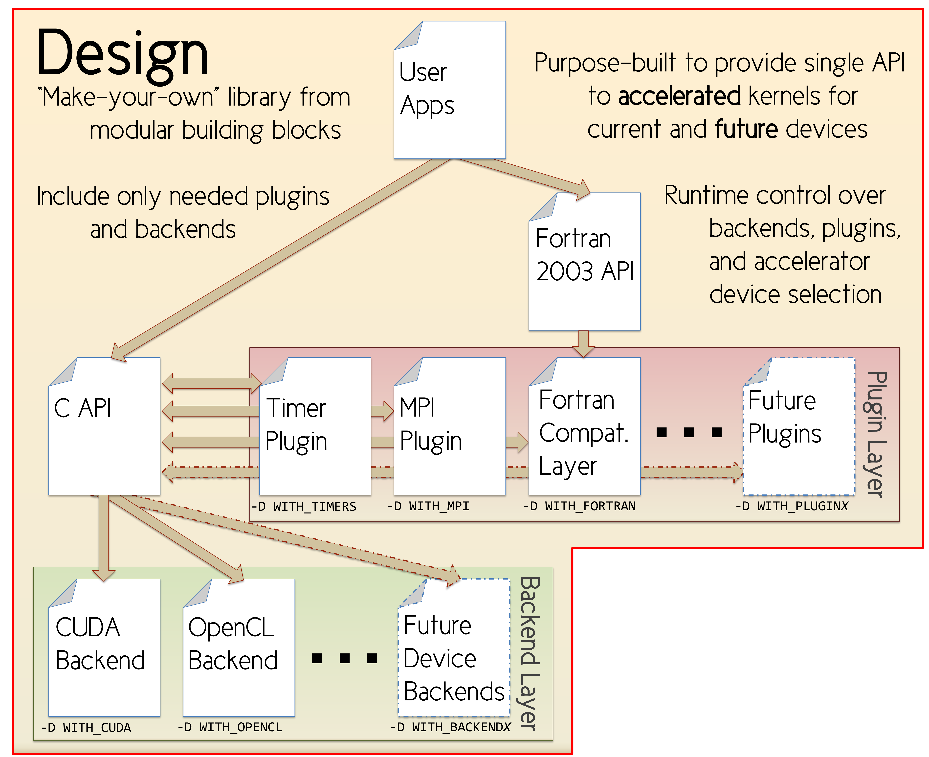
Vision: Abstraction Library → MetaMorph
Motivation
  Architectures changing rapidly → scientists should not have to rewrite codes!
Goal
  Community-driven development of accelerated back-ends and plugins
  Support for distributing workload onto the right device(s) with minimal user intervention, i.e.
    Automatic load balancing at runtime
    to deliver better performance and
    resource utilization (via CoreTSAR)
Desired Features
  Usable by non-architecture experts
  (via drop-in replacement functions)
  How? Hide accelerator-centric
  languages & optimizations behind a
  standard interface
Notes:
Usable by non-architecture experts
(via drop-in replacement functions)
while eliminating heavyweight
framework-centric development

Slide 49
Vision: Abstraction Library → MetaMorph
Motivation
  Architectures changing rapidly → scientists should not have to rewrite codes!
Goal
  Community-driven development of accelerated back-ends and plugins
  Support for distributing workload onto the right device(s) with minimal user intervention, i.e.
    Automatic load balancing at runtime
    to deliver better performance and
    resource utilization (via CoreTSAR)
Desired Features
  Usable by non-architecture experts
  (via drop-in replacement functions)
  How? Hide accelerator-centric
  languages & optimizations behind a
  standard interface
Notes:
Usable by non-architecture experts
(via drop-in replacement functions)
while eliminating heavyweight
framework-centric development

Slide 50
MetaMorph: Updates
Poster session at SC’14
  MetaMorph: A Modular Library for Democratizing the Acceleration of Parallel Computing across Heterogeneous Devices
  Strong interest in an HSA-native backend
    AMD et. al
  Moderate interest in an OpenMP backend
    target Intel MIC and CPU natively
    Intel might be considering dropping OpenCL
  Several papers on implementing SpMV GPU
  operations on CSR and similar sparse structures,
  efficiently and without expanding to dense form
  Paper on communication-avoiding Krylov for
  CPU/GPU hybrid clusters

Slide 51
MetaMorph: Updates
Data Marshalling & Face Transform Survey
  Three replies: GenIDLEST, INCOMP3D, and SENSEI
  Needed operations
    Transpose, Rotate (90/180/270), Mirror;
    GenIDLEST also needs Interpolate.
    SENSEI needs Z-ordering inversal of XY planes
Potential use in a Smooth Particle Hydrodynamics (SPH) code
  Essentially a particle-in-cell (PIC) code w/ sorted array of particles indexed by cell
  Needs MPI capability to transfer “extents” of contiguous memory containing particles for a given cell

Slide 52
MetaMorph: Expanded Feature Set
MPI Plugin: implemented and stabilized async kernels+transfers
  CUDA/OpenCL Callback functions and MPI Request management
    no helper thread, work only performed at sync calls or meta_flush()
  CUDA GPU-Direct support implemented but disabled due to MVAPICH2 instability
  Buffer pool designed for reusing async management structs/memory
    GPU transfers staged via host memory are not suitable for reuse
Auto-scaling grid/block to data size
  All kernels capable of variable work per thread (>1 or ≤1 elem/thread)
OpenMP Backend (portable default)
  CPU: OpenMP(+AVX option) implementation – all current kernels
  Intel MIC: OpenMP+AVX3 backend– all current kernels

Slide 53
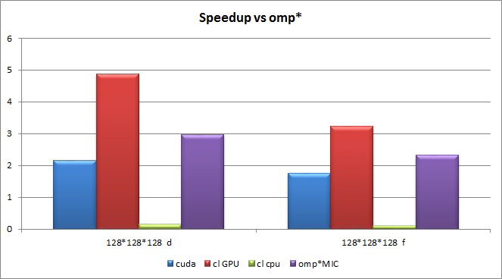
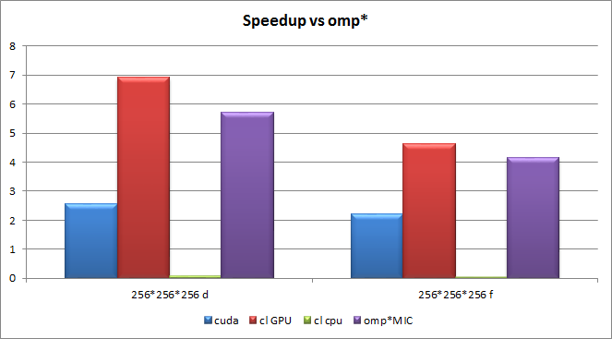
MetaMorph: Performance vs. CPU OpenMP+AVX
Dot product (memory bound)
  CPU: Intel(R) Core(TM) i5-2400, 4 cores @ 3.10GHz
  GPU: Tesla K20c
  *Baseline is 4-thread OpenMP w/ AVX

Slide 54
MetaMorph: Work in progress
Preliminary work towards stencil support (w/ LDC)
  Hands on exploration of LDC stencils and boundary handling
    stencil shapes are exotic - library of standard shapes would be insufficient
    9 conditional regions, but only 4 types of computation behavior
  Plan: allow arbitrary stencils to be expressed as semi-structured C
    Map ingested C to each platform via runtime modification of the kernel string
    Utilize just-in-time (JIT) compilation for each platform
      CUDA/OpenCL via their APIs (CUDA 7 added kernel JIT compilation)
      OpenMP via fork/exec of gcc followed by a dlopen
    JIT testing via custom saxpy kernels for each platform
      OpenMP (WORKING), OpenCL/CUDA (IMPLEMENTED)
soln_{p,new}
soln_{u,new}
soln_{v,new}
Core

Slide 55
MetaMorph: Work in progress
OpenMP + MIC Performance analysis
  Native mode vs. Offload mode
  Manual vectorization vs. Auto vectorization
    icc vs gcc
  Performance vs. CPU/AMD-GPU/Nvidia-GPU
OpenMP timer plugin integration

Slide 56
MetaMorph: Future Work
Finish prototyping and integrating stencil JIT support
  runtime adaptation of each kernel string to target platform
    Offline compilation & AST optimization passes to be added later
  Implement LDC via MetaMorph as stencil usage case study
MetaMorph conference submission (likely PPoPP or IPDPS)
  Perf/Portability of X (LDC??) over CPU/GPU/MIC via MetaMorph
Sparse structures and SpMV support
  common sparse structures (CSR, COO, CSR5, Jagged-diag, others?)
MPI plugin:
  face exchange transforms (Kaixi’s primitives)
  new “extent” transfer modes for SPH/PIC codes
  pipelined transfers (a la MPI-ACC)
New solver primitives (w/ de Sturler)
  potentially w/ automatic differentiation support (w/ Sandu)
Adaptive runtime “meta-backend” (a la CoreTSAR)
Notes:
Validation of ASYNC variants of face transforms and exchanges
MPI exchanges should be the most tricky, due to callback chains and helper functions required for transparent management of async transfers

Slide 57
MetaMorph: Future Work
Incorporation of remaining MPI face exchange transforms
  Rotations, mirroring, and scaling
  Develop plane ordering inversal primitive for SENSEI
Identify and Isolate primitives needed by computational math
  MatVec operations, Multigrids, other computational patterns
Expand MPI plugin to transfer “extents” and sets of extents
  to support SPH and other Particle-in-cell style computations
Investigate ParMETIS interoperability for potential plugin
Notes:
Validation of ASYNC variants of face transforms and exchanges
MPI exchanges should be the most tricky, due to callback chains and helper functions required for transparent management of async transfers

Slide 58
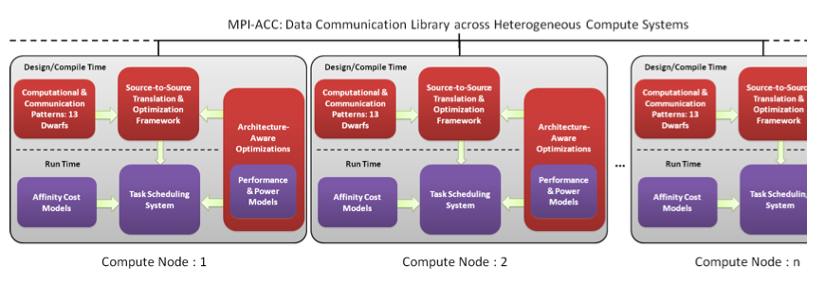
Ecosystem for Heterogeneous Parallel Computing
Inter-Node
Goal
  Co-designed data movement library that hides all the hardware and system software details from the algorithm developer while supporting a multitude of environments
Notes:
Goal: Unified data movement library that hides all the hardware and system software details from the algorithm developer, while supporting a wide variety of vendors (NVIDIA and AMD GPUs, CUDA and OpenCL, and so on).
The various processing elements in today’s supercomputers, such as CPUs, GPUs and other accelerators, are organized in complex memory hierarchies and data movement among these disjoint memory subsystems become a performance and productivity bottleneck very quickly in the co-design process.
Moreover, the data movement optimizations are very specific to the vendors and their libraries, e.g., GPUDirect technology is available only for NVIDIA GPUs (CUDA) and InfiniBand interconnects.
Example: MPI-ACC, a prototype for a data-movement library between heterogeneous memory systems by extending the popular MPI programming model (called MPI-ACC).

Slide 59
Data Movement in CPU-GPU Clusters
Performance: Hardware/Software Co-Design
GPU
device memory
GPU
device memory
PCIe
PCIe
CPU
main memory
Network
CPU
main memory
MPI Rank = 0
MPI Rank = 1
if(rank == 0)
{
GPUMemcpy(host_buf, dev_buf, D2H)
MPI_Send(host_buf, .. ..)
}
if(rank == 1)
{
MPI_Recv(host_buf, .. ..)
GPUMemcpy(dev_buf, host_buf, H2D)
}

Slide 60
MPI-ACC:
Generalized Runtime for Accelerator Systems
Performance: Hardware/Software Co-Design
Performance: Hardware/Software Co-Design
in context of Programmability & Portability
GPU
device memory
GPU
device memory
PCIe
PCIe
  Examples: MPI-ACC, MVAPICH, Open MPI
  Programmability/Productivity: multiple accelerators and prog. models (CUDA, OpenCL)
  Performance: system-specific and vendor-specific optimizations (Pipelining, GPUDirect, pinned host memory, IOH affinity)
CPU
main memory
Network
CPU
main memory
MPI Rank = 0
MPI Rank = 1
if(rank == 0)
{
MPI_Send(any_buf, .. ..)
}
if(rank == 1)
{
MPI_Recv(any_buf, .. ..)
}

Slide 61
MPI-ACC:
Generalized Runtime for Accelerator Systems
Performance: Hardware/Software Co-Design
in context of Programmability & Portability
Main Memory
Main Memory
GPU Memory
GPU Memory
NVRAM
NVRAM
CPU
Network
CPU
Unreliable Memory
Unreliable Memory
Rank = 0
Rank = 1
if (rank == 0)
{
MPI_Send(s_buf, .. ..);
}
if (rank == 1)
{
MPI_Recv(r_buf, .. ..);
}

Slide 62
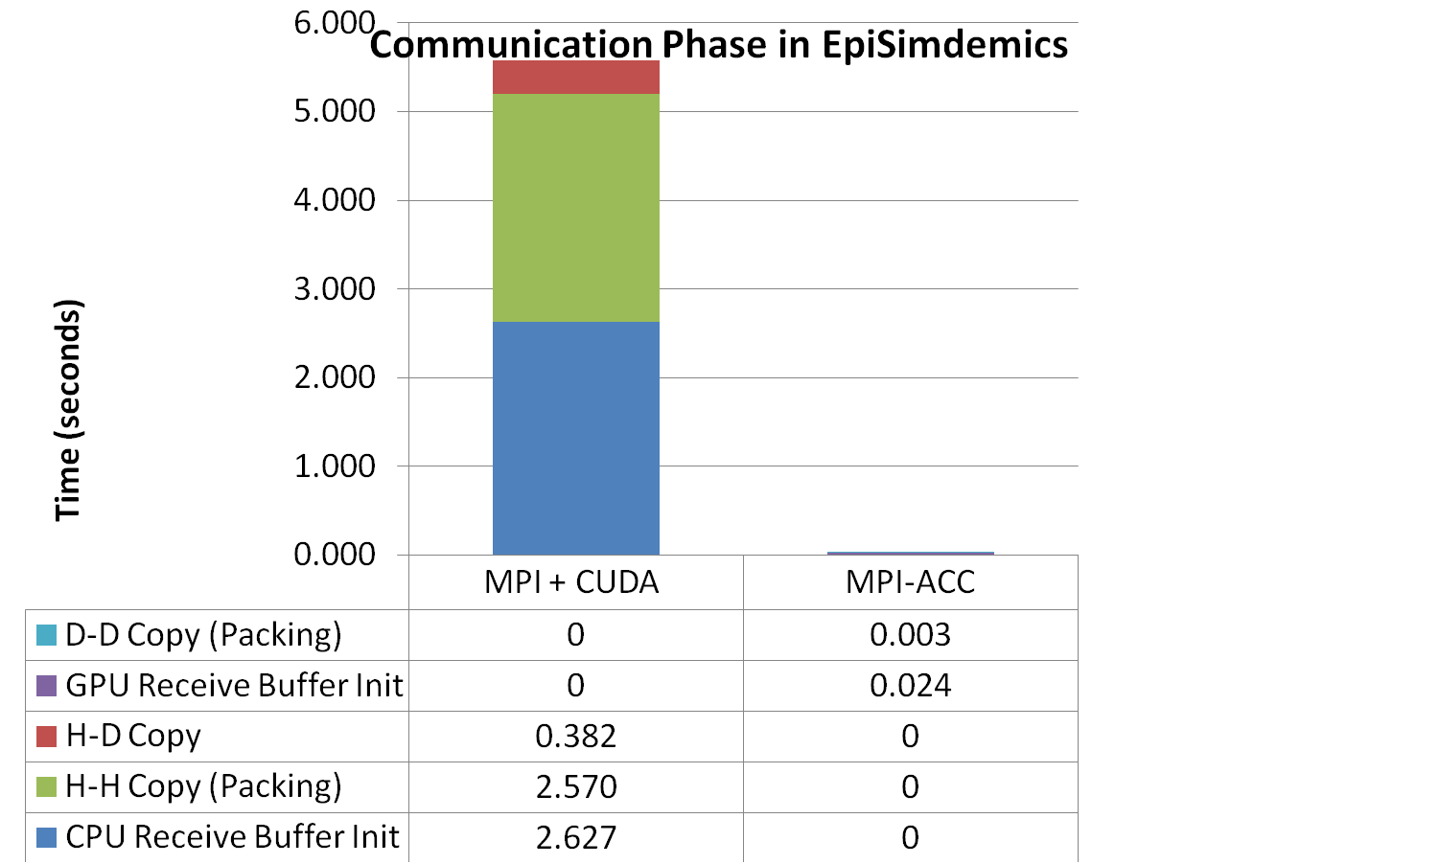
MPI+CUDA vs. MPI-ACC
Performance: Hardware/Software Co-Design
in context of Programmability & Portability
Accelerates data movement operations by two orders of magnitude
Enables new application-level optimizations
Slated to be integrated into the next official major release of MPICH
MPI-ACC runtime optimized
Notes:
MPI-ACC: An Integrated and Extensible Approach to Data Movement in Accelerator-Based Systems.
14th IEEE Int’l Conf. on High Performance Computing and Communications,
June 2012.

Slide 63
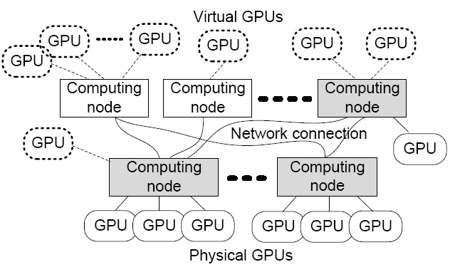
VOCL: A Virtual Implementation of OpenCL for Access and Management of Remote GPU Devices
GPU Virtualization
  Transparent utilization of remote GPUs
    Remote GPUs look like local “virtual” GPUs
    Applications can access them as if they are regular local GPUs
    VOCL will automatically move data and computation
  Efficient GPU resource management
    Virtual GPUs can migrate from one physical GPU to another
    If a system admin wants to add or remove a node, he/she can do that while applications are running (hot-swap capability)
“VOCL: An Optimized Environment for Transparent Virtualization of Graphics Processing Units,” IEEE Innovative Parallel Computing, May 2012.
“Transparent Accelerator Migration in a Virtualized GPU Environment,” IEEE/ACM International Symposium on Cluster, Cloud and Grid Computing, May 2012.

Slide 64
Virtual OpenCL (VOCL) Framework
  Transparent utilization of remote GPUs
  Efficient GPU resource management
Compute Node
VOCL Proxy
Compute Node
Compute Node
OpenCL API
Application
Application
Native OpenCL Library
MPI
OpenCL API
OpenCL API
Physical GPU
Native OpenCL Library
VOCL Library
MPI
Physical GPU
Virtual GPU
Virtual GPU
Compute Node
VOCL Proxy
Traditional Model
OpenCL API
Native OpenCL Library
“VOCL: An Optimized Environment for Transparent Virtualization of Graphics Processing Units,” IEEE Innovative Parallel Computing, May 2012.
VOCL Model
Physical GPU

Slide 65
Roadmap
Vision
Team
Approach: Synergistic Co-Design
Artifacts
  Optimized CFD Codes
  CoreTSAR / AffinityTSAR
  MetaMorph
  MPI-ACC
  VOCL: Virtual OpenCL
Achievements & Publications
Next Steps
Algorithms
Software
Hardware

Slide 66
Sampling of Achievements
Computer Science
  At Run Time: Automated run-time system that maps the right task(s) to the right processor at the right time for best performance → vendors
  Identified commonality for library for CFD codes: generalized GPU-to-GPU communication (via MPI), ghost-cell exchange between GPUs, …

Slide 67
Publications in 2015 (1 of 2)
L. Luo, J. R. Edwards, H. Luo, F. Mueller, “Fine-grained Optimizations of Implicit Algorithms in An Incompressible Navier-Stokes Solver on GPGPU,” AIAA Aviation and Aeronautics Forum and Exposition, Dallas, TX, 2015. CFD Comp
Zharovsky, A. Sandu, and H. Zhang: “A Class of IMEX Two-step Runge-Kutta Methods”. SIAM Journal on Numerical Analysis, Vol. 53, No. 1, pp. 321–341, 2015. Math
Y. Xia, J. Lou, H. Luo, J. Edwards, and F. Mueller, “OpenACC Acceleration of an Unstructured CFD Solver Based on a Reconstructed Discontinuous Galerkin Method for Compressible Flows”, International Journal for Numerical Methods in Fluids, DOI: 10.1002/fld.4009, 2015. CFD Comp
A. Sandu: “Rosenbrock Methods with an Explicit First Stage for Mildly Stiff PDEs”. International Journal of Computer Mathematics, in print, 2015. Math
B. P. Pickering, C. W. Jackson, T. R. W. Scogland, W.-C. Feng, and C. J. Roy, “Directive-Based GPU Programming for Computational Fluid Dynamics,” Computers and Fluids, Vol. 114, 2015, pp. 242-253. CFD Comp
A. Sandu and M. Guenther: “A Generalized-Structure View of Additive Runge-Kutta Methods”. SIAM Journal on Numerical Analysis, Vol. 53, Issue 1, pp. 17–42, 2015. Math

Slide 68
Publications in 2015 (2 of 2)
L. Luo, J. R. Edwards, H. Luo, F. Mueller, “Advanced Optimizations of An Implicit Navier-Stokes Solver on GPGPU based on a Fine-grained BILU solver,” 53nd AIAA Aerospace Sciences Meeting (SciTech), Kissimmee, FL, 2015. CFD Comp
M. Guenther and A. Sandu: “Multirate GARK Schemes”, Computational Techniques for Time Dependent Coupled Multiphysics and Multiscale Problems mini symposium MS6, SIAM Conference on Computational Science and Engineering, Salt Lake City, Utah, March 3–18, 2015. Math
Sandu and M. Guenther: “Generalized Structure Additive Runge-Kutta Methods”, Advances in Time-stepping Methods minisymposium MS136, SIAM Conference on Computational Science and Engineering, Salt Lake City, Utah, March 3–18, 2015. Math
P. Tranquilli, A. Sandu, and R. Glandon: “K-Methods, an Extension of Exponential and Rosenbrock Time Integrators”, Advances in Time-stepping Methods minisymposium MS136, SIAM Conference on Computational Science and Engineering, Salt Lake City, Utah, March 3–18, 2015.Math
J. M. Derlaga, T. S. Phillips, and C. J. Roy, “SENSEI Computational Fluid Dynamics Code: A Case Study in Modern Fortran Software Development,” manuscript submitted to Computers and Fluids, February 2015. CFD
J. Lou, Y. Xia, L. Luo, H. Luo, J. Edwards, and F. Mueller, “OpenACC-Based GPU Acceleration of a p-multigrid Discontinuous Galerkin Method for Compressible Flows on 3D Unstructured Grids”, AIAA-2015-0822, 53rd AIAA Aerospace Sciences Meeting, Kissimmee, FL, January 5-9, 2015. CFD Comp

Slide 69
Publications in 2014 (1 of 3)
B. Pickering, C. Jackson, T. Scogland, W. Feng, C. Roy, “Directive-Based GPU Programming for Computational Fluid Dynamics,” 52nd AIAA Aerospace Sciences Meeting (SciTech), National Harbor, MD, Jan. 2014.
Y. Xia, L. Luo, H. Luo, J. Edwards, F. Mueller, “GPU Acceleration of a Reconstructed Discontinuous Galerkin Method for Compressible Flows on Unstructured Grids,” 52nd AIAA Aerospace Sciences Meeting (SciTech), National Harbor, MD, Jan. 2014.
Y. Xia, H. Luo, L. Luo, J. Edwards, J. Lou, F. Mueller, “OpenACC-based GPU Acceleration of a 3-D Unstructured Discontinuous Galerkin Method,” 52nd AIAA Aerospace Sciences Meeting (SciTech), National Harbor, MD, Jan. 2014.
L. Luo, J. Edwards, H. Luo, F. Mueller, "Performance Assessment of Multi-block LES Simulations using Directive-based GPU Computation in a Cluster Environment," 52nd AIAA Aerospace Sciences Meeting (SciTech), National Harbor, MD, Jan. 2014.
C. Li, Y. Yang, H. Dai, S. Yan, F. Mueller, H. Zhou, “Understanding the Tradeoffs between Software-Managed vs. Hardware-Managed Caches in GPUs,” IEEE International Symposium on Performance Analysis of Systems and Software, Mar. 2014.
T. Scogland, W. Feng, B. Rountree, B. de Supinski, “CoreTSAR: Adaptive Worksharing for Heterogeneous Systems,” Int’l Supercomputing Conf., Leipzig, Germany, Jun. 2014

Slide 70
Publications in 2014 (2 of 3)
L. Luo, J. Edwards, H. Luo, F. Mueller, “GPU Port of a Parallel Incompressible Navier-Stokes Solver based on OpenACC and MVAPICH2,” AIAA Aviation 2014, Atlanta, GA, Jun. 2014.
Y. Xia, L. Luo, H. Luo, J. Lou, J. Edwards, F. Mueller, “On the Multi-GPU Computing of a Reconstructed Discontinuous Galerkin Method for Compressible Flows on 3D Hybrid Grids,” 7th AIAA Theoretical Fluid Mechanics Conference, Atlanta, GA, Jun. 2014.
A. Amritkar, D.Tafti, P. Sathre, K. Hou, S. Chivakula, W. Feng. “Accelerating Bio-Inspired MAV Computations using GPUs.” AIAA Aviation and Aeronautics Forum and Exposition 2014, Atlanta, GA, Jun. 2014.
K. Swirydowicz, E. de Sturler, X. Xu, C. Roy, “Fast Solvers and Preconditioners,” SIAM Annual Meeting, Chicago, IL, Jul. 2014.
A. Amritkar, D. Tafti. “CFD Computations using Preconditioned Krylov Solver on GPUs.” ASME 2014 Fluids Engineering Division Summer Meeting, Chicago, IL, Aug. 2014.
K. Swirydowicz, A. Amritkar, E. de Sturler, D. Tafti. “Recycling Krylov Subspaces for CFD Application,” ASME 2014 Fluids Engineering Division Summer Meeting, Chicago, IL, Aug. 2014.

Slide 71
Publications in 2014 (3 of 3)
E. Zharovsky, A. Sandu, H. Zhang, “A Class of IMEX Two-step Runge-Kutta Methods,” SIAM Journal on Numerical Analysis, 2014.
H. Zhang, A. Sandu, “FATODE: A Library for Forward, Adjoint, and Tangent Linear Integration of ODEs,” SIAM Journal on Scientific Computing, 2014.
P. Tranquilli, A. Sandu, “Rosenbrock-Krylov Methods for Large Systems of Differential Equations,” SIAM Journal on Scientific Computing, 36(3):1313-1338, 2014.
A. Cardone, Z. Jackiewicz, A. Sandu, H. Zhang, “Extrapolated IMEX Runge-Kutta Methods,” Mathematical Modelling and Analysis,19(1):18-43, 2014.
A. Cardone, Z. Jackiewicz, A. Sandu, H. Zhang, “Extrapolation-Based Implicit-Explicit General Linear Methods,” Numerical Algorithms, 65(3):377-399, 2014.
H. Zhang, A. Sandu, “Application of implicit-explicit general linear methods to reaction diffusion problems,” 12th International Conference of Numerical Analysis and Applied Mathematics (ICNAAM 2014), Rodos Palace Hotel, Rhodes,Greece, September 2014.

Slide 72
Thesis Manuscripts in 2015
A. Grim McNally (advised by E. de Sturler), “Reusing and Updating Preconditioners for Sequences of Matrices”, M.S. Thesis, Department of Mathematics, Virginia Tech

Slide 73
Thesis Manuscripts in 2014
Nishanth Balasubramanian, “ScalaMemAnalysis: A Compositional Approach to Cache Analysis of Compressed Memory Traces,” M.S. Thesis, Dept. of Computer Science, North Carolina State University, Jun. 2014. Now at NVIDIA.
Brent Pickering, “Evaluating the OpenACC API for Parallelization of CFD Applications,” M.S. Thesis, Dept. of Aerospace and Ocean Engineering, Virginia Tech, Jul. 2014. Now pursuing Ph.D. at Virginia Tech.
Thomas Scogland, “Runtime Adaptation for Autonomic Heterogeneous Computing,” Ph.D. Thesis, Dept. of Computer Science, Virginia Tech, Aug. 2014. Heading to DOE Lawrence Livermore National Laboratory.

Slide 74
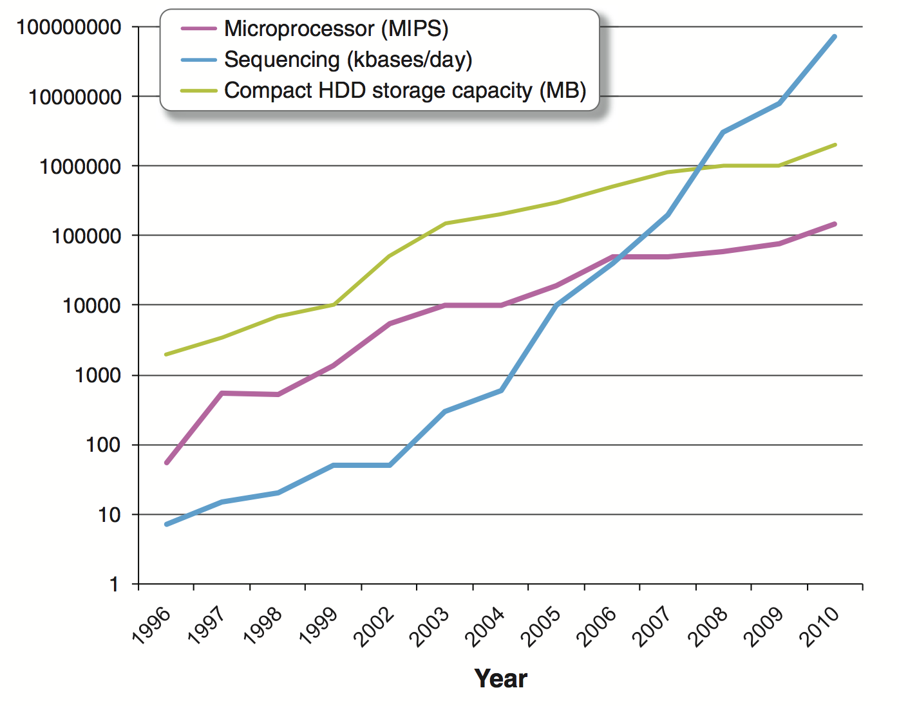

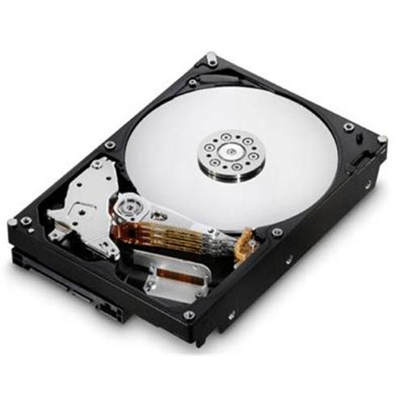
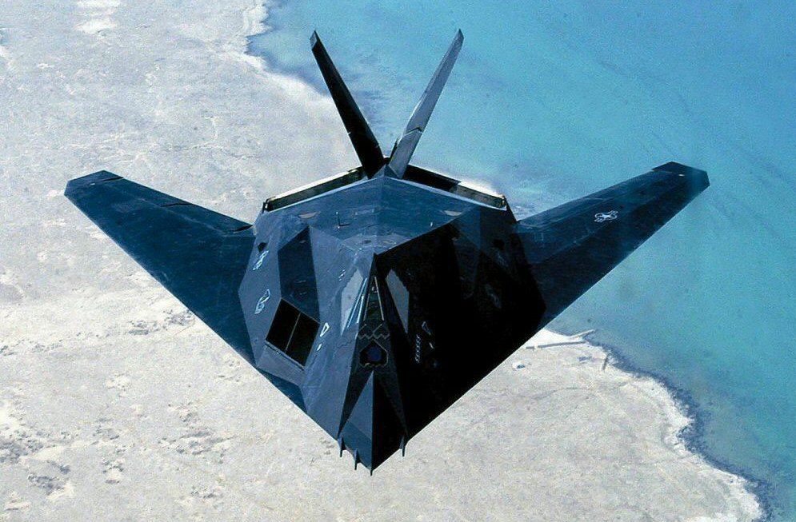
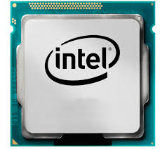
Synergistic Co-Design for BIG DATA
Prof. Wu Feng, Virginia Tech
Algorithms
Software
100x
4x
800x
Changing Landscape
  … from FLOPS (“old HPC”) to bytes (“new HPC” → BIG DATA)
2x
Apps
Hardware
Co-Design Exemplars
  ParaMEDIC: Parallel Metadata Environment for Distributed I/O & Computing (yrs → mins)
  Find missing genes
  Molecular Modeling
  Rational drug design
Software Ecosystem
http://archive.isgtw.org/?pid=1000811
    http://www.youtube.com/watch?v=zPBFenYg2Zk
Source: On the Future of Genomic Data by S. Kahn
Hardware
Temporal Data Mining of Brain http://synergy.cs.vt.edu/pubs/papers/feng-temporal-data-mining-gpu-gems-2011.pdf
White House BIGDATA Event, May 2013
(See also New York Times, Economist, BusinessWeek, Washington Post, …)
Notes:
Synergistic Co-Design for BIG DATA … not only wrt performance but also programmability, power consumption, price, and ultimately, productivity.
Moore’s law – doubling of transistors or compute capacity every 24months
Kryder’s law – doubling of storage density or storage capacity every 13 months
A doubling of sequencing output every 9 months has outpaced and overtaken performance improvements within the disk storage and high-performance computation fields. (See NSF-NIH BIGDATA proposal.)
BIG DATA is increasing in size much faster than our technology can keep up with.
0:15-0:35
Co-design w/ Venn diagram.
---
Capture and integrate the co-design in a way that supports a multitude of application areas: hardware/software ecosystem/apps.
Over a 12-core processor:
31x with source-to-source combined with architecture-aware
8x with task scheduling
---
Co-design exemplars needing formalism and abstraction

Slide 75
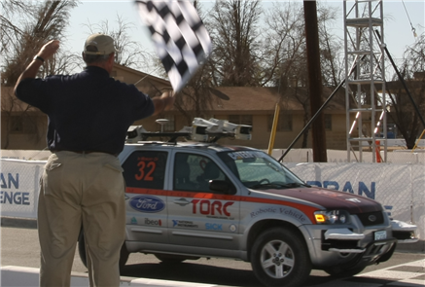



Synergistic Co-Design for DARPA Challenges
http://www.theroboticschallenge.org/
11 Finalists (w/ two from Virginia Tech)
Team ViGIR
Team Valor
Team Valor
Team ViGIR

Slide 76
AFOSR Basic Research Initiative:
Transformational Computing via Co-Design of High-Performance Algorithms and Hardware
Algorithms
Software
216x
4x
88x
This effort is envisioned as a “MURI-like” effort with
collaborative grants to teams that will create a new community of
researchers skilled in the design, development, and deployment of systems tuned to maximize the synergy of advanced algorithms and high-performance hardware.
Hardware
New Center at Virginia Tech:
Synergistic Environments for Experimental Computing (SEEC)
Notes:
This effort is envisioned as a “MURI-like” effort with collaborative grants to teams that will create a new community of researchers skilled in the design, development, and deployment of systems tuned to maximize the synergy of advanced algorithms and high-performance hardware.
Thus, this effort will be focused on fundamental and interdisciplinary research in computational hardware, computational software, and mathematical models, and is especially interested in work that characterizes the relationship between
hardware and algorithms.

Slide 77
What’s Next? (Last Year)
Platforms
  AMD & Intel CPU, AMD APU, AMD & NVIDIA GPUs, Intel MIC
Towards Ease of Use and Automation
(for Performance, Programmability, and Portability)
  Web resource for tenets of synergistic co-design
  … between algorithms, software, and hardware → automation (long term)
  Towards a CFD library for heterogeneous computing systems
    GPU-integrated MPI vs. GPUDirect, ghost cell exchange, bounds checking, …
  Code repositories for production codes
GPU-Integrated MPI Evaluation
  Experimental platforms (MIC and next-generation APU w/ “infinite memory”)
GPU mixed-precision solvers, GPU-efficient preconditioners
GPU-efficient accurate and stable high-order time stepping

Slide 78
Plans for Upcoming Year
SENSEI-LDC
Publish article with de Sturler’s group on preconditioners/solvers for GPU
Collaborate w/ Meuller’s group on MemTrace (explicit and implicit codes)
SENSEI-Lite
Complete code development to include viscous terms & implicit Jacobian
Collaborate with Sandu’s group on time accurate solutions
Collaborate with de Sturler’s group on preconditioners/solvers
SENSEI
Improve general preconditioners/solvers and implementation on GPU w/ de Sturler’s group
Develop strategy for handling function pointers and allocatables within OpenACC w/ Feng’s group
Implement OpenACC directives in SENSEI code base w/ Feng’s group

Slide 79
RDGFLO and INCOMP3D: Next Steps
Further Porting of RDGFLO
  Hierarchical WENO reconstruction, implicit time integration and turbulence model (LES)
Porting of the full version of INCOMP3D
  3D LDFSS, implicit time integration, full IB support and turbulence model (LES)
Biggest hurdle: multi-GPU MPI communication
  Avoid explicit GPU-CPU transfer during MPI data exchanges.
  A CUDA-aware MPI implementation (currently MVAPICH2) is used, which can take advantage of the best implementation available (GPUDirect, hardware RDMA in CUDA5).
  Current MPI Fortran interface does not support operations on OpenACC variables directly. Manual data packing on GPU using explicit CUDA programming is still required in OpenACC codes.

Slide 80
Year One: CS (Needs to be updated. Also less text.)
Conduct R&D on optimizing and automating heterogeneous computing at the node level, e.g., automated run-time scheduling
Develop, characterize, and optimize/re-factor dwarf abstractions (composition of dwarfs?)
Interact with methods/algorithms and applications teams on mapping to heterogeneous systems. (Slightly more detail needed, e.g., tradeoffs on mapping explicit/implicit to GPU, data-transfer overhead of codes, interfacing to linear solvers like Trilinos, etc.)
Support domain scientists on heterogeneous computing w/ GPUs
Infrastructure: Tools for domain scientists and engineers, e.g., PGI Accelerator Suite (including OpenACC, PGI Fortran compiler, etc.)
Hire CS postdoc and 2 GRAs (Adrian + Wu)
  GRA Ross Glandon: Continue to educate him(self) on both time stepping algorithms and parallel computing
  Other GRA still to be hired (from Kaixi, Sriram, Aniket, Lokendra: post-September 2013, Tom: post-September 2013)
Notes:
PGI Accelerator Suite:
Escaflowne
5-node GPU cluster for SCHEV $
9-node GPU cluster (Fire)
HokieSpeed

Slide 81
Next Steps
Next steps
  A list of (re-factored) deliverables and tasks for our program manager.
Need a picture of hierarchical parallelism
  Need a picture of MPI … domain scientists responsible for mapping/decomposition
  Need a picture of OpenMP/OpenCL … automated portion for supporting task scheduling

Slide 82
Ongoing and Upcoming Tasks
Further Porting of RDGFLO
  Hierarchical WENO reconstruction; Implicit time integration
  Large eddy simulation
Porting of the full version of INCOMP3D
  3D LDFSS, implicit time integration
  Full IB support, turbulence model (LES) and multi-phase, reacting fluids
Multiple GPUs with MPI communication
  Avoid explicit GPU-CPU transfer during MPI data exchanges.
  A CUDA-aware MPI implementation (currently MVAPICH2) is used, which can take advantage of the best implementation available (GPUDirect hardware RDMA in CUDA5).
  Mix OpenACC with CUDA-aware MPI calls. Current MPI interfaces does not support OpenACC variables directly.

Slide 83
Mobile and Desktop Supercomputing
Description
  AMD GPUs (4), NVIDIA GPUs (4), AMD APUs (2), Intel MIC (2)
Pictures of above
  Note early access to potpourri of experimental architectures
Make sure to give 5-second blurb to “memory-unlimited” GPU, i.e., AMD Radeon 7990 and 8970.
  How? Virtual memory addressing. Limited only by system memory.

Slide 84
Acknowledgements
This work was funded by the Air Force Office of Scientific Research (AFOSR) Computational Mathematics Program
  Program Manager: Fariba Fahroo
  Grant No. FA9550-12-1-0442

Slide 85
Appendix

Slide 86
HPL: High-Performance Linpack
HPL - Bad Things
• LINPACK Benchmark is 36 years old
• Top500 (HPL) is 20.5 years old
• Floating point-intensive performs O(n3) floating point
operations and moves O(n2) data.
• No longer so strongly correlated to real apps.
• Reports Peak Flops (although hybrid systems see only 1/2 to 2/3 of Peak)
• Encourages poor choices in architectural features
• Overall usability of a system is not measured
• Used as a marketing tool
• Decisions on acquisition made on one number
• Benchmarking for days wastes a valuable resource
A benchmark that
  Solves a dense n by n system of linear equations Ax = b. (Used since 1993 by TOP500 to rank the fastest supercomputers in the world.)
  Seeks to approximate how fast a computer will perform when solving real problems.
  Number of Operations: 2/3n³ + 2n²
Issue

Slide 87
HPCG: High-Performance Conjugate Gradient

Slide 88

What is an AMD APU?

Slide 89
Collaborations with Math
Collaboration on the implicit SENSEI-LDC code
Focus is on solvers and preconditioners
Maximum efficiency is found when considering interactions between: matrix storage format, memory use, hardware, preconditioner, solver
K. Swirydowicz, E. de Sturler, X. Xu, and C. J. Roy, “Fast Solvers and Preconditioners,” SIAM Annual Meeting, Chicago, IL, July 7-11, 2014
Collaboration on SENSEI
SENSEI uses modern Fortran, but includes ISO-C bindings so we can interface with existing solvers in C
SENSEI uses a built in CPU solver library (Fortran), but has recently been extended towards GPU functionality using the CUDA ITSOL interface (C); this is the same interface used by de Sturler’s group
The folks in Math should now have access to the SENSEI GIT repository

Slide 90
Collaborations with CS
Collaboration w/ Feng’s group: SENSEI-LDC and SENSEI
Worked with Tom Scogland to get explicit SENSEI-LDC code running on multiple GPUs (AIAA Paper, journal submission in progress)
Developed plan for GPU-parallelizing SENSEI using OpenACC
B. P. Pickering, C. W. Jackson, T. R. W. Scogland, W.-C. Feng, and C. J. Roy, “Directive-Based GPU Programming for Computational Fluid Dynamics,” AIAA Paper 2014-1131, 52nd Aerospace Sciences Meeting, National Harbor, MD, January 13-17, 2014
Collaboration w/ Sandu’s group: SENSEI-Lite
Developed a MATLAB version of SENSEI: the “real” SENSEI-Lite
Current code capabilities: structured grid, general geometry, finite volume method, single block, inviscid, and explicit solver
Upcoming capabilities: viscous (Navier-Stokes) & implicit w/ full Jacobian
Sandu’s group currently has access to code through github
Sandu’s group will use the implicit code for studying their IMEX and ROK/EXPK schemes for time accurate simulations

Slide 91
Ecosystem for Heterogeneous Parallel Computing
Intra-Node
MANUAL CO-DESIGN
Epidemiology
Sequence
Alignment
Molecular
Dynamics
Earthquake
Modeling
Neuro-
informatics
Cybersecurity
MAVs
Manual
Co-Design
→
Automated
Co-Design
Heterogeneous Parallel Computing Platform
Notes:
PROPOSED Software Ecosystem (originally OpenCL-oriented → OpenMP-oriented for ease of transition of CFD codes to heterogeneous environments):
A software ecosystem that we are planning to build for our material scientists, physicists, chemists, geologists, and in-situ visualization scientists at Virginia Tech, many with heavy investment in CUDA code that they want to be able to run on a potpourri of heterogeneous parallel computing (HPC) platforms, e.g.,
Integrated CPU+GPU systems, e.g., AMD Fusion and NVIDIA ION/ION2 chipsets
Desktop CPU+discrete GPU system, e.g., AMD/Intel x86 CPU + consumer AMD/NVIDIA GPU (Radeon HD 5870 or GTX 480/580)
Server/Cluster CPU+discrete GPU system, e.g., HokieSpeed, which is currently being installed at VT

Slide 92
Acceleration Potential of Kernels
Performance: Hardware/Software Co-Design
Parallelism: Multicores and Accelerators (GPUs, Intel MIC)
Problem: Existing Codes Sequential or Coarse Parallelism
  Ad-hoc approach parallelization → unknown results
Vision: Infer speedup potential before refactoring code
  Determine variable reuse for given architecture
  Estimate speedup for fine-grained parallelization
  Assess effects of manual code and data transformations
  Suggest (or auto-generate) code and data transformations

Slide 93

Overview of MAV Requirements
Notes:
Processing: Compute
Once the specific model for aerodynamics has been chosen (e.g., the unsteady RANS equations), there exist a multitude of algorithmic, software, and hardware choices that can be made (see Fig. 2).
Each combination of possible algorithmic, software, and hardware choices can result in different requirements with respect to computational processing, communication, and memory, and in turn, produce significantly different performance.
As an example, consider the mapping of grid type, spatial discretization, and temporal discretization algorithms to computational processing, communication, and memory requirements, as shown in Fig. 4.

Slide 94
Targeted CFD Codes
SENSEI (C. Roy, Virginia Tech)
  Structured, multiblock, 2nd order, finite volume code
  Artificial compressibility method
  Arbitrary Lagrangian/Eulerian (ALE) 2nd or higher order spatial accuracy
  Artificial compressibility (AC) and immersed boundary (IB) methods
GenIDLEST (D. Tafti, Virginia Tech)
  Structured, multiblock, 2nd order, finite volume code
  Pressure projection method
  ALE and immersed boundary methods (IBM)
RDGFLO (H. Luo, NCSU)
  Unstructured, discontinuous Galerkin (DG) method
  High-order solution of compressible flows
INCOMP3D (J. Edwards, NCSU)
  Structured, multiblock finite volume code
  Second or higher order spatial accuracy
  ALE and IBM

Slide 95
GPU GenIDLEST: Preliminary Profiling
Performance Breakdown
Data marshaling performed on GPU, but …
  Data transfers still ~ 20% of execution time
  Maximum speedup achievable: 5x! (Amdahl’s law)
    Better overlapping of computations with transfers → MPI-ACC
Time % | Component
44% | kernel_pc_jac_blk2_pc_ortho
19.3% | GPU-CPU Data Transfers
7.32% | kernel_pc_jac_glb2_ortho
7.13% | kernel_matxvec2_ortho
…. | ….
Notes:
Tafti

Slide 96
GPU GenIDLEST: Issues
Kernels operating at low occupancy
  52% @ 75% occupancy, 33% @ 25% occupancy, 15% @ < 25% occupancy
  Manual optimization techniques: (1) Improved register usage, (2) optimize use of in-kernel resources, and (3) concurrent kernel execution
Reductions performed on CPU
  Entails transferring data back to CPU for reduction
  Efficient reduction algorithms available for GPU → port reduction to GPU
Linear algebra kernels – saxpy, daxpy, matrix-vector multiply
  15% of execution time
  Benchmark performance against GPU BLAS libraries
Sliced array data transfers in CUDA Fortran
  Results into multiple cudaMemcpy calls for a single data transfer. OUCH!
Notes:
Tafti

Slide 97
Targeted CFD Codes
SENSEI (C. Roy, Virginia Tech)
  Structured, multiblock, 2nd order, finite volume code
  Artificial compressibility method
  Arbitrary Lagrangian/Eulerian (ALE) 2nd or higher order spatial accuracy
  Artificial compressibility (AC) and immersed boundary (IB) methods
GenIDLEST (D. Tafti, Virginia Tech)
  Structured, multiblock, 2nd order, finite volume code
  Pressure projection method
  ALE and immersed boundary methods (IBM)
RDGFLO (H. Luo, NCSU)
  Unstructured, discontinuous Galerkin (DG) method
  High-order solution of compressible flows
INCOMP3D (J. Edwards, NCSU)
  Structured, multiblock finite volume code
  Second or higher order spatial accuracy
  ALE and IBM
Notes:
When questioned on whether or not I am a CFD expert, my reply is "No, but I did stay at a Holiday Inn Express," attributing my expertise to my stay there.

Slide 98
RDGFLO: Overview
Reconstructed Discontinuous Galerkin Flow Solver
Key Features
  Compressible Navier-Stokes / Euler equations.
  Third-order reconstructed discontinuous Galerkin (DG) finite element method.
  Unstructured hybrid grids, i.e., tetrahedron, prism, pyramid, hexahedron.
  Time-accurate and steady-state solution schemes.
  MPI-based parallel computing on CPU clusters.
Need GPU acceleration for RDGFLO because …
Rewriting a huge legacy code using CUDA is too costly. Alternatively, …
High-order methods are expensive for large-scale problems in terms of computing time!
OpenACC does not require much change of data structures and algorithms in a legacy code.

Slide 99
RDGFLO: GPU Parallelization
Race condition occurs in GPU parallelization in loops over faces when data writes to their left and right cell arrays.
Example: the elemental residual array for the cell (red) can be overwritten simultaneously in multiple GPU cores in loops over its faces by its face-neighboring cells (blue).
Coloring algorithm: reorder face indices and pack them in groups; Criterion: faces that share common elements do not reside in the same group (the same strategy in the case of OpenMP).
Example: an ACC sequential loop over the groups is nested outside the ACC parallel loop over the faces (the original loop is untouched).
All geometric and solution arrays are copied from host to device only once. For steady-state problems, solution arrays are only copied back to host memory at the end of time iterations and dumped in files.

Slide 100

RDGFLO: Weak Scaling Tests
Unit timings on the grid of 966k cells
-- CPU: AMD Opteron Processor 6128
-- GPU-type1: nVidia Tesla C2050
-- GPU-type2: nVidia Tesla K20c
Preliminary Result: A speedup factor of 20x (or more) is achievable.

Slide 101
Targeted CFD Codes
SENSEI (C. Roy, Virginia Tech)
  Structured, multiblock, 2nd order, finite volume code
  Artificial compressibility method
  Arbitrary Lagrangian/Eulerian (ALE) 2nd or higher order spatial accuracy
  Artificial compressibility (AC) and immersed boundary (IB) methods
GenIDLEST (D. Tafti, Virginia Tech)
  Structured, multiblock, 2nd order, finite volume code
  Pressure projection method
  ALE and immersed boundary methods (IBM)
RDGFLO (H. Luo, NCSU)
  Unstructured, discontinuous Galerkin (DG) method
  High-order solution of compressible flows
INCOMP3D (J. Edwards, NCSU)
  Structured, multiblock finite volume code
  Second or higher order spatial accuracy
  ALE and IBM
Notes:
When questioned on whether or not I am a CFD expert, my reply is "No, but I did stay at a Holiday Inn Express," attributing my expertise to my stay there.

Slide 102



INCOMP3D: Overview
Multi-block Incompressible Navier-Stokes Solver for Large Eddy Simulation
Key Features
  Higher order PPM / central-difference schemes
  Fully implicit time evolution using dual-time stepping methodology
  Multi-block structured meshes (MPI parallelism)
  Immersed boundary methods for complex motion events
Need GPU acceleration for INCOMP3D to reduce costs associated with large-eddy simulation at high Reynolds numbers

Slide 103
INCOMP3D: GPU Parallelization
Two scaled-down versions realized
OpenACC (ACC) port
  Main loop is carried out on GPU only. All essential arrays remain on GPU main memory. Temporary data arrays are created directly on GPU.
  One code can be compiled into pure CPU or GPU-accelerated versions, using different compiler options. This facilitates long-term maintenance.
CUDA Fortran (CUF) port
  Each time step are carried out by one monolithic kernel, which includes residual calculation and time marching.
  Residual array is directly created in shared memory; time step is local to each thread. Memory requirement is greatly reduced.
  Overlapping blocks are used, due to inter-thread data dependency.
  Residual calculation involves flux grouping by direction (i and j directions), to avoid memory contingency.
  CUDA Fortran array overhead identified and solved using global variables.

Slide 104

INCOMP3D: Initial Findings
ACC and CUF both achieved significant speedup over CPU
CUF achieved better performance, but requires much more effort to port and maintain
  Direct access of shared memory allows greater flexibility on algorithms.
  Easier to make mistakes; harder to debug.
ACC provides a good compromise between CPU and CUDA
  Good speedup ($\sim$10x), with minimal to moderate effort on porting.
  Easier to debug and maintain.
Example: steady-state flow inside a channel with 3 circular obstacles, Re=200. All results (in seconds) are obtained using nVidia c2050.

Slide 105

Upcoming Tasks (Edwards)
Accuracy study and optimization of 2-stage BILU(0)
  Storage of factorized $D_{i,j,k}$ is different from the original algorithm.
  Triangle substitution needs modification.
  Solver accuracy may be slightly different from the original codes.
Scheduling multiple blocks on one GPU – rehashing
  Balance must be found between “size of blocks” vs. “number of blocks”.
Improvement on MPI
  Recently available hardware GPU RDMA may improve MPI efficiency.
  General data exchange libraries can be adopted.
Atomic operations instead of coloring schemes
  Atomic operations are now available in PGI’s latest compilers supporting OpenACC 2.0.
Two-level synchronization in wavefront scheme
Further optimizations of other kernels (flux, BC, LHS)

Slide 106
Collaboration (Edwards)
Collaboration with F. Muller’s group (NCSU CS)
  Invaluable cluster and software support by Muler’s group.
  Technical challenges on OpenACC and CUDA are actively discussed.
Collaboration with RDGFLO3D (NCSU MAE)
  Repositories of codes are set up for easy access.
  Common algorithms on implicit methods are shared, reducing code development effort.
  Y. Xia, L. Luo, H. Luo, J. Lou, J. Edwards, F. Mueller, “On the Multi-GPU Computing of a Reconstructed Discontinuous Galerkin Method for Compressible Flows on 3D Hybrid Grids,” AIAA Aviation 2014, Georgia
Incorporation of GPU-aware functionalities of MVAPICH2 (VT CS)
  With the support on MVAPICH2 from Hao Wang, INCOMP3D is able to conduct efficient data transfers across GPUs on different cluster nodes.
  Portability of the data transfer codes is greatly improved.
  H. Wang, S. Potluri, D. Bureddy, C. Rosales, D. K. Panda, "GPU-Aware MPI on RDMA-Enabled Clusters: Design, Implementation and Evaluation," IEEE Transactions on Parallel and Distributed Systems, vol. 99, PrePrints, 2014.
Advanced wavefront scheme for the implicit solvers (VT CS)
  An advanced synchronization scheme pioneered by Feng’s group (VT CS) is being studied.
  S. Xiao, W. Feng, “Inter-Block GPU Communication via Fast Barrier Synchronization,” 24th IEEE International Parallel and Distributed Processing Symposium, Atlanta, Georgia, April 2010.

Slide 107
Publications in 2013
P. Tranquilli, A. Sandu, “Rosenbrock-Krylov Methods for Large Systems of Differential Equations” http://arxiv.org/abs/1305.5481, May 2013.
J. M. Derlaga, T. S. Phillips, C. J. Roy, “SENSEI Computational Fluid Dynamics Code: A Case Study in Modern Fortran Software Development,” AIAA Paper 2013-2450, 21st AIAA Computational Fluid Dynamics Conf., June 2013.
S. R. Glandon, P. Tranquilli, A. Sandu, “ Acceleration of Matrix-Free Time Integration Methods”, Workshop on Latest Advances in Scalable Algorithms for Large-Scale Systems (ScalA) at SC13, November 2013.
Notes:
Y. Xia, L. Luo, H. Luo, J. Edwards, and F. Mueller, 'GPU Acceleration
of a Reconstructed Discontinuous Galerkin Method for Compressible Flows
on Unstructured Grids", to be presented at 52nd AIAA Aerospace Sciences
Meeting, January 13-16, 2014.

Slide 108
Publications (Under Review and In Preparation)
Under Review
  P. Tranquilli, A. Sandu, “Exponential-Krylov Methods for Ordinary Differential Equations,” Journal of Computational Physics.
  H. Zhang, A. Sandu, S. Blaise: High Order Implicit-Explicit General Linear Methods with Optimized Stability Regions,” SIAM Journal on Scientific Computing, MS 097670.
  A. Aji et al., “MPI-ACC: GPU-Integrated MPI for Scientific Applications,” IEEE Transactions on Parallel & Distributed Systems.
  T. Scogland, W. Feng, B. Rountree, B. de Supinski, “CoreTSAR: Core Task-Size Adapting Runtime,” IEEE Transactions on Parallel & Distributed Systems.
  J. Lou, Y. Xia, L. Luo, H. Luo, J. Lou, J. Edwards, F. Mueller, “OpenACC-based GPU Acceleration of a p-multigrid Discontinuous Galerkin Method for Compressible Flows on 3D Unstructured Grids,” AIAA Science and Technology Forum.
In Preparation
  B. Pickering, C. Jackson, T. Scogland, W. Feng, C. Roy, “Directive-Based GPU Programming for Computational Fluid Dynamics,” in preparation for Computers and Fluids, Aug. 2014.
  J. Derlaga, T. Phillips, C. J. Roy, “SENSEI Computational Fluid Dynamics Code: A Case Study in Modern Fortran Software Development,” in preparation for Journal of Aerospace Computing, Information, and Communication, Aug. 2014.
  K. Swirydowicz, E. de Sturler, X. Xu, and C. Roy, “Effective Solvers and Preconditioners on GPUs for CFD Applications,” in preparation for Parallel Computing.
  A. Amritkar, E. de Sturler, K. Swirydowicz, D. Tafti, K. Ahuja, “Recycling Krylov Subspaces for CFD Applications,” in preparation for Computer Methods in Applied Mechanics and Engineering.
  A. K. Grim McNally, M. Li, E. de Sturler, S. Gugercin, “Preconditioning Parameterized Linear Systems,” in preparation for SIAM J. Scientific Computing.

