Slide 1
Interactions
Working together with Dr. Mueller’s group at NCSU for the application of his cache analysis technique to kernels to RDGFLO code on GPUs. Provide the code platform in support of Dr. Frank Mueller’s parallelization analysis on GPU. Collaboration with Dr. Feng’s group at VT for the implementation of the GPUDirect technique in RDGFLO code. Working closely with Dr. Edwards’s group at NCSU for the OpenACC/CUDA hybrid programing in RDGFLO code In consultation with Dr. Sandu’s group at VT for the implementation of the GPU efficient Rosenbrock-Krylov methods in RDGFLO code. Cooperation with Dr. de Sturter’s group at VT for the implementation of the GPU efficient preconditioners in RDGFLO code.

Slide 2
Publications
Yidong Xia, Hong Luo, Lixiang Luo, Jack Edwards, Jialin Lou, and Frank Mueller. OpenACC-based GPU Acceleration of a 3-D Unstructured Discontinuous Galerkin Method. AIAA Paper, AIAA-2014-1129, 52nd Aerospace Sciences Meeting, 2014. Yidong Xia, Lixiang Luo, Hong Luo, Jialin Lou, Jack Edwards, and Frank Mueller. On the Multi-GPU Computing of a Reconstructed Discontinuous Galerkin Method for Compressible Flows on 3D Hybrid Grids. AIAA Paper, AIAA-2014-3081, 7th AIAA Theoretical Fluid Mechanics Conference, 2014. Jialin Lou, Yidong Xia, Lixiang Luo, Hong Luo, Jialin Lou, Jack Edwards, and Frank Mueller. OpenACC-based GPU Acceleration of a p-multigrid Discontinuous Galerkin Method for Compressible Flows on 3D Unstructured Grids. AIAA Paper. (Submitted to AIAA Science and Technology Forum 2015)

Slide 3
What’s Next? Plans for Next year
Implementation of a p-multigrid method in RDGFLO code on GPU clusters. Higher approximation: RDG(P1P2)+explicit TVDRK3 Lower approximation: DG(P0)+implicit first order backward Euler Implementation of an implicit method in RDGFLO code on GPU clusters. Algorithms suitable for GPU parallel computing Memory limitation on GPU devices Implementation of Rosenbrock-Krylov methods in RDGFLO code on GPU clusters. Time integration schemes suitable for GPU parallel computing

Slide 4


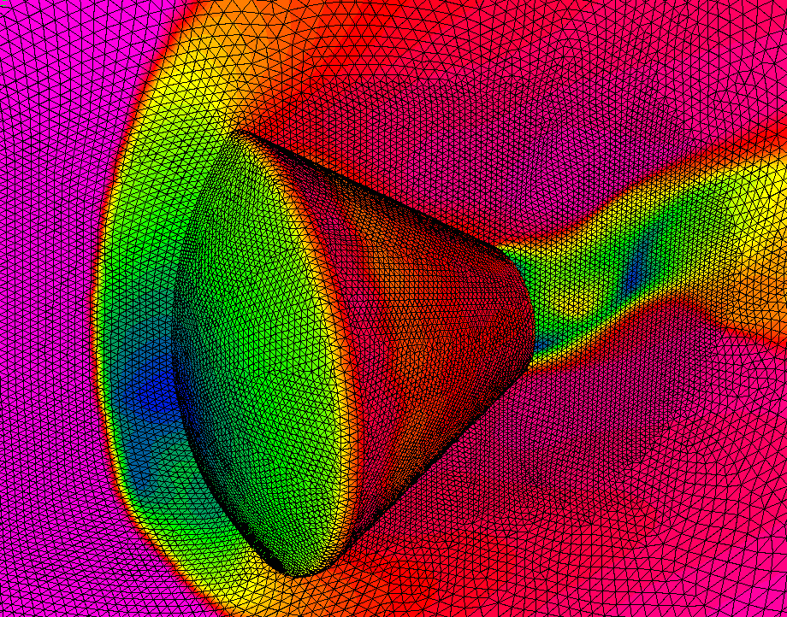
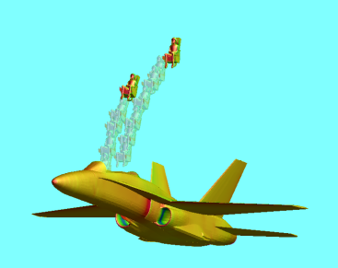
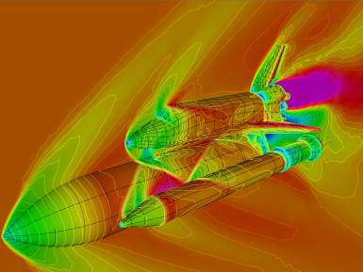
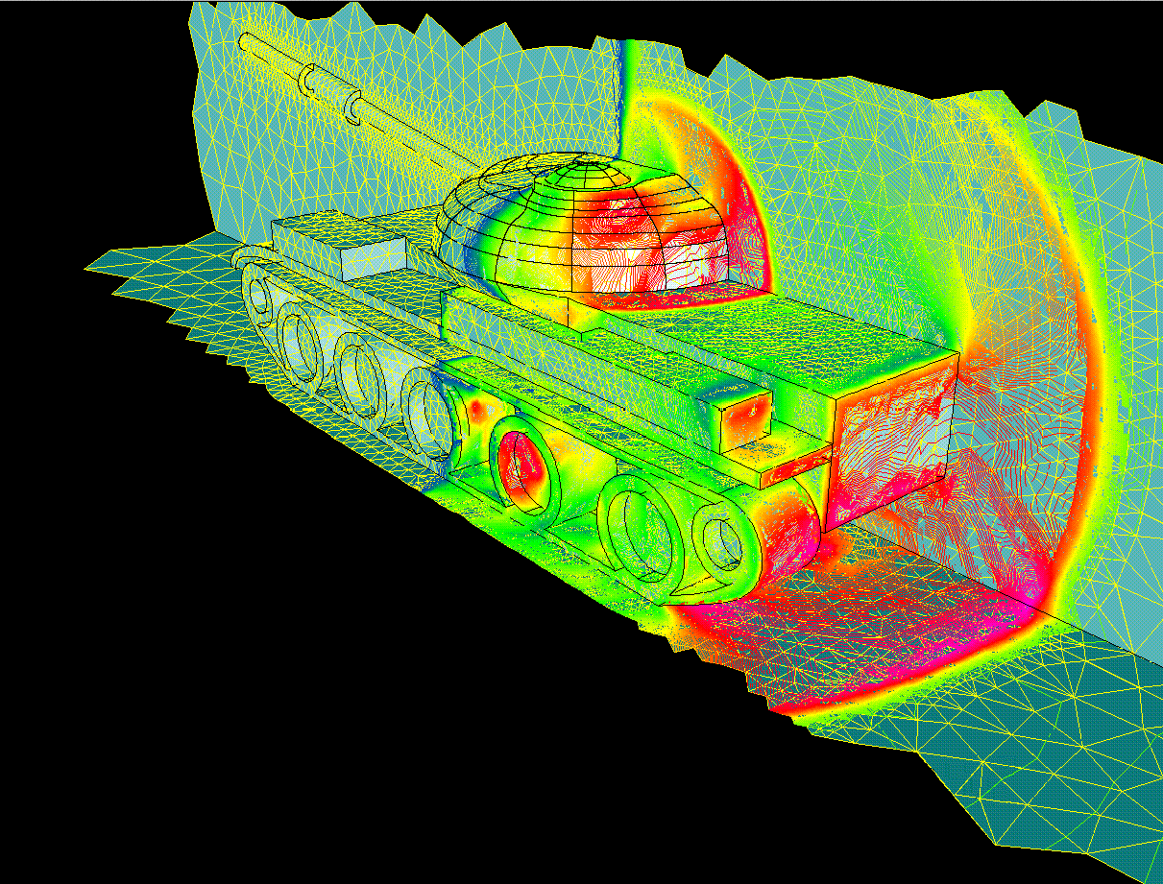
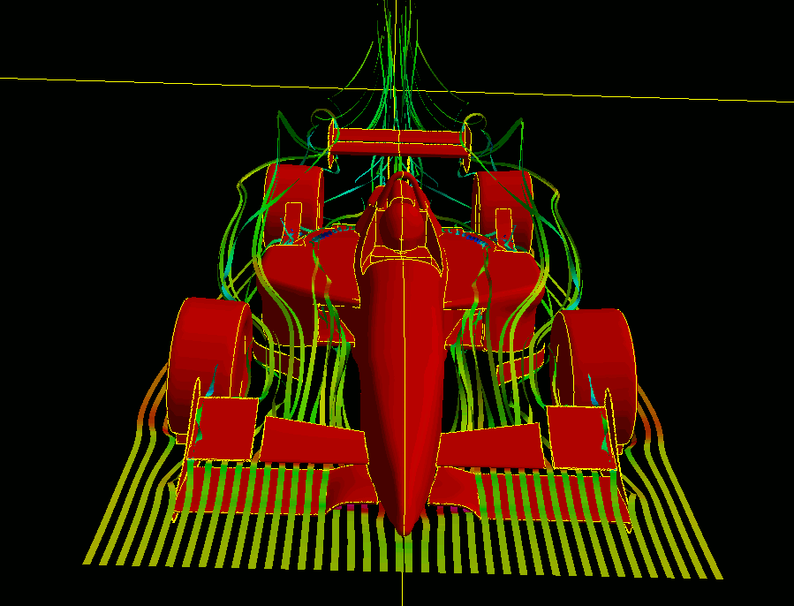
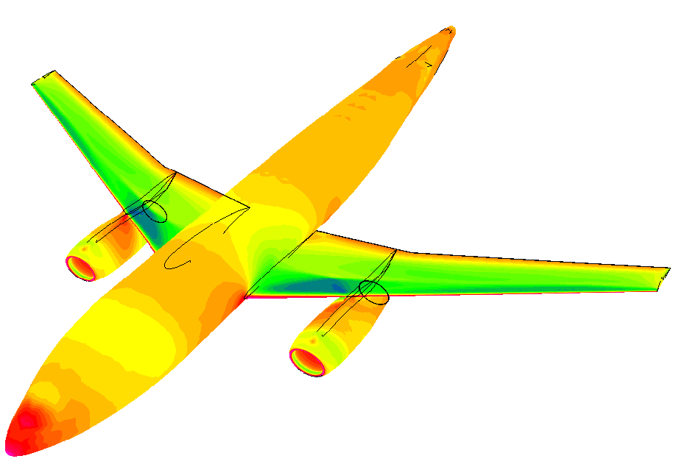
Development of a Portable, GPU-Accelerated Reconstructed Discontinuous Galerkin CFD Code for Compressible Flows at All Speeds
AFOSR BRI
Co-Design of Hardware/Software for Predicting UAV Aerodynamics
Jialin Lou, Yidong Xia, Lixiang Luo, Hong Luo, and Jack Edwards
Department of Mechanical and Aerospace Engineering
North Carolina State University
and
Frank Mueller, and Nishanth Balasubramanian
Department of Computer Science
North Carolina State University
Presented by Jialin Lou, Ph.D. Student
Wednesday, July 23 2014

Slide 5
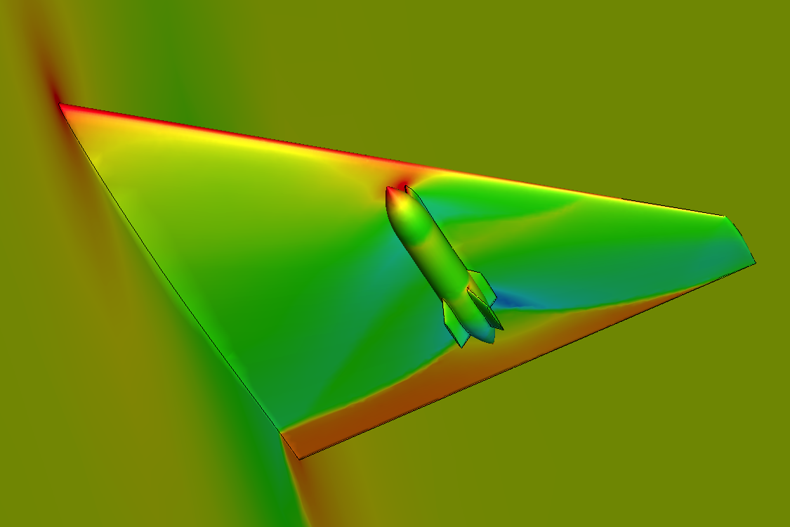
Legacy CFD Package
RDGFLO – a targeted code for OpenACC-based GPU parallelization
A Reconstructed Discontinuous Galerkin finite element FLOw solver High-order solution of compressible flows at all speeds on 3-D hybrid grids Time-accurate / steady-state solution schemes Domain-partition based MPI parallel computing on HPC clusters
Gallery
ONERA M6 wing
wing/pylon/finned-store configuration
Boeing 747 aircraft

Slide 6
Development of OpenACC Parallel Regions
Multiple-GPU communication
Workflow for the Navier-Stokes / Euler equations | Workflow for MPI data exchanges
DO itime = 1, ntime | (executed on host CPU’s)
→ Predict time-step size | $acc update host(unkno(:,:,nelem+1:nadje))
DO istage = 1, nstage | → …
→ Least-squares reconstruction | → CALL mpi_irecv()
→ IF (nprc > 1) MPI data exchanges | → CALL mpi_isend()
→ IF (viscous) Compute diffusion terms | → CALL mpi_waitall
→ WENO reconstruction | → …
→ IF (nprc > 1) MPI data exchanges | $acc update device(unkno(:,:,nelem+1:nadje))
→ Compute convective terms
→ Update solution vector
→ IF (nprc > 1) MPI data exchanges
ENDDO
ENDDO

Slide 7
Development of OpenACC Parallel Regions
A common method for avoiding “race condition” in face integral
Perform face integral at the element level All the computing is implemented as loops over mesh elements Overheads Lead to redundant computation of face integrals Require an additional element-face connectivity array Reference articles on unstructured DG/FV methods (with CUDA) A. Corrigan et al. Running Unstructured Grid-based CFD Solvers on Modern Graphics Hardware. Int. J. Numer. Methods Fluids, 66(2):221–229, 2011. Tristan Cabel and Stephane Lanteri. Discontinuous Galerkin Time-Domain Solver on GPU Based Systems. Plafrim meeting, May 31, 2011
This design approach implies a major rebuild in code structures!
Notes:
Race condition -> multiple writes to the same elemental residual vector and leads to incorrect results.
This “element based” loop strategy is still a very fast method on GPU devices, if you read the referred papers

Slide 8
Development of OpenACC Parallel Regions
An alternative method for avoiding “race condition” in face integral
Face renumbering (coloring method) renumber the faces and split them into several groups. Any two faces that share a common cell do not reside in the same group. The original face loops are nested in a sequential loop over groups.
An example of “face renumbering & grouping”
Before
Physical boundary faces |  |  |  | Partition boundary faces |  |  | Internal faces
After
4 groups |  |  |  | 3 groups |  |  | 6 groups

Slide 9
Development of OpenACC Parallel Regions
Example: face loops after “face renumbering & grouping”
The original face loops are nested in a sequential loop over groups.
OpenMP version Nfac1 = Njfac do ipass = 1, Npass_ift Nfac0 = Nfac1 + 1 Nfac1 = fpass_ift(ipass) !$omp parallel !$omp do do ifa = Nfac0, Nfac1 do ig = 1, Ngp !... contribution to the face-left element rhsel(:, :, iel) = rhsel(:, :, iel) - flux !... contribution to the face-right element rhsel(:, :, ier) = rhsel(:, :, ier) + flux enddo enddo !$omp end parallel enddo | OpenACC version Nfac1 = Njfac do ipass = 1, Npass_ift Nfac0 = Nfac1 + 1 Nfac1 = fpass_ift(ipass) !$acc parallel !$acc do do ifa = Nfac0, Nfac1 do ig = 1, Ngp !... contribution to the face-left element rhsel(:, :, iel) = rhsel(:, :, iel) - flux !... contribution to the face-right element rhsel(:, :, ier) = rhsel(:, :, ier) + flux enddo enddo !$acc end parallel enddo

Slide 10
Development of OpenACC Parallel Regions
“Face renumbering & grouping” vs. “element loops”
Advantages No redundant computation. Least intrusion to the original code structures. Recoverable to CPU parallel computing. Disadvantages Sequential groups lead to overheads in initializing more parallel kernels. Remarks No direct comparison of these two strategies is yet conducted for our solver. It is unknown which will render better performance on GPU. Since portability is our design priority, the current approach is a preferred, although optimal performance might be compromised.

Slide 11





Computing Resource
CPU
2-way SMPs with AMD Opteron 6128 (Many Core) with 8 cores per socket (16 cores per node) 32 GB DRAM 2.0 GHz core-speed for 6128 Opteron (single core)
GPU
NVIDIA Tesla K20c Memory amount: 5.0 GB Stream processors: 2496 | NVIDIA Tesla C2050 Memory amount: 3.0 GB Stream processors: 448
Software (64 bit)
Operating system CentOS 5.7 Linux x86 64 Compilation & runtime suite PGI Accelerator with OpenACC (ver. 13.9) OpenMPI (ver. 1.5.1)

Slide 12
Performance Assessment
Timing measurements
Unit running time T_{unit} where the running time T_{wall-clock} refers to the time recorded for completing the time marching loop with a given iteration number Ntime.
Test suite (simulations in double-precision arithmetic)
Verification Test | Compare results obtained by GPU code with CPU code with an absolute error tolerance of 1.0×10⁻¹²
Weak Scaling Test | Compare the unit running time with different number of GPU cards for a fixed problem size per GPU card

Slide 13
Example 1. Inviscid flow past a 3D sphere
Subsonic flow past a sphere at M∞ = 0.50 and α = 0°.
On a sequence of four successively refined tetrahedral grids. Figure. Pressure contours plotted on the surface triangular meshes

Slide 14
Example 1. Subsonic flow past a Sphere
Subsonic flow past a sphere at M∞ = 0.50 and α = 0°.
Grids | Elements | GPU’s | Storage(GB) |  | Unit time (ms)
 |  |  | P1 | P1P2 | P1 | P1P2
Level-1 | 501,972 | ×1 | 1.4 | 1.8 | 1.72 | 14.14
Level-2 | 1,015,570 | ×2 | 2.8 | 3.6 | 1.79 | 14.47
Level-3 | 1,999,386 | ×4 | 5.6 | 7.3 | 1.89 | 15.22
Level-4 | 4,029,430 | ×8 | 11.2 | 14.6 | 1.95 | 16.06

Slide 15
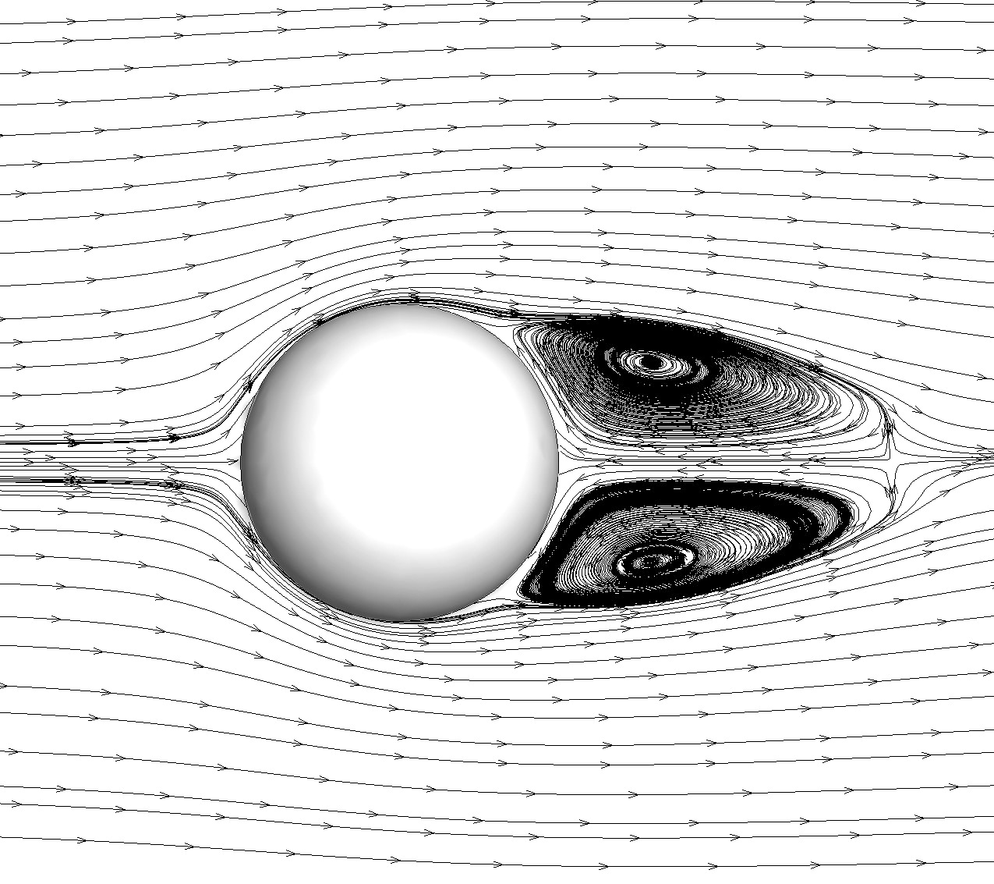
Example 2. Viscous flow past a 3D sphere
Subsonic flow past a sphere at M∞ = 0.50, α = 0° and Re=118.
Figure. The tetrahedral grid and streamtraces on the symmetry plane

Slide 16
Example 2. Viscous flow past a 3D sphere
Subsonic flow past a sphere at M∞ = 0.50 and α = 0°.
Grids | Elements | GPU’s | Storage(GB) |  | Unit time (ms)
 |  |  | P1 | P1P2 | P1 | P1P2
Level-1 | 500,095 | ×1 | 1.9 | 2.5 | 5.96 | 19.84
Level-2 | 1,000,103 | ×2 | 3.8 | 4.9 | 6.05 | 20.26
Level-3 | 2,000,051 | ×4 | 7.6 | 9.9 | 6.16 | 21.11
Level-4 | 4,000,227 | ×8 | 15.2 | 19.8 | 6.53 | 22.71

Slide 17
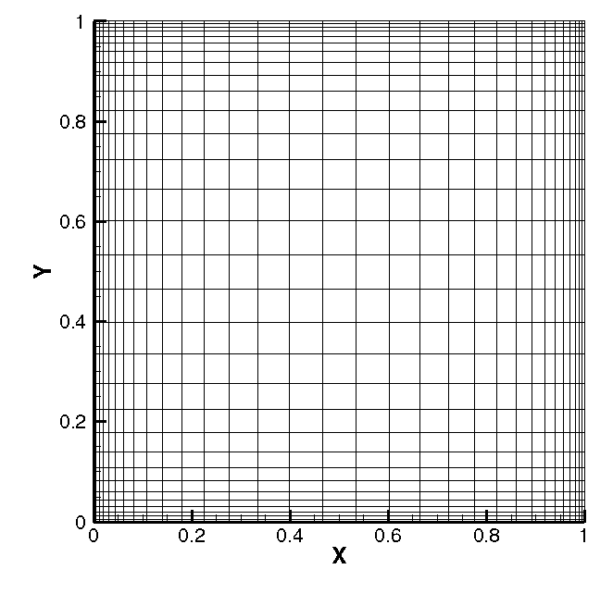
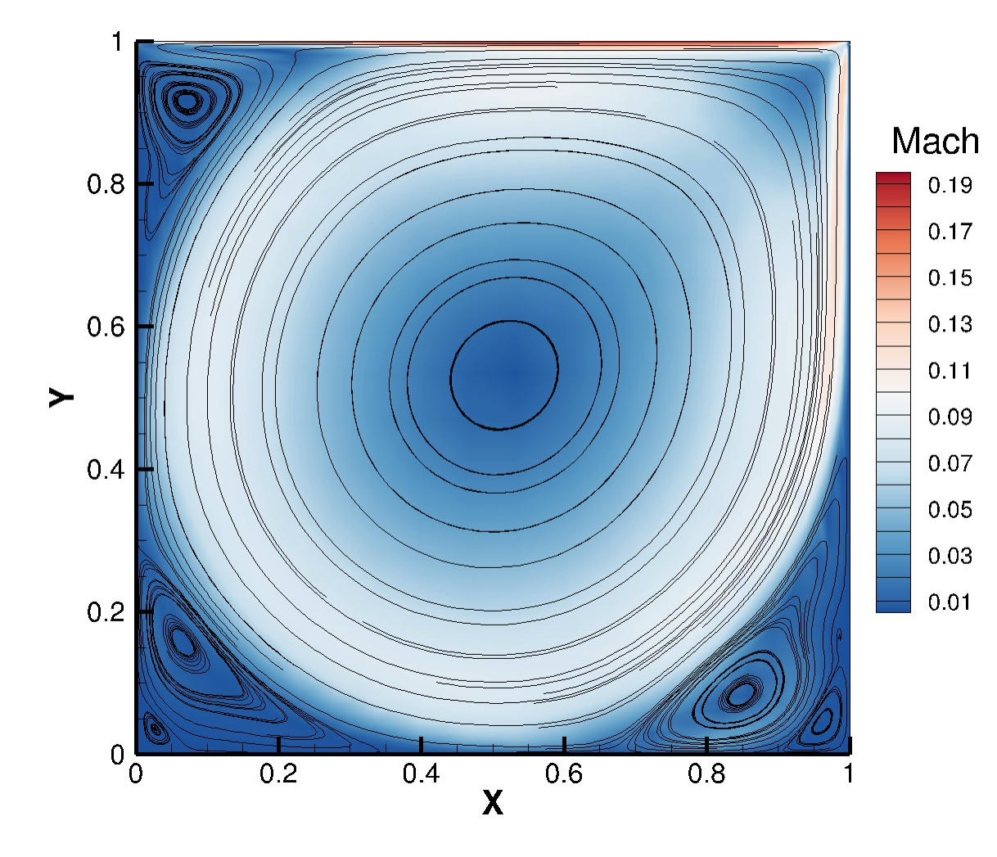
Example 3. Quasi-2D lid driven square cavity
At lid velocity of V_{B}=(0.2,0,0) and Re=10,000.
Figure. The hexahedral grid and streamtraces of a quasi-2D lid driven cavity

Slide 18
Example 3. Quasi-2D lid driven square cavity
At lid velocity at V_{B}=(0.2,0,0) and Re=10,000.
Grids | Elements | GPU’s | Storage(GB) |  | Unit time (ms)
 |  |  | P1 | P1P2 | P1 | P1P2
Level-1 | 500,000 | ×1 | 2.3 | 3.0 | 9.40 | 15.04
Level-2 | 1,000,000 | ×2 | 4.6 | 6.1 | 9.54 | 15.33
Level-3 | 2,000,000 | ×4 | 9.2 | 12.2 | 9.63 | 15.72
Level-4 | 4,000,000 | ×8 | 19.6 | 24.4 | 9.68 | 16.47

Slide 19
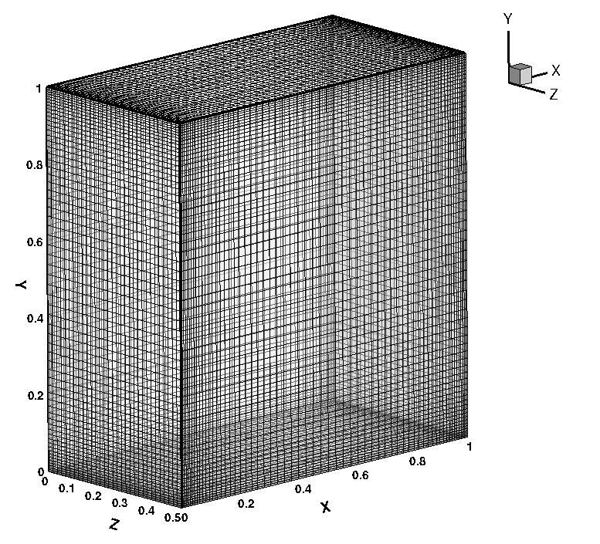
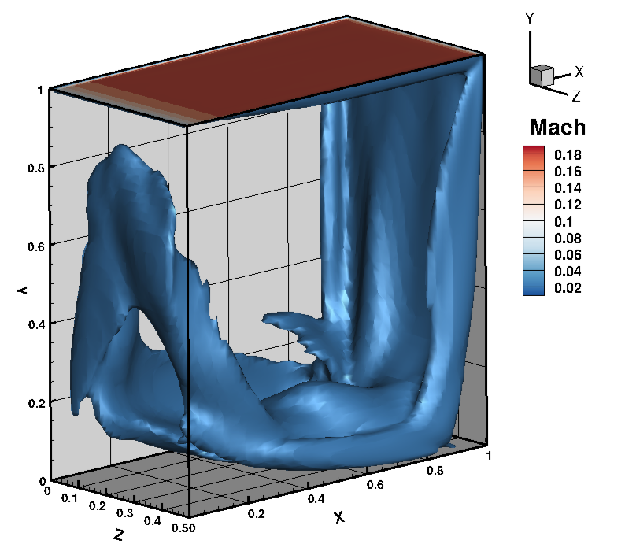
Example 4. 3D lid driven square cavity
At lid velocity at V_{B}=(0.2,0,0) and Re=10,000.
Figure. The hexahedral grid and streamtraces of a 3D lid driven cavity

Slide 20
Example 4. 3D lid driven square cavity
At lid velocity at V_{B}=(0.2,0,0) and Re=10,000.
Grids | Elements | GPU’s | Storage(GB) |  | Unit time (ms)
 |  |  | P1 | P1P2 | P1 | P1P2
Level-1 | 500,000 | ×1 | 2.3 | 3.0 | 10.60 | 15.03
Level-2 | 1,000,000 | ×2 | 4.6 | 6.1 | 10.82 | 15.36
Level-3 | 2,000,000 | ×4 | 9.2 | 12.2 | 10.83 | 15.84

Slide 21
Concluding Remarks
RDGFLO with OpenACC
Performance on multiple GPU (weak scaling) High parallel efficiency for DG(P1) and RDG(P1P2) Extensibility The current parallel strategy can be applied to more functionalities Verified compilers PGI Fortran Verified platform NVIDIA CUDA-enabled GPUs Limitation Memory constraint on GPU device Balance between [optimal GPU parallelism] and [code portability] Speed-up (Strong scaling) An average scaling factor of over 22.0x vs. 1 CPU core An average scaling factor of over 1.4x vs. 16 CPU cores

Slide 22
Future Work
Implicit time integration
Challenging issues Algorithms suitable for GPU parallel computing memory limitation on GPU devices
p-multigrid Discontinuous Galerkin method
Higher approximation: RDG(P1P2)+explicit TVDRK3 Lower approximation: DG(P0)+implicit first order backward Euler

Slide 23
Future Work
Flowchart of p-multigrid DG method
Explicit TVDRK RDG(P1P2) + implicit backward Euler DG(P0)
Workflow for the Navier-Stokes / Euler equations
DO itime = 1, ntime | →Transfer P1→P0
→ Predict time-step size on higher level | →Predict time-step size on lower level
 | → Compute R.H.S vector R
DO istage = 1 , nstage | → Compute L.H.S matrix A = M/dt – dR/dU
 | → Solve the linear system Au=R
→P1P2 least-squares reconstruction | GMRES algorithm
→R.H.S. from diffusion | → …
→WENO reconstruction | → Preconditioning: P⁻¹Au=P⁻¹R
→R.H.S. from convection | Option 0. no preconditioning ✗
→obtain initial solution on higher level | Option 1. Jacobian
 | Option 2. LU-SGS
ENDDO | → Transfer P0→P1 and update
 | ENDDO
Notes:
Remarks:
(1)For structured grids P can be as simple as only the diagonal of A. (2) For unstructured grids P at least needs to be the block-diagonal of A for efficiently preconditioning

