Slide 1
GenIDLEST Co-Design
Amit Amritkar & Danesh Tafti
Collaborators
Wu-chun Feng, Paul Sathre, Kaixi Hou, Sriram Chivukula, Hao Wang, Tom Scogland,
Eric de Sturler & Kasia Swirydowicz
Virginia Tech
AFOSR-BRI Workshop
July 23 2014

Slide 2
Solver co-design with Math team
Amit Amritkar, Danesh Tafti, Eric deSturler, Katarzyna Swirydowicz
Solution of pressure Poisson equation
  Most time consuming function (50 to 90 % of total time)
Solving multiple linear systems Ax = b
  ‘A’ remains constant from one time step to other in many CFD calculations
rGCROT/rGCRODR algorithm
  Recycling of basis vectors from one time step to the subsequent ones
Hybrid approach
  rGCROT to build the outer vector space initially
  rBiCG-STAB for subsequent systems for faster performance

Slide 3
Co-design with CS team
Amit Amritkar, Danesh Tafti, Wu Feng, Paul Sathre, Kaixi Hou, Sriram Chivukula, Hao Wang, Tom Scogland
Manual CUDA code optimization
  From 5x to 10x
OpenACC version of the code
  OpenACC vs CUDA code performance (Currently at 0.4x)
Integration with “Library”
  Dot product
  Inter mesh block communication

Slide 4
Publications
Amit Amritkar, Eric De Sturler, Katarzyna Swirydowicz, Danesh Tafti and Kapil Ahuja. “Recycling Krylov subspaces for CFD application.” To be submitted to Computer methods in Applied Mechanics and Engineering
Amit Amritkar and Danesh Tafti. “CFD computations using preconditioned Krylov solver on GPUs.” Proceedings of ASME 2014 Fluids Engineering Division Summer Meeting, August 3-7, 2014, Chicago, Illinois, USA
Katarzyna Swirydowicz, Amit Amritkar, Eric De Sturler and Danesh Tafti. “Recycling Krylov subspaces for CFD application.” Presentation at ASME 2014 Fluids Engineering Division Summer Meeting, August 3-7, 2014, Chicago, Illinois, USA
Amit Amritkar, Danesh Tafti, Paul Sathre, Kaixi Hou, Sriram Chivakula and Wu-Chun Feng. “Accelerating Bio-Inspired MAV Computations using GPUs.” Proceedings of AIAA Aviation and Aeronautics Forum and Exposition 2014, 16 - 20 June 2014, Atlanta, Georgia

Slide 5
Future work
Use GPU aware MPI
  GPU Direct v2 gives about 25% performance improvement
Overlapping computations with communications
Integrate with the library developed by the CS team
  Assess performance on multiple architectures
Evaluation of RK methods (Rosenbrock-Krylov) and IMEX DIMSIM for fractional step algorithm
Evaluation of OpenACC for portability and OpenMP 4.0 for accelerator programming
Use of co-processing (Intel mic)
  Combination of CPU and Co-processor
Notes:
Data copy between CPU/GPU with face data pack/unpack

Slide 6
Comparison of execution time for OpenACC vs CUDA vs CPU (serial)

Slide 7
Recap
GPU version of GenIDLEST
  Strategy
Validation studies of the GPU code
  Turbulent channel flow
  Turbulent pipe flow
Application
  Bat flight

Slide 8
Outline
Co-design
  CS Team
  Math Team
Future work
GenIDLEST Code
  Features and capabilities
Application
  Bat flight – scaling study
Other modifications

Slide 9
GenIDLEST Flow Chart

Slide 10
Data Structures and Mapping to Co-Processor Architectures
Global grid
Compute Node
Nodal grid
CPUs
Co-procs.
GPU
MPI
offload
Mesh blocks
OpenMP
offload
Intel MIC
Cache blocks
MPI
MPI

Slide 11
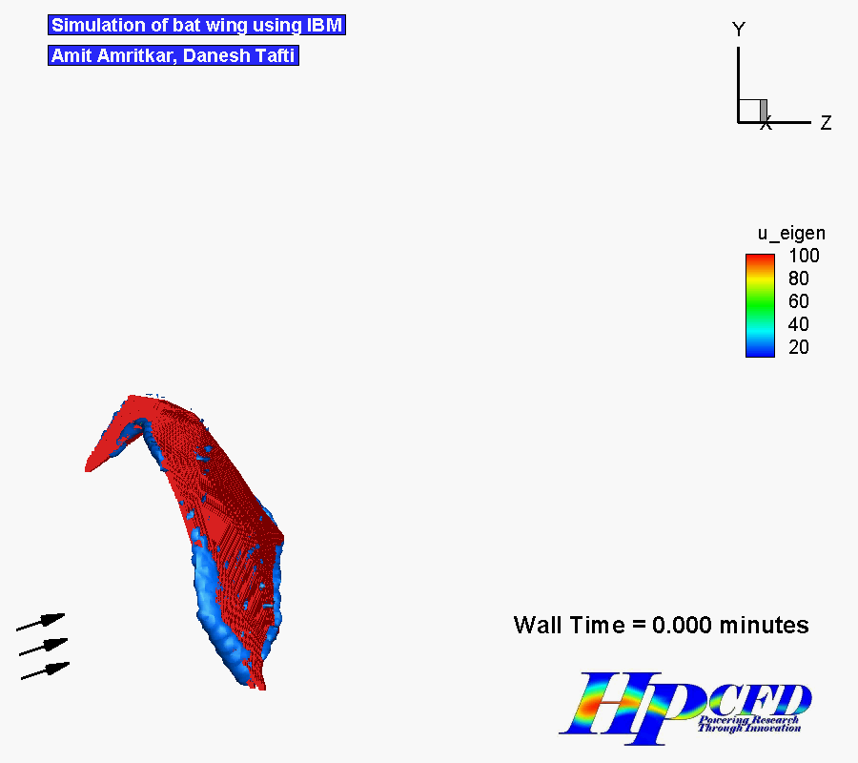
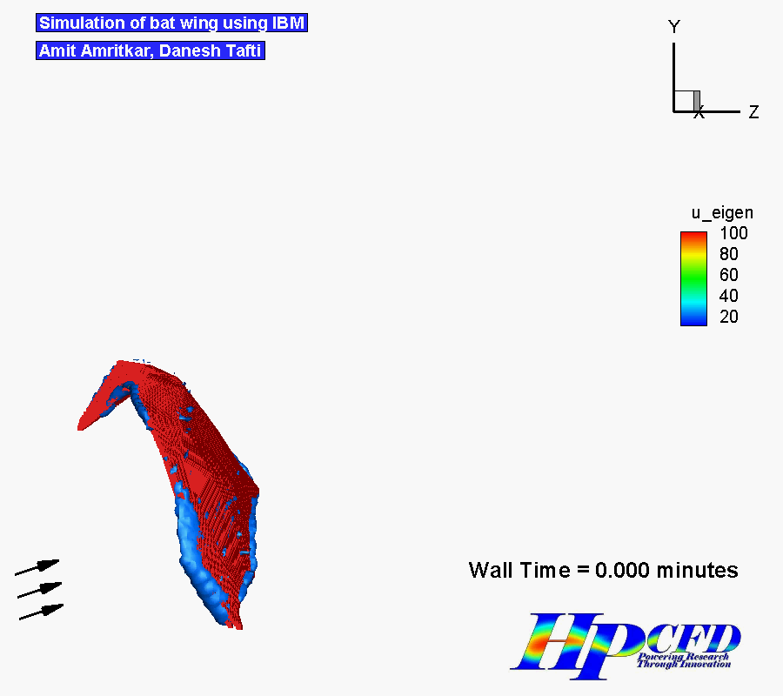
GPU (60 GPUs) CPU (60 CPU cores)

Slide 12
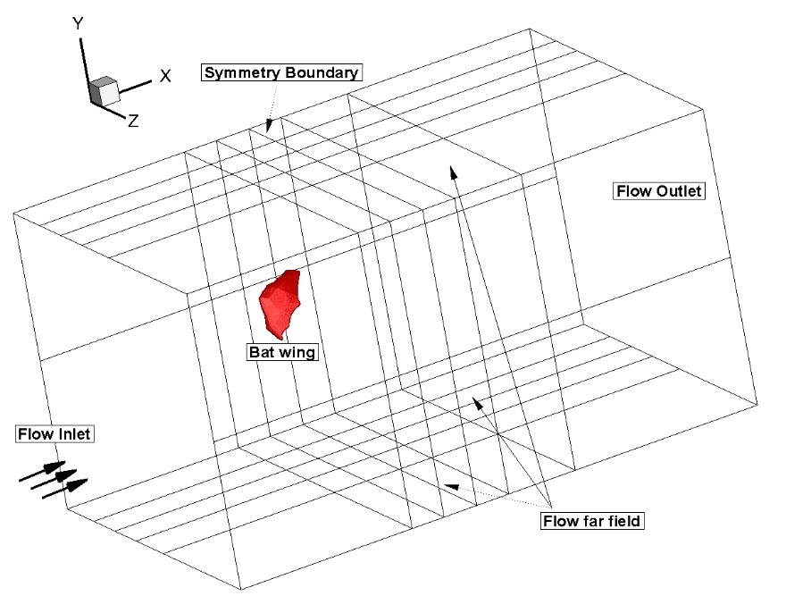
GPU code scaling study
Strong scaling study
  Bat flight
  24 million grid node
HokieSpeed – no RDMA

Slide 13
Comparison of mean time taken on 32 GPUs
The time taken in data exchange related calls has increased for 256 mesh block case
Local copy on a GPU is expensive

Slide 14
Code profiling
Consolidated profiling data
  Time spent (percentage)
CPU calculations are pre and post processing of data including I/O
Communication costs dominate
  Potentially reduce by using RDMA (GPUDirect v3)
 | 256 Mesh block | 32 Mesh block
Communication | 61 | 40
GPU calculations | 22 | 35
CPU calculations | 8 | 15
Other | 9 | 10

Slide 15
Modifications to the point Jacobi preconditioner
Original version on GPU
  Only one iteration per load into memory
  Synchronization across thread blocks after every inner iteration
Modified version on GPU
  Use of shared memory
    Multiple inner iterations
  Synchronization across thread blocks after all inner iterations
Do iterations
  Launch kernel
  stencil calculations
  End
  End
  Launch kernel
Do iterations
stencil calculations
End
End

Slide 16
Modified preconditioner
Time in pressure solving for 1 time step
  Same number of iterations to converge
Turbulent channel flow
Bat wing flapping
# GPUs | Original kernel (s) | Modified kernel (s) | Speedup
1 | 0.236 | 0.159 | 1.32x
4 | 3.075 | 2.033 | 1.33x
# GPUs | Original kernel (s) | Modified kernel (s) | Speedup
32 | 5.13 | 3.04 | 1.4x
64 | 1.96 | 1.61 | 1.17x

Slide 17
Non-orthogonal case optimization
Pipe flow calculations
  19 point stencil
Time in pressure calculations for 1 time step
  Same number of iterations to converge
Use of shared memory
  Size limitations
    Reduce the cache block size further
    Other strategy to load all variables into shared memory
# GPUs | Original (s) | Optimized (s) | Speedup
36 | 0.67 | 0.625 | 1.06x

Slide 18
Other modifications
Modifications to accommodate multiple layers of cells for communication
  Modified in-situ calculations of i,j,k mapping to a threadblock
  Modified indices in dot_product
Convergence check on GPUs
  Reduction kernel

Slide 19
TAU profiling results
Time take in various subroutines for (32 block case)
Column legend (exclusive)
MPI_send_recv (G)
Preconditioner (G)
Dot product (G)
Exchange_variable (G)
MPI_allreduce (MPI)
MPI_waitall (MPI)
Calc_face_value (CPU)
Face_value_soc (CPU)
Preconditioner momentum (G)
Update_cell_flux (CPU)
Bicgstab momentum (G)
Tecplot file writing (CPU)
Bicgstab (G)
Flux (CPU)
Convect (CPU)
Others (mixed)
The time taken in data exchange is high and should decrease with GPUDirect
CPU time is about 20% of total time

