Slide 1


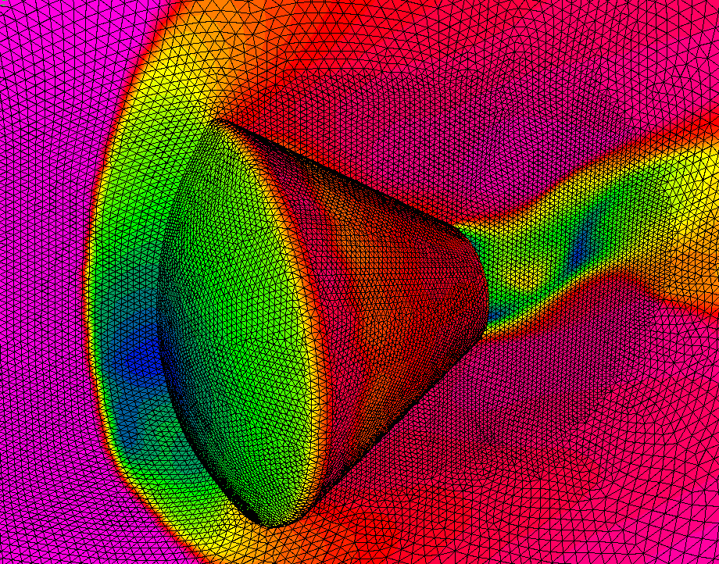
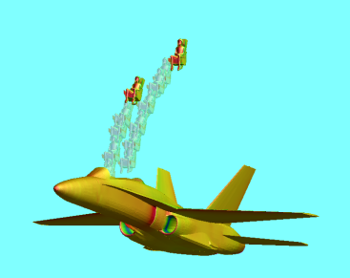
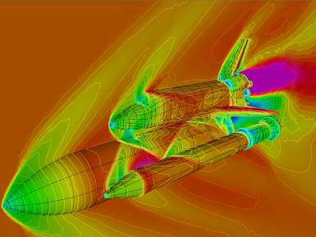
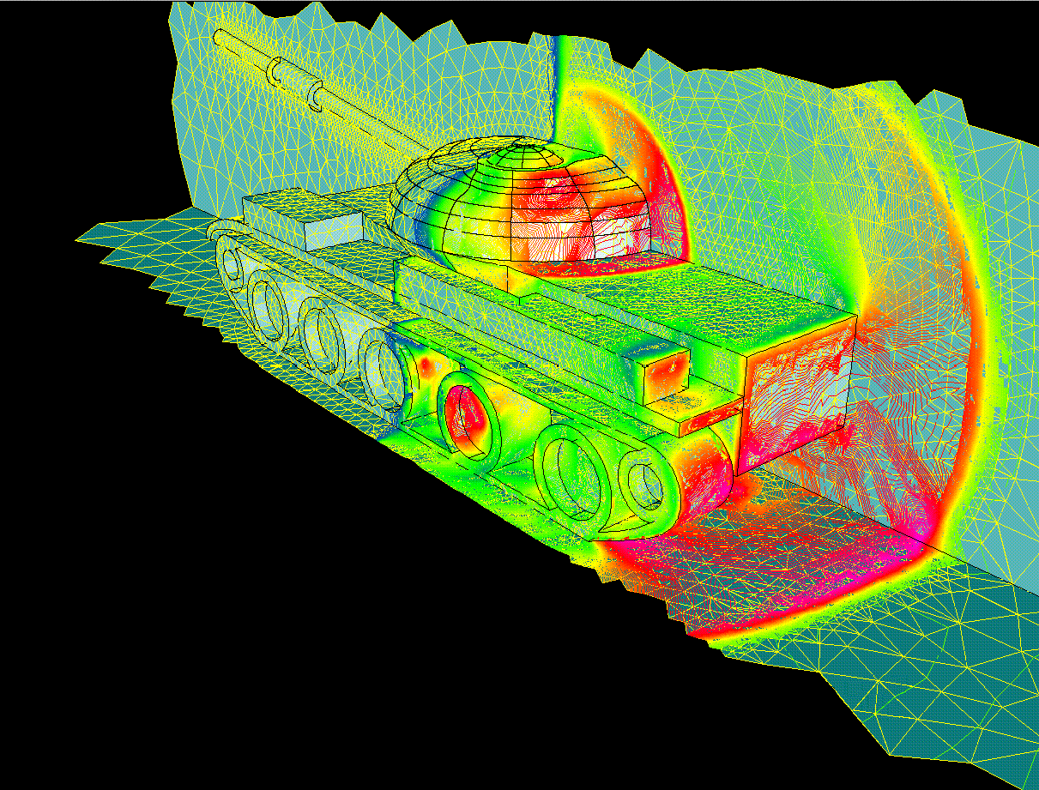
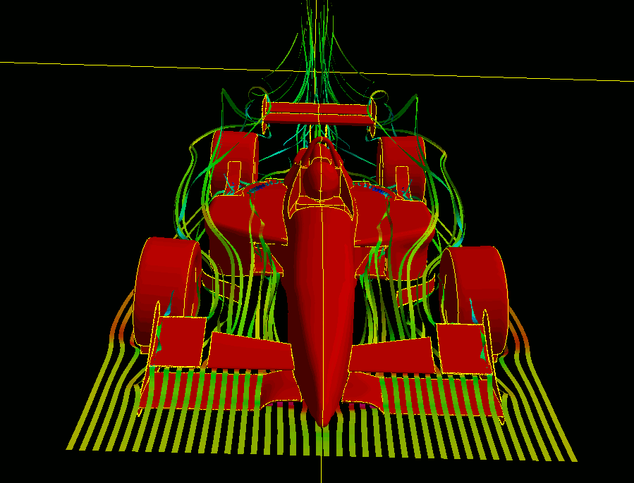
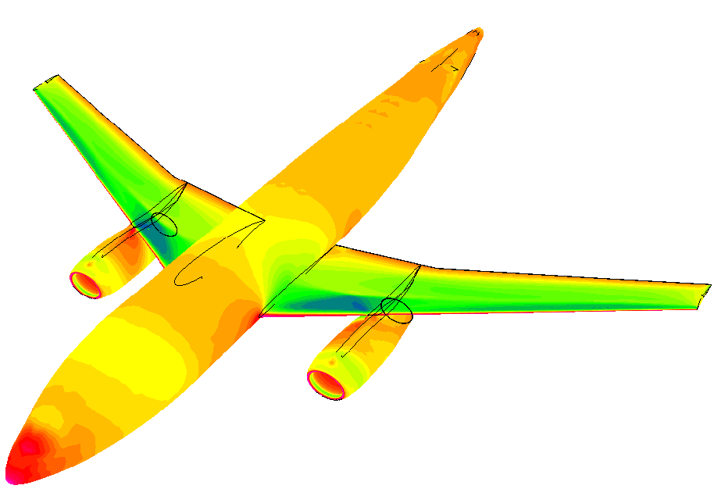
Development of a Portable, GPU-Accelerated Reconstructed Discontinuous Galerkin Code on Unstructured Hybrid Grids
AFOSR BRI
Co-Design of Hardware/Software for Predicting UAV Aerodynamics
Jialin Lou, Xiaodong Liu, Lixiang Luo, Hong Luo, and Jack Edwards
Department of Mechanical and Aerospace Engineering
North Carolina State University
and
Frank Mueller, and Saransh Gupta
Department of Computer Science
North Carolina State University
Presented by Jialin Lou, Ph.D. Student
Friday, December 19 2014

Slide 2
Outline
AFOSR BRI – Co-Design of Hardware/Software for Predicting UAV Aerodynamics
Overview
Motivation and objective
Governing equations of fluid dynamics
Discontinuous Galerkin formulation
Development of RDGFLO code
Applications
Concluding remarks
Future work

Slide 3
GPU Computing in CFD – Overview
AFOSR BRI – Co-Design of Hardware/Software for Predicting UAV Aerodynamics
GPGPU
General-purpose computing on graphics processing units The utilization of GPU, which typically handles computation only for computer graphics, to perform computation in applications traditionally handled by CPU.
Why?
The great potential and scalability of GPGPU for CFD applications!
How?
Offload the computing-intensive portion from the host CPUs to the GPU devices.
Programming models
OpenCL: the currently dominant open GPGPU programming language NVIDIA’s CUDA: the dominant proprietary framework OpenACC: a collection of directives designed to simplify parallel programming
Notes:
Not new concept. It’s roughly clear to everyone in scientific computing why you want to it and how you can do it. But maybe a lot of people do not know much what specific method to try.

Slide 4
GPU Computing in CFD – Overview
AFOSR BRI – Co-Design of Hardware/Software for Predicting UAV Aerodynamics
A variety of applications (selected)
For the finite difference method (FDM) E. Elsen, P. LeGresley, and E. Darve. Large Calculation of the Flow over a Hypersonic Vehicle Using a GPU. J. Comput. Phys., 227(24):10148–10161, 2008. For the finite volume method (FVM) A. Corrigan, F. Camelli, R. Löhner, and J. Wallin. Running Unstructured Grid-based CFD Solvers on Modern Graphics Hardware. Int. J. Numer. Methods Fluids, 66(2):221–229, 2011. For the spectral difference method (SDM) B. Zimmerman, Z. Wang, and M. Visbal. High-Order Spectral Difference: Verification and Acceleration Using GPU Computing. AIAA Paper, 2013-2491, 2013. For the discontinuous Galerkin method (DGM) A. Klöckner, T. Warburton, J. Bridge, and J. S. Hesthaven Nodal Discontinuous Galerkin Methods on Graphics Processors. J. Comput. Phys., 228(21):7863–7882, 2009.
Observation: most GPU-related CFD solvers are based on CUDA

Slide 5
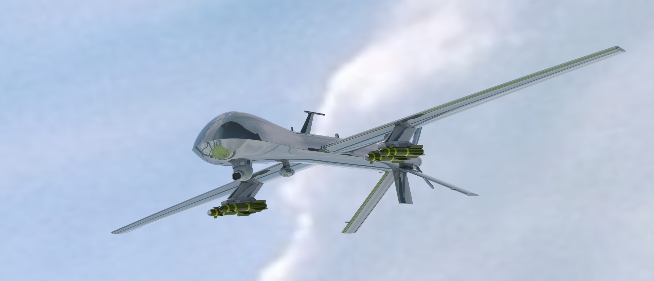
Motivation & Objectives
AFOSR BRI – Co-Design of Hardware/Software for Predicting UAV Aerodynamics
Motivation
Tap the power of GPU parallel computing for the aerodynamic design of Unmanned Aerial Vehicle (UAV) with CFD toolkits
MQ-1 Predator UAV (Source: grabcad.com CAD by Chao Wey)

Slide 6


Motivation & Objectives
AFOSR BRI – Co-Design of Hardware/Software for Predicting UAV Aerodynamics
Objectives
A portable, efficient and ultimately competitive GPU parallelization strategy for extensible and sustainable high-fidelity CFD code development
An unavoidable debate – CUDA, OpenCL or OpenACC?
It really depends on your needs, e.g., for us, cross-platform portability Support from a wide range of compiler and accelerator vendors C/C++ and Fortran Best performance Less fine-tuning effort, especially for a legacy code package Available computing resource

Slide 7







GPU-Computing Framework
AFOSR BRI – Co-Design of Hardware/Software for Predicting UAV Aerodynamics
Desirable features of the resulting CFD code
Multi-compiler compatibility GNU Fortran compiler Intel Fortran compiler PGI Accelerator Fortran compiler (with OpenACC support) CAPS Fortran compiler (with OpenACC support) Cross-platform portability Intel CPUs AMD CPUs / APUs (with potential OpenACC support in 2014) NVIDIA CUDA-enabled GPUs (with OpenACC support) Extensible and sustainable programming schemes Competitive performance
Notes:
In a practical sense, the current OpenACC-based code does not enjoy a wide range of portability.

Slide 8
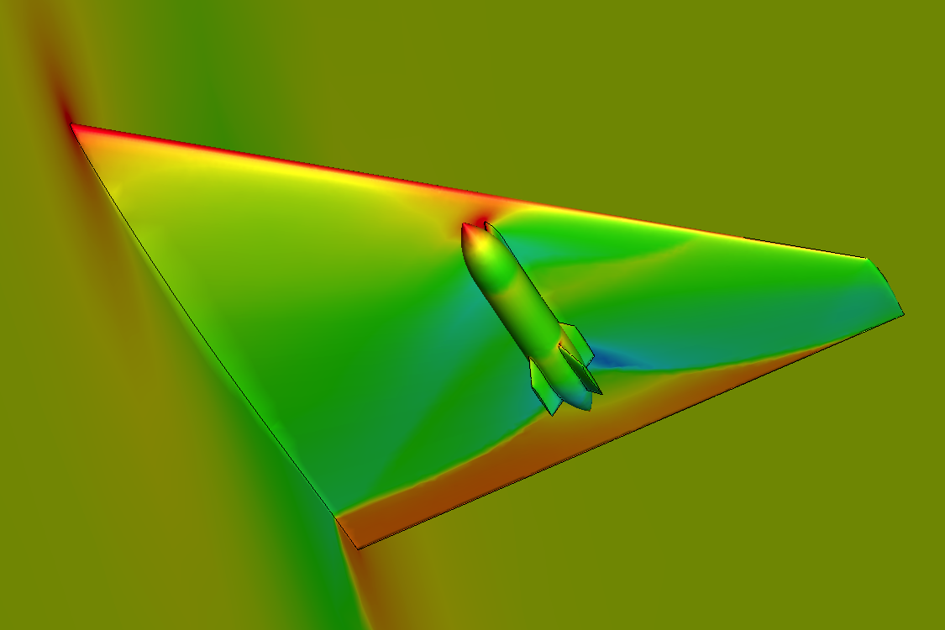
Legacy CFD Package
AFOSR BRI – Co-Design of Hardware/Software for Predicting UAV Aerodynamics
RDGFLO – a baseline code for OpenACC-based GPU parallelization
A Reconstructed Discontinuous Galerkin finite element FLOw code High-order solution of compressible flows at all speeds on 3-D hybrid grids Explicit / implicit solution schemes Domain-partition based MPI parallel computing
Gallery
ONERA M6 wing
wing/pylon/finned-store configuration
Boeing 747 aircraft

Slide 9
Governing Equations of Fluid Dynamics
AFOSR BRI – Co-Design of Hardware/Software for Predicting UAV Aerodynamics
The Navier-Stokes equations for unsteady compressible flows
where the summation convention is used. The conservative variable vector U, advective flux vector F, and viscous flux G are defined by

Slide 10
Governing Equations of Fluid Dynamics
AFOSR BRI – Co-Design of Hardware/Software for Predicting UAV Aerodynamics
The Navier-Stokes equations for unsteady compressible flows (cont.)
The pressure p can be computed from the equation of state (EOS) which is valid for perfect gas. The ratio of specific heats γ is assumed to be constant and equal to 1.4. The viscous stress tensor τ_{ij} and heat flux vector q_{j} are given by where T is the temperature of the fluid, Pr the laminar Prandtl number, which is 0.7 for air. μ represents the molecular viscosity, which can be determined through the Sutherlands law where μ₀ is the viscosity at the reference temperature T₀ and S = 110K.

Slide 11
Discontinuous Galerkin Method
AFOSR BRI – Co-Design of Hardware/Software for Predicting UAV Aerodynamics
Weak formulation of the governing equations
where B_{i}(x) is the basis function of polynomials of degree p, and N is the dimension of the polynomial space p. The Taylor-basis discontinuous Galerkin (DG(p)) solution in each element For example, the underlying piecewise linear polynomial DG(P1) solution where (x_{c}, y_{c}, z_{c}) is the coordinate of the element center.

Slide 12
Reconstructed Discontinuous Galerkin Method
AFOSR BRI – Co-Design of Hardware/Software for Predicting UAV Aerodynamics
Hierarchical WENO reconstruction
A quadratic polynomial DG(P2) solution is obtained via a hierarchical WENO reconstruction approach in each element Least-squares reconstruction to obtain an initial quadratic solution WENO reconstruction for the second derivatives to maintain linear stability WENO reconstruction for the first derivatives to maintain nonlinear stability References H. Luo, Y. Xia, S. Li, and R. Nourgaliev. A Hermite WENO Reconstruction-Based Discontinuous Galerkin Method for the Euler Equations on Tetrahedral grids. J. Comput. Phys. 231(16):5489–5503, 2012. H. Luo, Y. Xia, S. Spiegel, R. Nourgaliev, and Z. Jiang. A Reconstructed Discontinuous Galerkin Method Based on a Hierarchical WENO Reconstruction for Compressible Flows on Tetrahedral Grids. J. Comput. Phys. 236:477–492, 2013.

Slide 13
Discontinuous Galerkin Method
AFOSR BRI – Co-Design of Hardware/Software for Predicting UAV Aerodynamics
Semi-discrete form
A system of ordinary differential equations (ODEs) in time where M is the mass matrix and R is the residual vector. Three-stage TVD Runge-Kutta (TVDRK3) time stepping

Slide 14
Design of OpenACC Parallel Regions
AFOSR BRI – Co-Design of Hardware/Software for Predicting UAV Aerodynamics
Example: a readily vectorizable region
Domain integral: loop over mesh elements Ω_{e}
OpenMP version !$omp parallel !$omp do do ie = 1, Nelem do ig = 1, Ngp !... contribution to this element rhsel(:, :, ie) = rhsel(:, :, ie) + flux enddo enddo !$omp end parallel | OpenACC version !$acc parallel !$acc loop do ie = 1, Nelem do ig = 1, Ngp !... contribution to this element rhsel(:, :, ie) = rhsel(:, :, ie) + flux enddo enddo !$acc end parallel

Slide 15
Design of OpenACC Parallel Regions
AFOSR BRI – Co-Design of Hardware/Software for Predicting UAV Aerodynamics
Example: a region that is not readily vectorizable
Face integral: loop over mesh faces Τ_{e}
OpenMP version !$omp parallel !$omp do do ifa = Njfac+1, Nafac do ig = 1, Ngp !... contribution to the face-left element rhsel(:, :, iel) = rhsel(:, :, iel) - flux !... contribution to the face-right element rhsel(:, :, ier) = rhsel(:, :, ier) + flux enddo enddo !$omp end parallel | OpenACC version !$acc parallel !$acc do do ifa = Njfac+1, Nafac do ig = 1, Ngp !... contribution to the face-left element rhsel(:, :, iel) = rhsel(:, :, iel) - flux !... contribution to the face-right element rhsel(:, :, ier) = rhsel(:, :, ier) + flux enddo enddo !$acc end parallel
“race condition” – multiple writes to the same elemental residual vector!

Slide 16
Design of OpenACC Parallel Regions
AFOSR BRI – Co-Design of Hardware/Software for Predicting UAV Aerodynamics
A common method for avoiding “race condition” in face integral
Perform face integral at the element level All the computing is implemented as loops over mesh elements Overheads Lead to redundant computation of face integrals (doubled!) Require an additional element-face connectivity array Reference articles on unstructured DG/FV methods (with CUDA) A. Corrigan et al. Running Unstructured Grid-based CFD Solvers on Modern Graphics Hardware. Int. J. Numer. Methods Fluids, 66(2):221–229, 2011. Tristan Cabel and Stephane Lanteri. Discontinuous Galerkin Time-Domain Solver on GPU Based Systems. Plafrim meeting, May 31, 2011
This design approach requires a major rebuild in code structures!
Notes:
This “element based” loop strategy is still a very fast method on GPU devices, if you read the referred papers

Slide 17
Design of OpenACC Parallel Regions
AFOSR BRI – Co-Design of Hardware/Software for Predicting UAV Aerodynamics
An alternative approach to avoiding “race condition” in face integral
Face renumbering (coloring method) renumber the faces and split them into several groups. Any two faces that share a common cell do not reside in the same group. The original face loops are nested in a sequential loop over groups.
An example of “face renumbering & grouping”
Before
Physical boundary faces |  |  |  | Partition boundary faces |  |  | Internal faces
After
4 groups |  |  |  | 3 groups |  |  | 6 groups

Slide 18
Design of OpenACC Parallel Regions
AFOSR BRI – Co-Design of Hardware/Software for Predicting UAV Aerodynamics
Example: face loops after “face renumbering & grouping”
The original face loops are nested in a sequential loop over groups.
OpenMP version Nfac1 = Njfac do ipass = 1, Npass_ift Nfac0 = Nfac1 + 1 Nfac1 = fpass_ift(ipass) !$omp parallel !$omp do do ifa = Nfac0, Nfac1 do ig = 1, Ngp !... contribution to the face-left element rhsel(:, :, iel) = rhsel(:, :, iel) - flux !... contribution to the face-right element rhsel(:, :, ier) = rhsel(:, :, ier) + flux enddo enddo !$omp end parallel enddo | OpenACC version Nfac1 = Njfac do ipass = 1, Npass_ift Nfac0 = Nfac1 + 1 Nfac1 = fpass_ift(ipass) !$acc parallel !$acc do do ifa = Nfac0, Nfac1 do ig = 1, Ngp !... contribution to the face-left element rhsel(:, :, iel) = rhsel(:, :, iel) - flux !... contribution to the face-right element rhsel(:, :, ier) = rhsel(:, :, ier) + flux enddo enddo !$acc end parallel enddo

Slide 19
Design of OpenACC Parallel Regions
AFOSR BRI – Co-Design of Hardware/Software for Predicting UAV Aerodynamics
“Face renumbering & grouping” vs. “element loops”
Advantages No redundant computation. Least intrusion to the original code structures. Recoverable to CPU parallel computing. Disadvantages Sequential groups lead to overheads in initializing more parallel kernels. Remarks No direct comparison of these two strategies is yet conducted for our solver. It is unknown which will render better performance on GPU. Since portability is our design priority, the current approach is a preferred, although optimal performance might be compromised.

Slide 20
Development of RDGFLO
Workflow for p-multigird Discontinuous Galerkin method
!! Loop over time steps | !! P-multgrid
DO itime = 1, ntime | <ACC> Transfer P1->P0
<ACC> Predict time-step size on higher level | <ACC> Predict time-step size on lower level
!! Loop over TVDRK stages for rDG(P1P2) | <ACC> Compute R.H.S vector R
Do istage = 1, nstage | <ACC> Compute L.H.S matrix A = M/dt – dR/dU
 | <ACC> Solve the linear system Au=R
<ACC> P1P2 least-squares reconstruction | !! Linear solver + Preconditioner
<ACC> R.H.S. residual from diffusion | ! Preconditioning: P⁻¹Au=P⁻¹R
<ACC> WENO reconstruction | ! Option 1. GMRES + LU-SGS
<ACC> residual from convection | ! Option 2. LU-SGS + Jacobi
<ACC> update solution vector | ! Option 3. Jacobi
 | ! Option 4. …
ENDDO | ENDDO

Slide 21





Computing Resource
CPU
2-way SMPs with AMD Opteron 6128 (Many Core) with 8 cores per socket (16 cores per node) 32 GB DRAM 2.0 GHz core-speed for 6128 Opteron (single core)
GPU
NVIDIA Tesla K20c Memory amount: 5.0 GB Stream processors: 2496
Software (64 bit)
Operating system CentOS 5.7 Linux x86 64 Compilation & runtime suite PGI Accelerator with OpenACC (ver. 13.9) OpenMPI (ver. 1.5.1)

Slide 22
Performance Assessment
AFOSR BRI – Co-Design of Hardware/Software for Predicting UAV Aerodynamics
Timing measurements
Unit running time T_{unit} where the running time T_{run} refers to the time recorded for completing the time marching loop with a given iteration number Ntime.
Control sets (simulations in double-precision arithmetic)
GPU | Parallel computing with 1 GPU device
CPU | Serial computing with 1 CPU core

Slide 23
Timing test
Subsonic flow past a sphere at M∞ = 0.50 and α = 0°.
On a sequence of four successively refined tetrahedral grids. Pressure contours plotted on the surface triangular meshes

Slide 24
Timing test
Timing measurements of using p-multigrid DG methods
 | T_{unit} by pMG DG(P1) |  |  | T_{unit} by pMG rDG(P1P2)
Nelem | GPU | CPU | Speedup | GPU | CPU | Speedup
2,426 | 12.53 | 16.31 | 1.30 | 25.93 | 39.95 | 1.54
16,467 | 5.15 | 19.40 | 3.77 | 16.36 | 49.28 | 3.01
124,706 | 3.01 | 27.15 | 9.00 | 13.55 | 53.24 | 3.94
966,497 | 2.02 | 21.37 | 10.58 | - | - | -

Slide 25
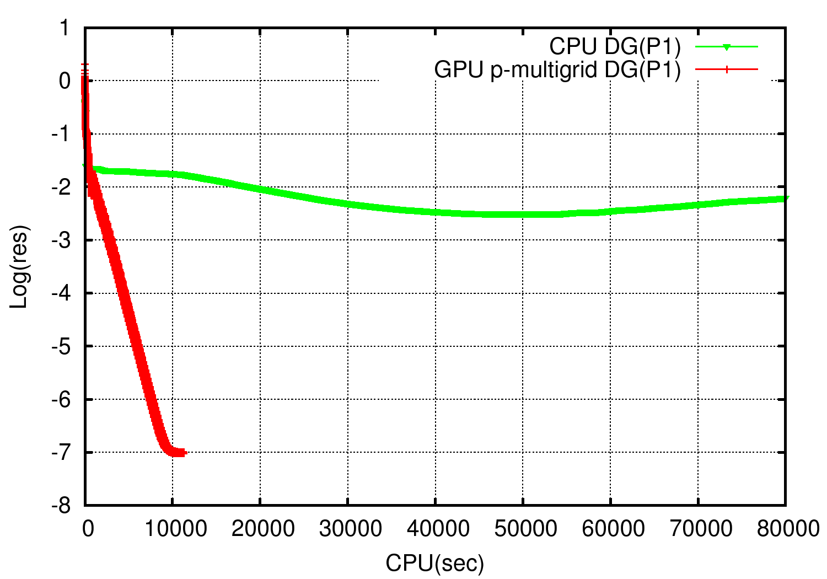
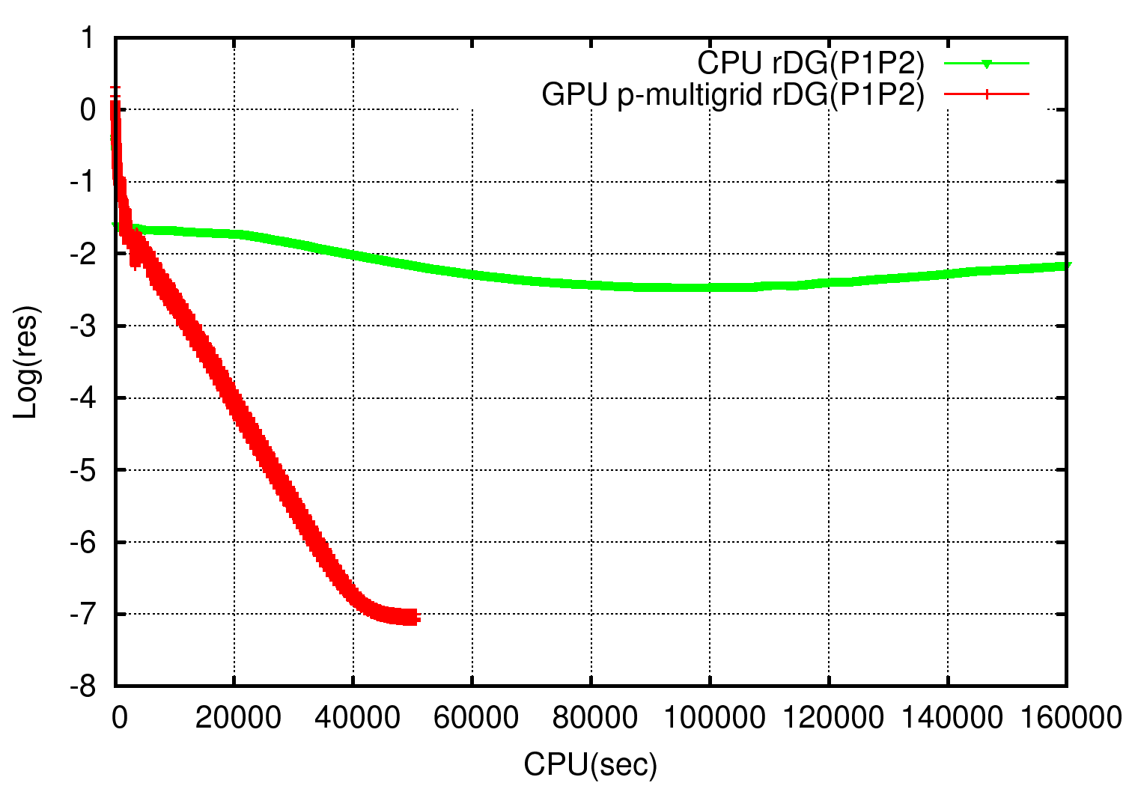
Timing test
Convergence history v.s. CPU time between pMG DG on GPU and DG on CPU.

Slide 26
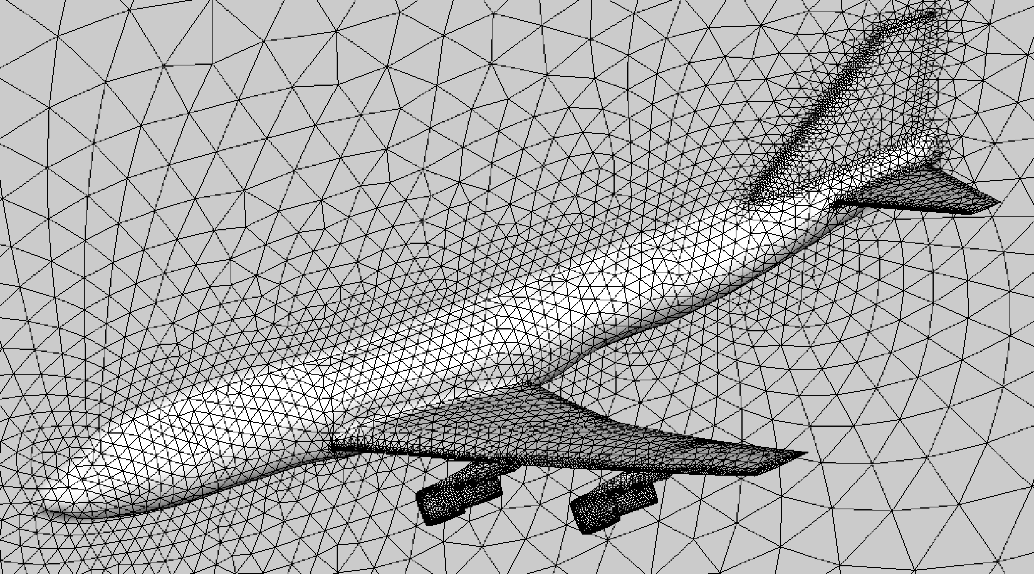
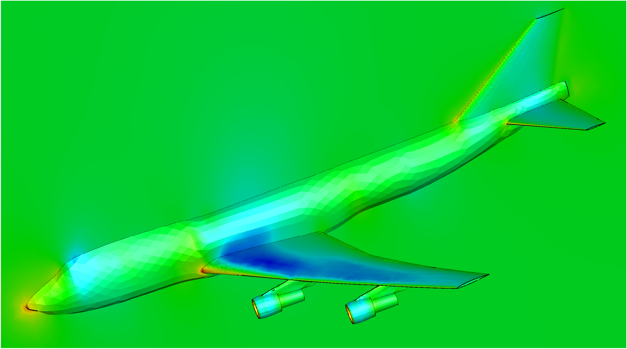
Timing test
Transonic flow over a Boeing 747 aircraft. M∞ = 0.85 and α = 2°.
On a set of two tetrahedral grids. (nelem = 253,577 and 1,025,170) Pressure contours plotted on the surface of the Boeing 747 aircraft.

Slide 27
Timing test
Timing measurements of using p-multigrid DG methods
 | T_{unit} by pMG DG(P1) |  |  | T_{unit} by pMG rDG(P1P2)
Nelem | GPU | CPU | Speedup | GPU | CPU | Speedup
253,477 | 3.47 | 21.49 | 6.19 | 32.94 | 81.43 | 2.47
1,025,170 | 2.61 | 22.71 | 8.70 | - | - | -

Slide 28
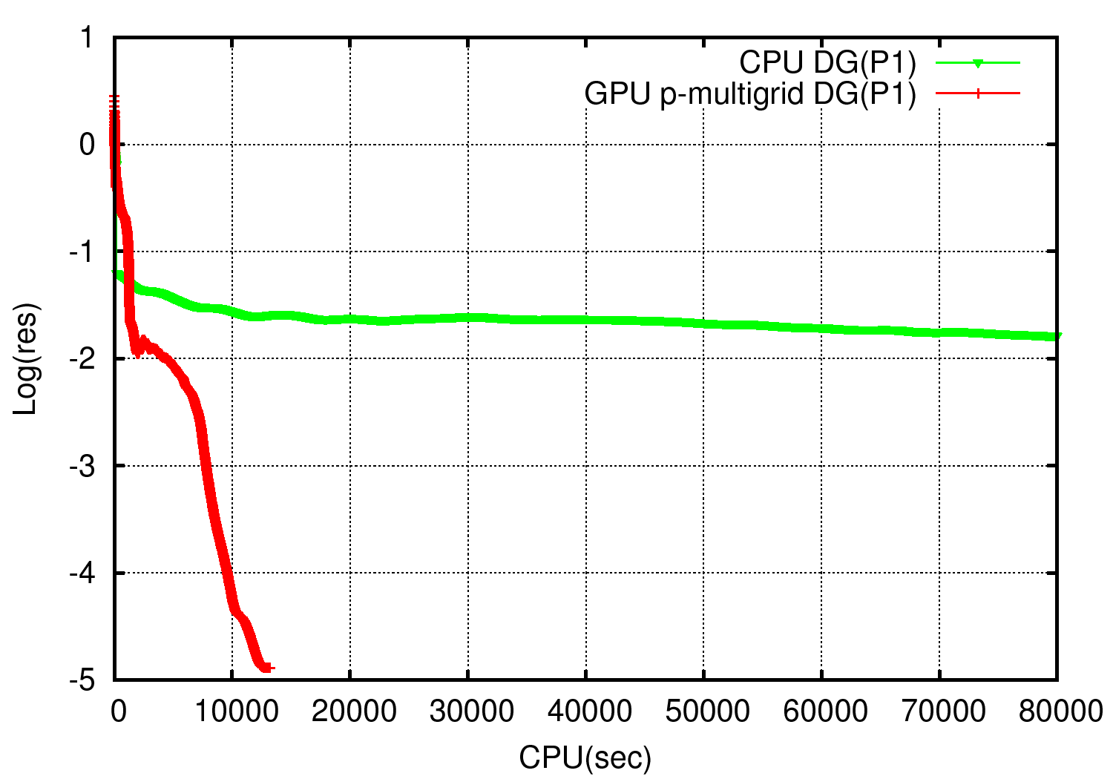
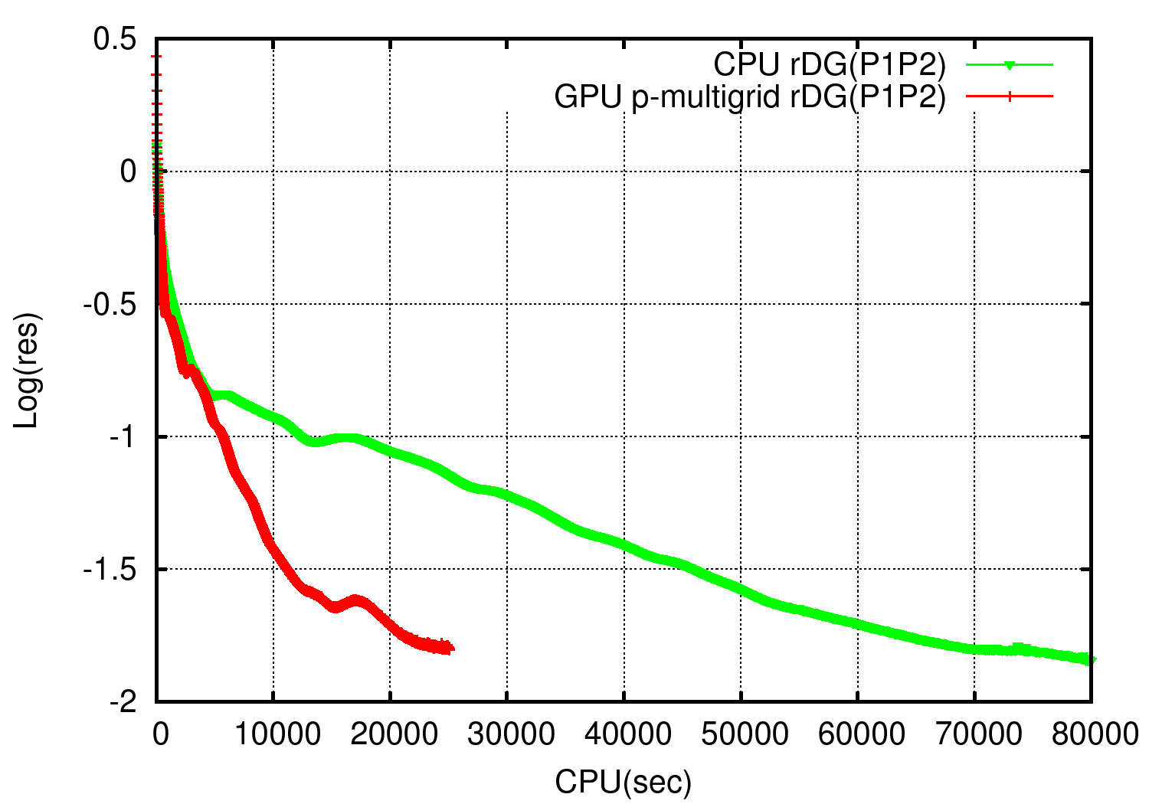
Timing test
Convergence history v.s. CPU time between pMG DG on GPU and DG on CPU.

Slide 29
Development of RDGFLO
Implicit Rosenbrock method
Starting point: Diagonally implicit Runge-Kutta method Main idea: Linearize the formula Replace the Jacobian by so that the Jacobian is only computed once. 3rd order with 4 internal stages ROB methods are implemented in RDGFLO code.
Notes:
Advantage: Each stage of this method would need to solve a linear system with a fixed Jacobian matrix. Therefore, it would be much less time consuming than implicit Runge-Kutta method.

Slide 30
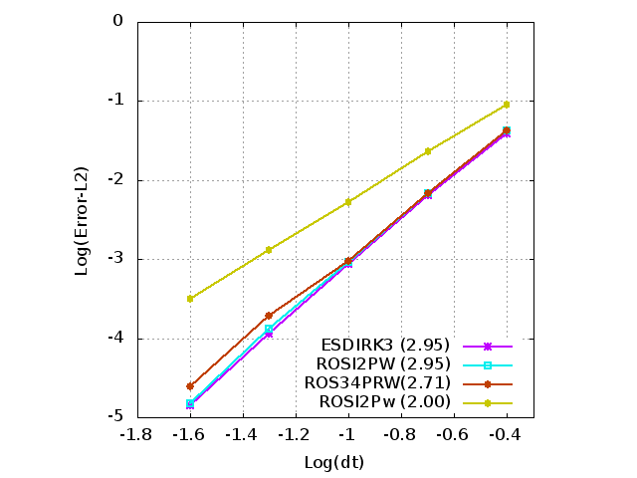
Numerical validation
Isentropic vortex Free-stream conditions Perturbations L2-norm
 | The ESDIRK3 ,ROSI2PW, and ROS34PRW schemes exhibit a slope of 2.95, 2.95 and 2.71 respectively, indicating these 3 methods could achieve a 3rd order of convergence. However, ROSI2Pw scheme, just exhibits a slope of 2.0, indicating that this scheme only obtains a 2nd order of accuracy. All the parameters for ROS are taken from Joachim Rang’ paper, “New Rosenbrock methods of order 3 for PDAEs of index 2.”
Notes:
The case, isentropic vortex is used to validate the 3rd time accuracy order of ROS .
The free-stream conditions are
Then Perturbations are added to the free
stream as follows,

Slide 31
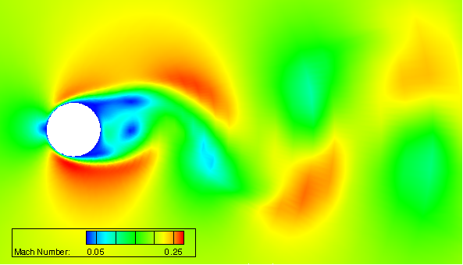
Numerical validation
Karman vortex street. Ma=0.1, Re=200
Computed Mach contours at t=100 for flow past a cylinder at a Mach number of 0.1, and Reynolds number of 200.

Slide 32
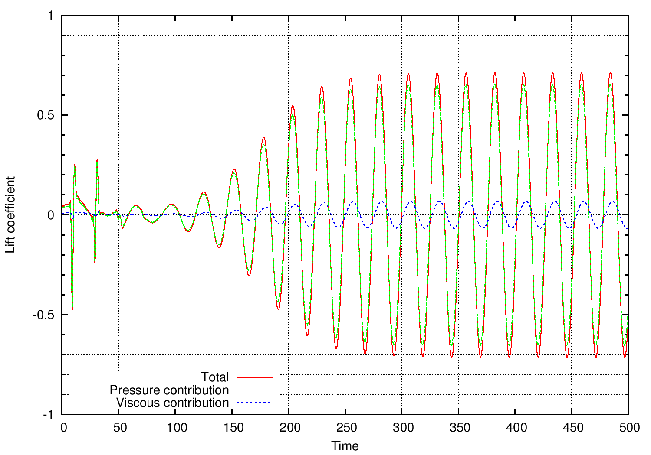
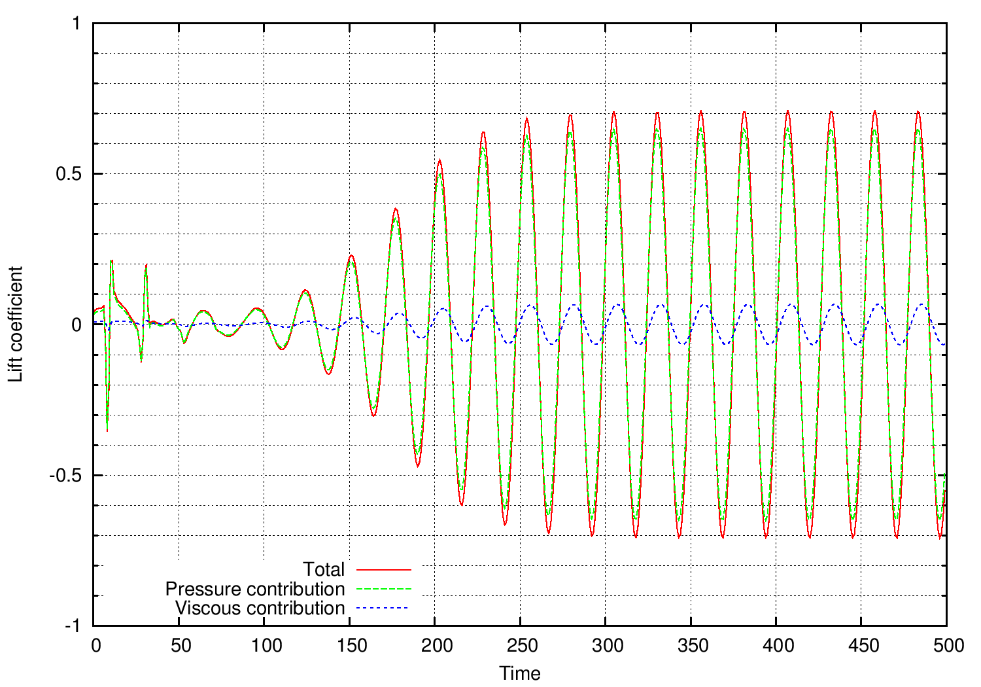
Numerical validation
Karman vortex street. Ma=0.1, Re=200
Time history of the lift coefficient for viscous flow past a cylinder. Left: ROSI2PW+rDG(P1P2), Right: ROS34PRW+rDG(P1P2)

Slide 33
Numerical validation
Karman vortex street. Ma=0.1, Re=200
Comparison of CPU time (running on 256 cores) between ROS and the ESDIRK3 (based on rDGp1p2)
Solution at t=500 | △t | Time steps | CPU time
ESDIRK3 | 0.5 | 1,000 | 1,047.0
ROSI2P2W | 0.1 | 5,000 | 886.8
ROS34PRW | 0.5 | 1,000 | 316.5

Slide 34
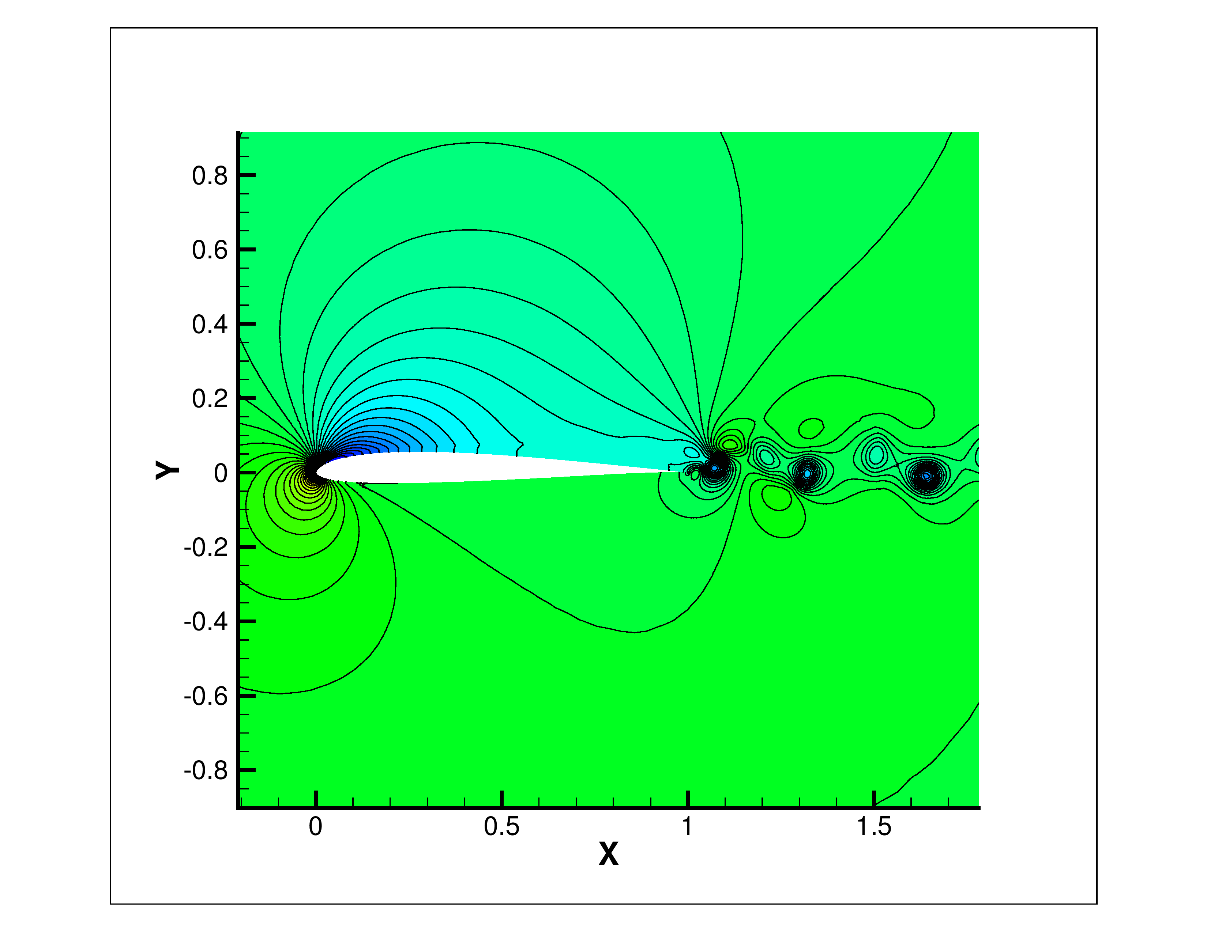
Numerical validation
SD7003 airfoil Ma=0.1, Re=10,000 , AoA=4°
Computed pressure contours

Slide 35
Numerical validation
SD7003 airfoil Ma=0.1, Re=10,000 , AoA=4°
Comparison of CPU time (running on 256 cores) between ROS and the ESDIRK3 (based on rDG(P1P2))
Solution at t=100 | △t | Time steps | CPU time
ESDIRK3 | 0.01 | 10,000 | 83,187.0
ROSI2PW | 0.01 | 10,000 | 3,168.6
ROS34PRW | 0.004 | 25,000 | 7,117.5

Slide 36
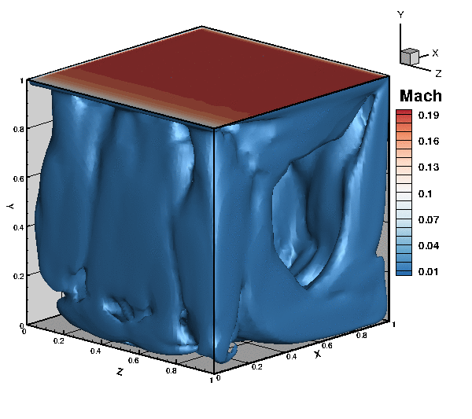
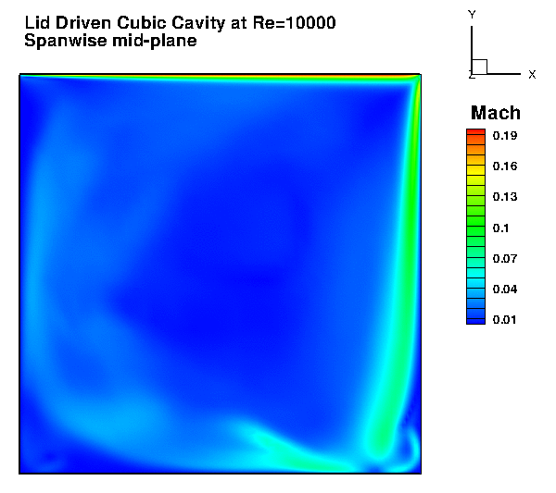
Numerical validation
3D Lid driven cavity Ma=0.2, Re=10,000
Instantaneous Mach number iso-surfaces in the cubical domain
Instantaneous Mach number contours on spanwise mid-plane
Simulation of incompressible flows using a compressible flow code
Notes:
Implicit DG(P1) w/ Jacobi Method

Slide 37
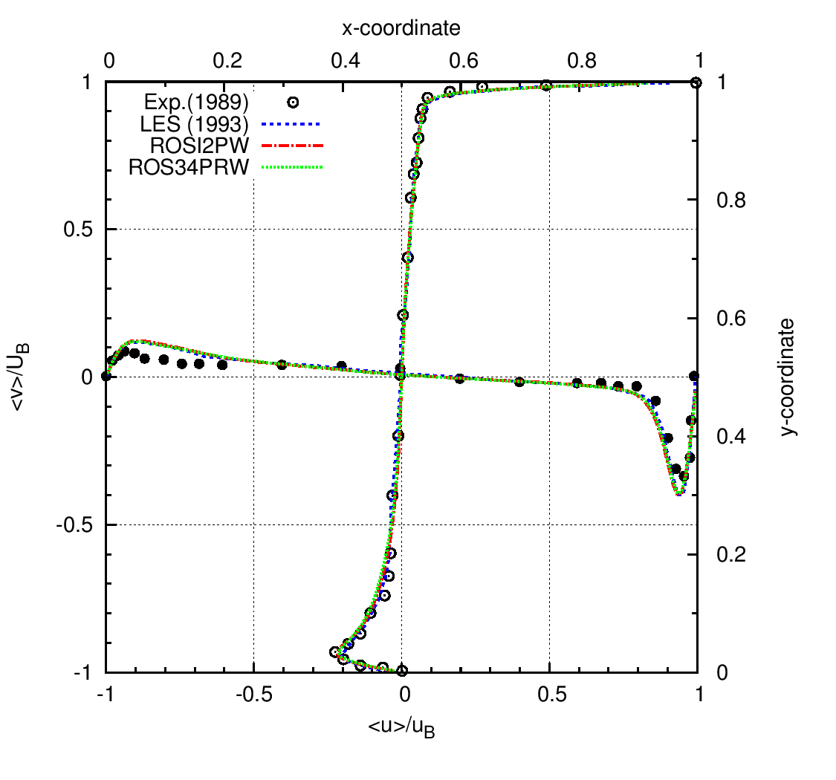
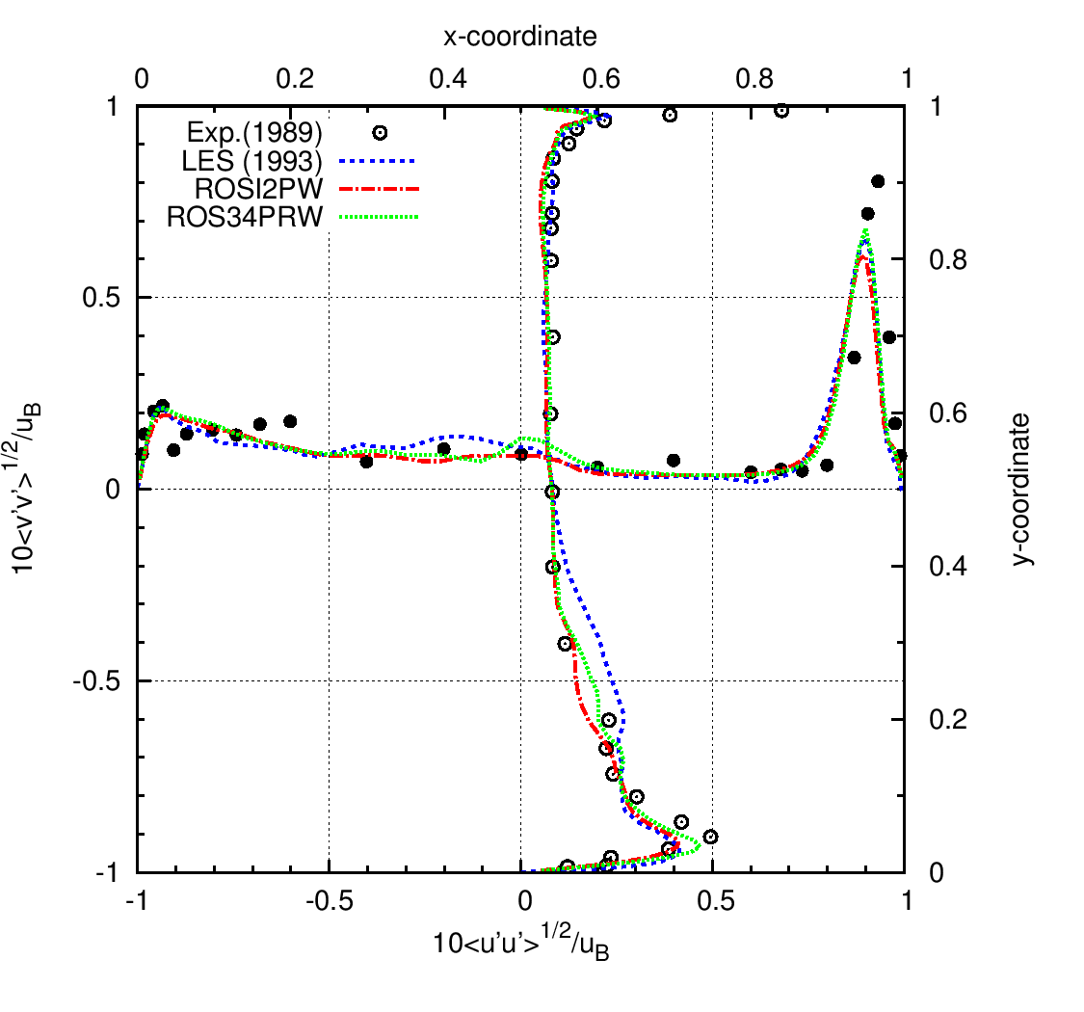
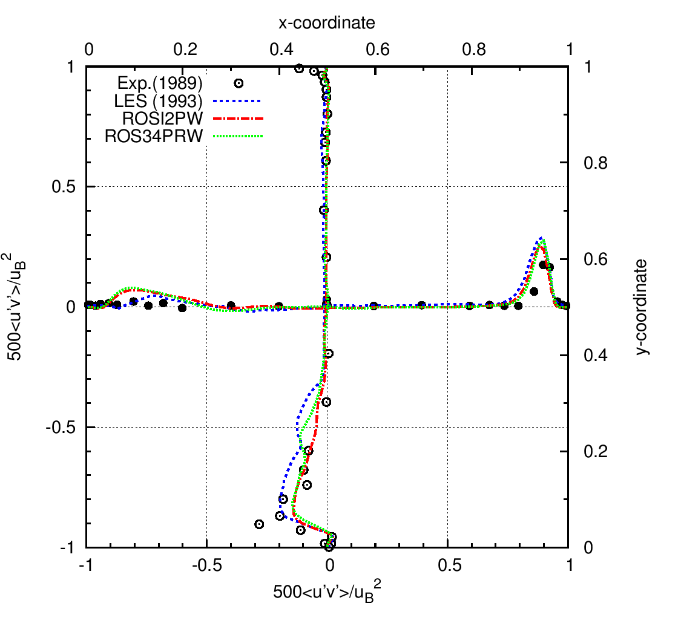
Numerical validation
3D Lid driven cavity Ma=0.2, Re=10,000

Slide 38
Numerical validation
3D Lid driven cavity Ma=0.2, Re=10,000
Comparison of CPU time (running on 256 cores) between the ROS and ESDIRK3
Solution at t=3000 | △t | Time steps | CPU time
ESDIRK3 | 0.1 | 30,000 | 263,010.0
ROSI2PW | 0.1 | 30,000 | 68,437.8
ROS34PRW | 0.1 | 30,000 | 66,065.0

Slide 39
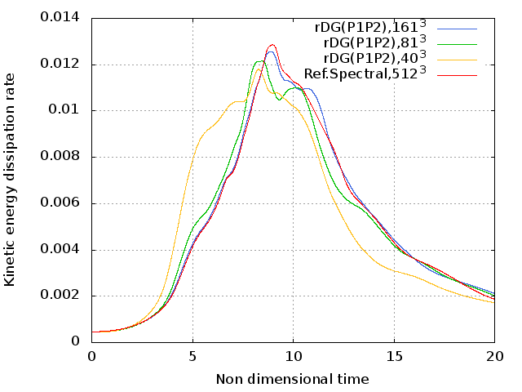
Application of RDGFLO – DNS
Explicit RDG periodic boundary condition
Add an array ‘bperi(2,nbfac)’ to store the periodic B.C. information
DNS problem: 3D Taylor-Green vortex problem on hexahedral grid

Slide 40
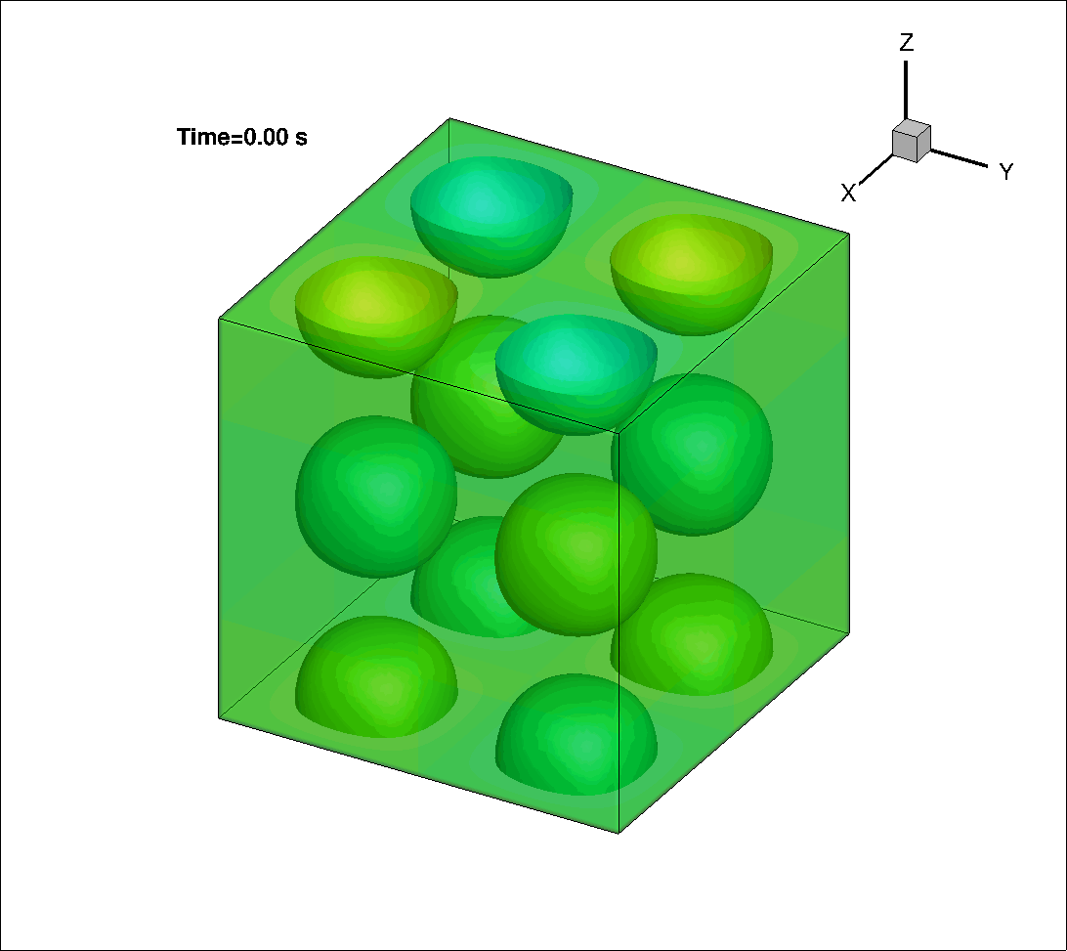
Application of RDGFLO – DNS
DNS problem: 3D Taylor-Green vortex problem on hexahedral grid
GPU/CPU computing history of the iso-surface of the z-component of the dimensionless vorticity (nelem=81³, 0<t<20s)

Slide 41
Timing test
Numerical test: Taylor vortex problem on hexahedral grid
Timing on wall-time
nelem | 1gpu | 1cpu | speed_up-1 | 16cpu | speed_up-16
41³ | 11.14 | 128.73 | 11.55 | 14.38 | 1.29
81³ | 11.65 | 120.80 | 10.37 | 13.52 | 1.16
Result
For computing 20s in physical time, one GPU takes 1.06h on 41³ grid, while 16 CPUs need 1.37h. For 81³ grid, one GPU needs 17.2h while 16 CPUs requires 20h. Timing results for finer mesh would require multi-GPU computing based on MPI data transfer.

Slide 42
Concluding Remarks
AFOSR BRI – Co-Design of Hardware/Software for Predicting UAV Aerodynamics
Development of RDGFLO
A p-multigrid reconstructed discontinuous Galerkin method has been implemented on GPU platform An average speed-up factor up to 10.58x is achieved using pMG-DG(P1) An average speed-up factor up to 3.94x is achieved using pMG-rDG(P1P2) Implicit Rosenbrock methods have been developed on CPU platform Demonstrate a temporal third order of accuracy. Outperform ESDIRK3, leading to an efficient and accurate method for unsteady flow problems
Application of RDGFLO
Direct Numerical Simulation for Taylor-Green Vortex problem An average speed-up factor up to 11.55x can be achieved using rDG(P1P2)

Slide 43
Future Work
AFOSR BRI – Co-Design of Hardware/Software for Predicting UAV Aerodynamics
Development of RDGFLO
p-Multigrid reconstructed discontinuous Galerkin method on GPU platform Extend the current solver to viscous problem. Avoid memory contention issue for LU-SGS using renumbering algorithm Implicit Rosenbrock method on GPU platform Port to GPU platform using OpenACC derivatives Fully implicit reconstructed discontinuous Galerkin method on GPU platform Extend the implicit solver onto higher order method to make the fully implicit rDG solver working on GPU platform Attempt to avoid local array issue for GMRES
Application of RDGFLO
Direct Numerical Simulation for Taylor-Green Vortex problem Extend the current work onto Multi-GPU platform via MPI data transfer for larger scale of problems

Slide 44
Plan for the next two years
AFOSR BRI – Co-Design of Hardware/Software for Predicting UAV Aerodynamics
Development
  A third order accurate RDGFLO code in both time and space on multi GPUs
  Improvement and optimization of the RDGFLO code via Co-design
Application
  LES and DNS for aerodynamic flows
  Shock boundary layer interaction
  Hypersonic flows
  Combustion and reactive flows

