Slide 1
GenIDLEST Co-Design
Amit Amritkar, Keyur Joshi, Long He
& Danesh Tafti
Collaborators
Wu-chun Feng, Paul Sathre, Kaixi Hou, Sriram Chivukula, Hao Wang, Tom Scogland,
Eric de Sturler & Kasia Swirydowicz
Virginia Tech
AFOSR-BRI Workshop
December 19 2014

Slide 2
Recap
GPU version of GenIDLEST
  CUDA Fortran
Validation studies of the GPU code
  Turbulent channel flow
  Turbulent pipe flow
Application
  Bat flight

Slide 3
Goals
Improvement of GenIDLEST performance
  GPU computing
    Code (linear solvers) port with CUDA Fortran
    Optimization/MetaMorph Library
    Use OpenACC to accelerate the code
  Linear solvers
    Recycling of Krylov subspaces
    Preconditioners
Parallel Fluid Structure interaction in GenIDLEST
  Non-linear Finite Element Method (FEM) for structure
    Unstructured grid
  Immersed Boundary Method (IBM)
    Interface tracking
  Parallelization Challenges

Slide 4
GPU computing co-design with CS team
Amit Amritkar, Danesh Tafti, Wu Feng, Paul Sathre, Kaixi Hou, Sriram Chivukula, Hao Wang, Tom Scogland
Manual CUDA code optimization
  From 5x to 10x
OpenACC version of the code
  OpenACC vs CUDA code performance
    OpenACC currently at 0.6x of CUDA
Integration with MetaMorph
  Dot product
  Inter mesh block communication

Slide 5
Solver co-design with Math team
Amit Amritkar, Danesh Tafti, Eric deSturler, Katarzyna Swirydowicz
Solution of pressure Poisson equation
  Most time consuming function (50 to 90 % of total time)
Solving multiple linear systems Ax = b
  ‘A’ remains constant from one time step to other in many CFD calculations
rGCROT/rGCRODR algorithm
  Recycling of vectors from one time step to the subsequent ones
Hybrid approach
  rGCROT to build the recycle space initially
  rBiCG-STAB for subsequent systems for faster performance
Left vs Right preconditioning
  Right preconditioning suited for BiCGSTAB
  Similar performance for rGCROT and GMRES(m)

Slide 6
Future work
Code Acceleration (CS team)
  Integrate with the MetaMorph library
    Assess performance on multiple architectures
  Overlapping computations with communications
  Evaluation of OpenMP 4.0 for accelerator programming
Linear Solvers/preconditioners (Math team)
  Study of recycling algorithms on different classes of problems
  Convergence based on quantity of interest like turbulence statistics instead of primary variables (pressure & velocity)
  Multilevel preconditioner

Slide 7
Publications
Journal
  Amit Amritkar, Eric De Sturler, Katarzyna Swirydowicz, Danesh Tafti and Kapil Ahuja. “Recycling Krylov subspaces for CFD application.” To be submitted to Computer methods in Applied Mechanics and Engineering
  Amit Amritkar and Danesh Tafti. “CFD computations using a preconditioned Krylov solver on GPUs.” Journal of Fluids Engineering, under review
Conference
  Katarzyna Swirydowicz, Amit Amritkar, Eric De Sturler and Danesh Tafti. “Recycling Krylov subspaces for CFD application.” Presentation at ASME 2014 Fluids Engineering Division Summer Meeting, August 3-7, 2014, Chicago, Illinois, USA
  Amit Amritkar and Danesh Tafti. “CFD computations using preconditioned Krylov solver on GPUs.” Proceedings of ASME 2014 Fluids Engineering Division Summer Meeting, August 3-7, 2014, Chicago, Illinois, USA
  Amit Amritkar, Danesh Tafti, Paul Sathre, Kaixi Hou, Sriram Chivakula and Wu-Chun Feng. “Accelerating Bio-Inspired MAV Computations using GPUs.” Proceedings of AIAA Aviation and Aeronautics Forum and Exposition 2014, 16 - 20 June 2014, Atlanta, Georgia

Slide 8
Fluid Structure Interaction
Long He, Keyur Joshi, Danesh Tafti
Immersed Boundary Method
Finite Element Solver
Fluid structure Interaction coupling
Benchmark simulation results

Slide 9
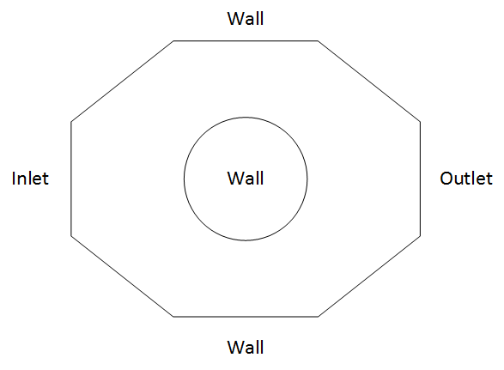
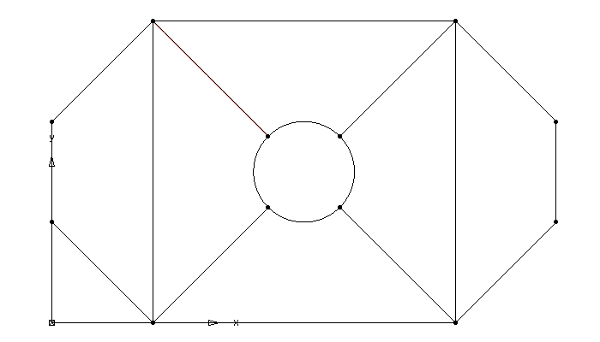
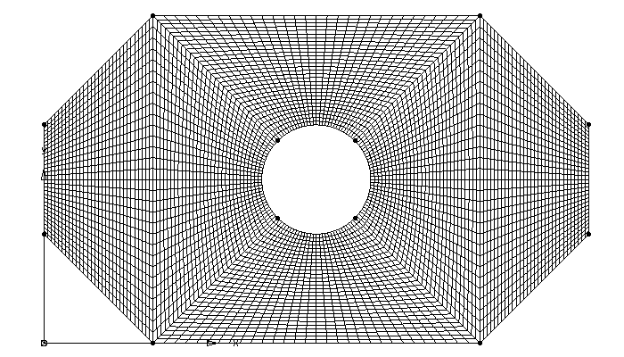
Immersed Boundary Method
Body conforming grid
Immersed boundary grid
Notes:
If we want to simulate the geometry on the left, for BCG : at least divide it into 6 blocks.
IBM: bgmesh and surface mesh.

Slide 10
Immersed Boundary Method
Curvilinear body-fitting grid around a circular surface
Body non-conforming cartesian grid and an immersed boundary
Notes:
Have a close look at the circle

Slide 11
Immersed Boundary Method
Types of nodes and domains
  Fluid
  Solid
  Fluid IB
Nodetype: solid is 0, fluid is 1, fluid ibnode is 2

Slide 12
Immersed Boundary Method
Based on the immersed boundary provided by the surface grid, all the nodes in the background are assigned as one of the following nodetypes: fluid node, solid node, fluid IB node, solid IB node.
The governing equations are solved for all the fluid nodes in the domain.
Modifications are made on the IB node values in order for the fluid and solid nodes to see the presence of the immersed boundary.
Nodetype: solid is 0, fluid is 1, fluid ibnode is 2
Notes:
If one close fluid node has a velocity 1, the next ib node maybe have a interpolation velocity value of 0.5. and in the next time step, this 0.5 will act as a velocity boundary condition

Slide 13


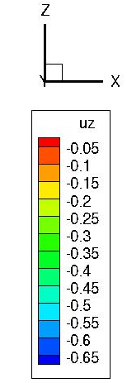
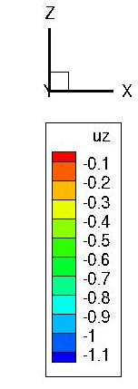


Nonlinear Structural FE Code
Capable of Large deformation, large strain, large rotation
Geometric Nonlinearity
Total Lagrangian as well as Updated Lagrangian formulation
3D as well as 2D elements
Linear model
Nonlinear model
Extensible to material nonlinearity,( hyperelasticity, plasticity)
Extensible to active materials such as piezo-ceramics
Notes:
We have 4 elements developed: triangular,quadrilateral, tetrahedron and brick.
Linear models fails to capture physics when deformations are large as it does not account for changing material co-ordinate system and presence of stress in the material. Geometric nonlinearity takes care of these material co-ordinate system transformations and stress-stiffening.

Slide 14
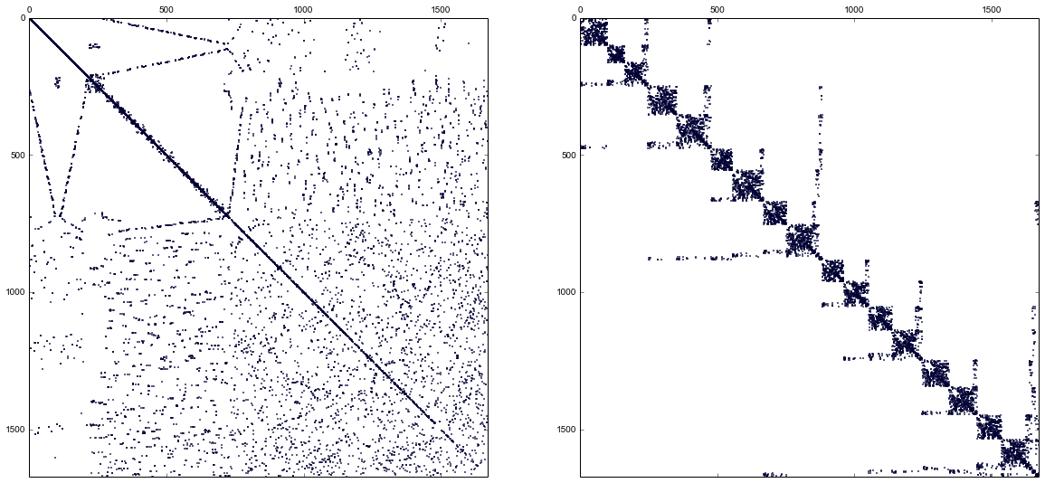
Nonlinear Structural FE Code
Special sparse matrix storage stores only nonzero elements
Preconditioned Conjugate Gradient method
Nonlinear iterations through Newton-Raphson iterations, also modified NR and Initial Stress updates are supported
Newmark method for time integration gives unconditional stability and introduces no numerical damping
Parallelized through OpenMP and extensible to MPI
Exploring METIS for mesh partition and mesh adaptation
Node renumbering
Notes:
METIS does node reordering using recursive subdomain bi-section. This leads to better cache efficient system matrix.

Slide 15
Fluid structure Interaction coupling
OpenMP/MPI
OpenMP
Notes:
Read the bgmesh and the ib surface first, and then put them into IBM, IBM define the nodetype on the background mesh. And then fluid solver will solve the governing equations for the fluid domain. After this, IBM will calculate the forces act on the IB surface. Then structure solver will solve the structure equations under these forces. After this, for strong coupling, we will check the convergence: the displacement change between each inner iteration; for loose coupling, we will match to the next time step. Then the coordinates and velocity and accelerations on the immersed surface will be updated base on the deformation calculated by the structure solver.

Slide 16
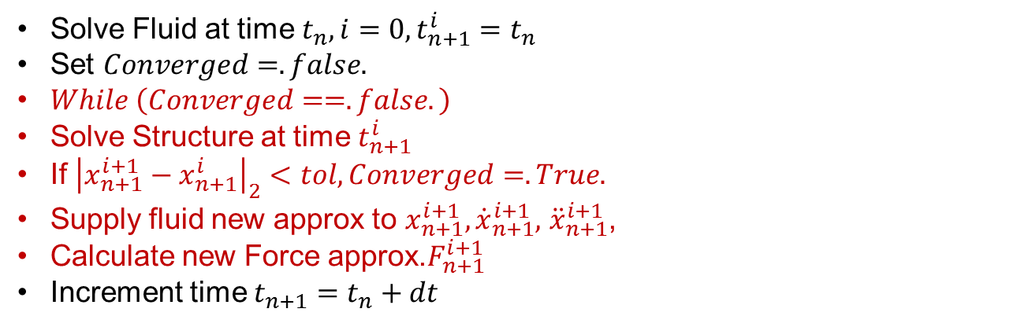
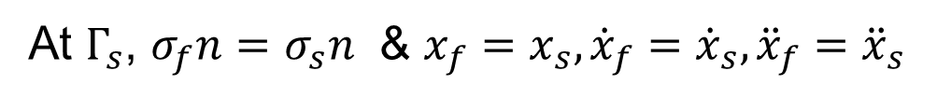


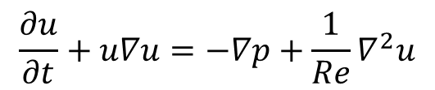
Turek-Hron FSI Benchmark
Fluid
$$\frac{∂u}{∂t}+u∇u=−∇p+\frac{1}{Re}∇^{2}u$$
$$Γ_{s}$$
wall
inlet
outlet
Structure
$$M\ddot{x}+C\left(\dot{x}\right)\dot{x}+K\left(x\right)x=F$$
Interface
At $Γ_{s}$, $σ_{f}n=σ_{s}n$ & $x_{f}=x_{s}, {\dot{x}}_{f}={\dot{x}}_{s},{\ddot{x}}_{f}={\ddot{x}}_{s}$
Solve Fluid at time $t_{n}, i=0,t_{n+1}^{i}=t_{n}$
Set $Converged=.false.$
$While \left(Converged==.false.\right)$
Solve Structure at time $t_{n+1}^{i}$
If ${\left|x_{n+1}^{i+1}−x_{n+1}^{i}\right|}_{2}<tol,Converged=.True.$
Supply fluid new approx to $x_{n+1}^{i+1},{\dot{x}}_{n+1}^{i+1},$ ${\ddot{x}}_{n+1}^{i+1}$,
Calculate new Force approx.$F_{n+1}^{i+1}$
Increment time $t_{n+1}=t_{n}+dt$
Notes:
$σ_{f}n=σ_{s}n$ 1. forces on the fluid is the same with the force on the structure
2. displacement, velocity, acceleration on the interface are the same for fluid and structure

Slide 17
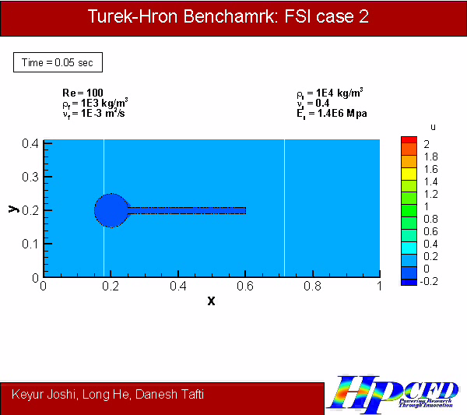
FSI Case 2
Notes:
This video shows validation of our code using one of the Turek-Hron FSI benchmark. We demonstrate capability of handling large deformation and structure/fluid density ratio unity, which is often very difficult to simulate in many framework. We can see transient flow development, onset of structural oscillation and eventually reaching a steady state vibration and regular vortex shedding patterns.

Slide 18

Bubble in channel flow
Notes:
Rubber ring : Reynolds number =100
This video shows that we can handle internal fluid as well and can simulate fluid-structure-fluid simulations

Slide 19
Parallelization of FSI Code
Currently FSI code is parallelized for shared memory architecture (OpenMP)
How to extend the code further to MPI or GPU computing to maximize parallel efficiency?
Challenges
  Partitioning the unstructured Structural FE mesh (using Parmetis/Scotch)
  Creating ghost cells at partition boundaries
  Creating gather and scatter algorithm for minimizing communication cost.
  Synchronization
  Debugging on parallel architecture

Slide 20
Parallelization Scenarios: Scenario-1
Scenario 1 – Structural computation is less demanding and localized to one processor
Proposed Solution
We would like to restrict structure to 1 MPI process with several OpenMP/GPU threads while Fluid is spawned on multiple MPI processes

Slide 21
Parallelization Scenarios: Scenario-2
Scenario 2 – Structure has multiple units and presents an opportunity to be solved independently, e.g., QuadCopter
Proposed Solution
We would like to solve these structural units on independent MPI processes , each unit can use several OpenMP/GPU threads while Fluid is spawned on multiple MPI processes irrespective of structural partition

Slide 22
Parallelization Scenarios: Scenario-3
Scenario 3 – Structural computation themselves are demanding
We would like to break structural unit itself into multiple MPI processes , each unit can use several OpenMP/GPU threads while Fluid is spawned on multiple MPI processes irrespective of structural partition
Proposed Solution
Notes:
Enhanced capability such as contact detection, collision simulation are very demanding computationally.
Due to several demands on multifunctional, lightweight materials, materials used in MAV constructions are increasingly complex to model (orthotropic properties, layered materials, carbon nanotubes, piezomotors)
Also, properties of these materials may be dependent on load, temperature and other environmental factors. Some parts may go through plastic deformation too. Such simulations pose computational challenge in structural solution.

Slide 23


Future Application
Deformation of elastic wings:
Energy harvesting applications
Shape memory alloys
Biomechanical Engineering
Airfoil Aerodynamics
Aero-elasticity
Source: www.youtube.com

Slide 24
Future work
Structural solver (co-design with Math teams)
  Evaluate different preconditioners (currently point Jacobi)
    Non-diagonal dominant matrix
  Evaluate time stepping algorithms
Parallelization of FSI
  Collaborate with CS/Math teams to identify most effective ways to parallelize FSI problem
  Evaluate use of PGAS (partitioned global address space) model – global arrays

Slide 25
Left vs Right preconditioner
Turbulent channel flow case
  Application to BiCGStab
Flow through porous media
  10 time steps
  rGCROT
  Hybrid approach (rGCROT + rBiCGStab)
100 Time steps | Average iterations | Time
Right | 75.45 | 1041
Left | 81.25 | 1165
Left (PC residual) | 141.96 | 1867
 | Right | Left
Time (S) | 3025 | 3028
 | Right | Left
Time (S) | 2399 | 2696

