Slide 1
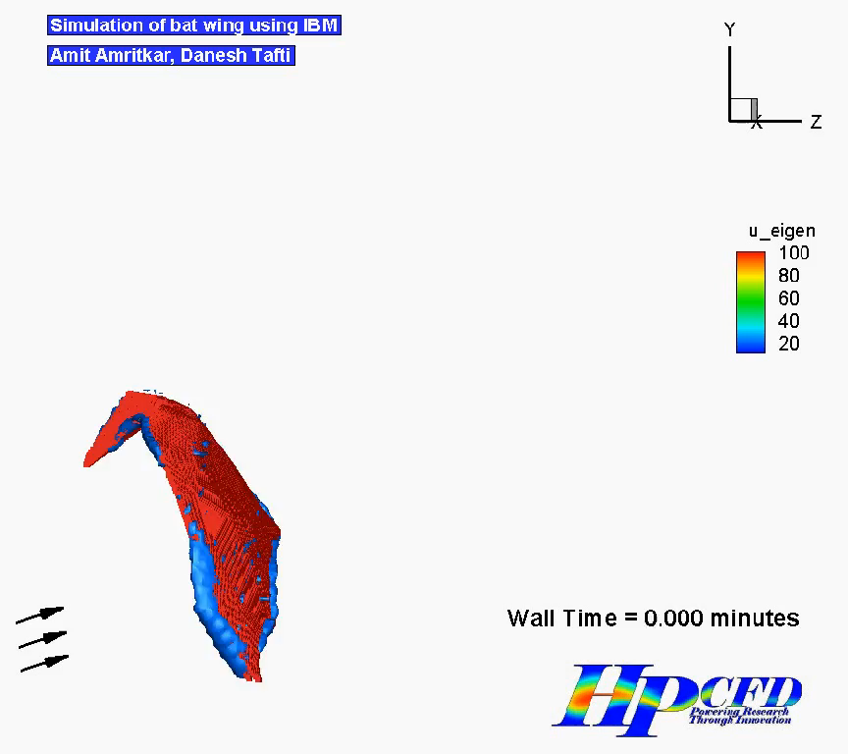
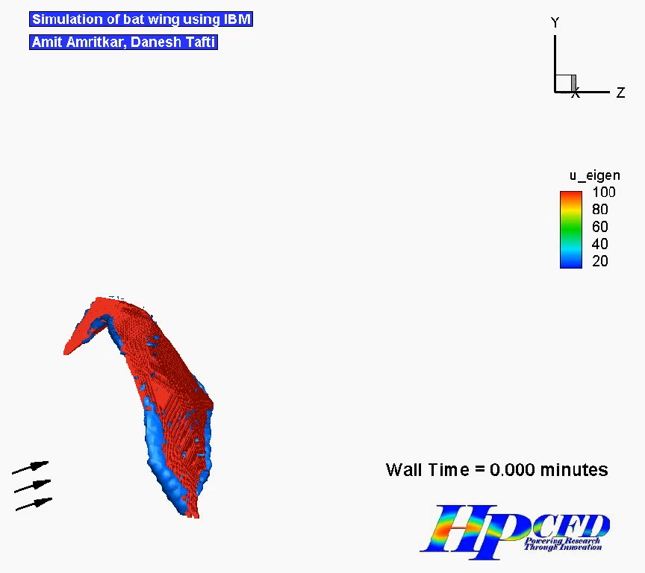
Bat wing simulation on GPU and CPU
Amit Amritkar, Danesh Tafti
Virginia Tech
GPU
CPU

